Slide 1
Isostasy
The Floating World
Harvey Greenberg
greenberg@ess.washington.edu
Room 374

Slide 2
http://gis.ess.washington.edu/grg/harveypubs.html
http://www.youtube.com/watch?v=YHWMHzi_deg

Slide 4
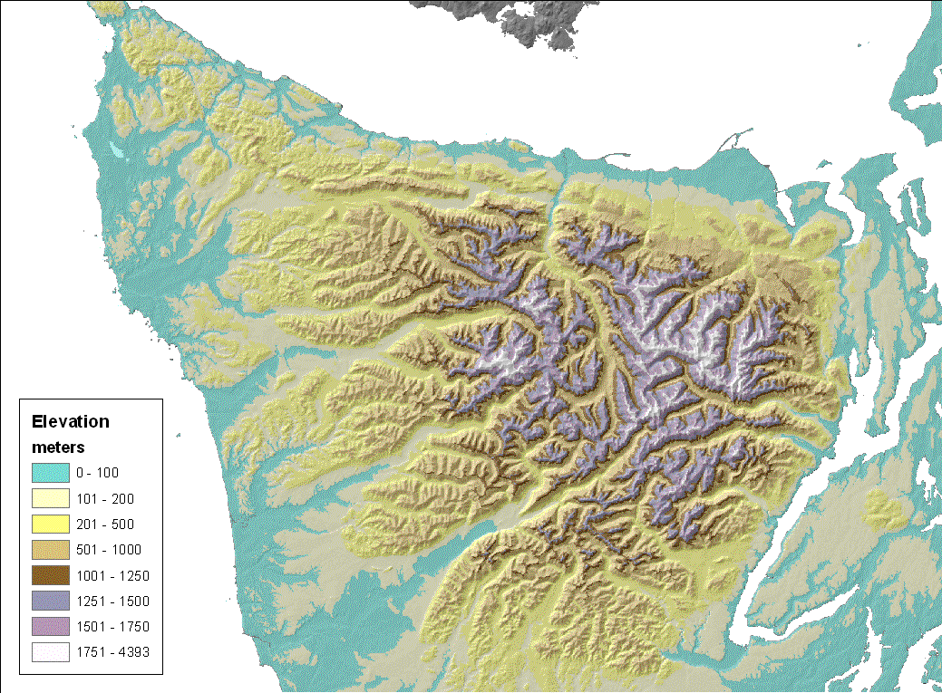

Slide 7
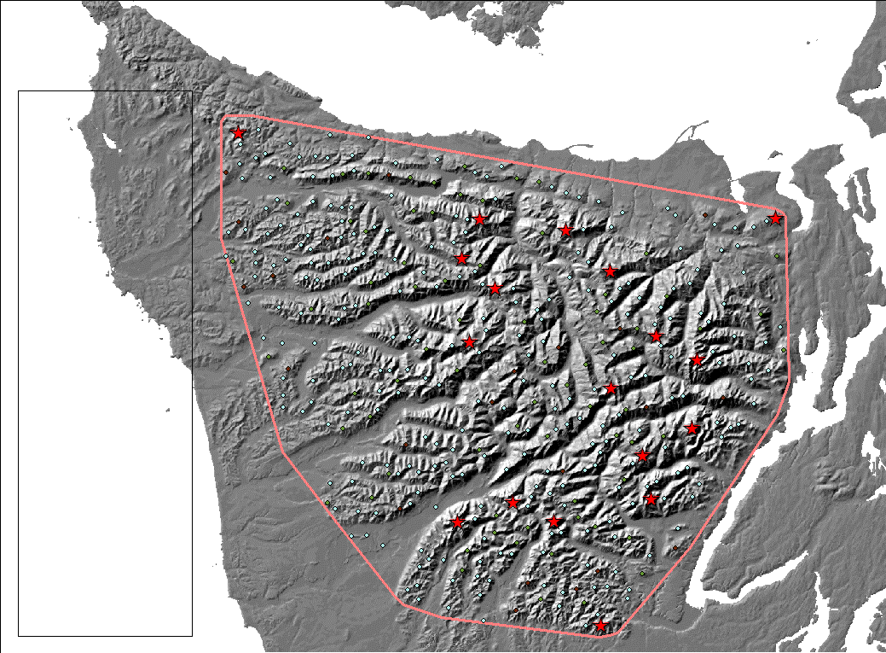

Slide 8
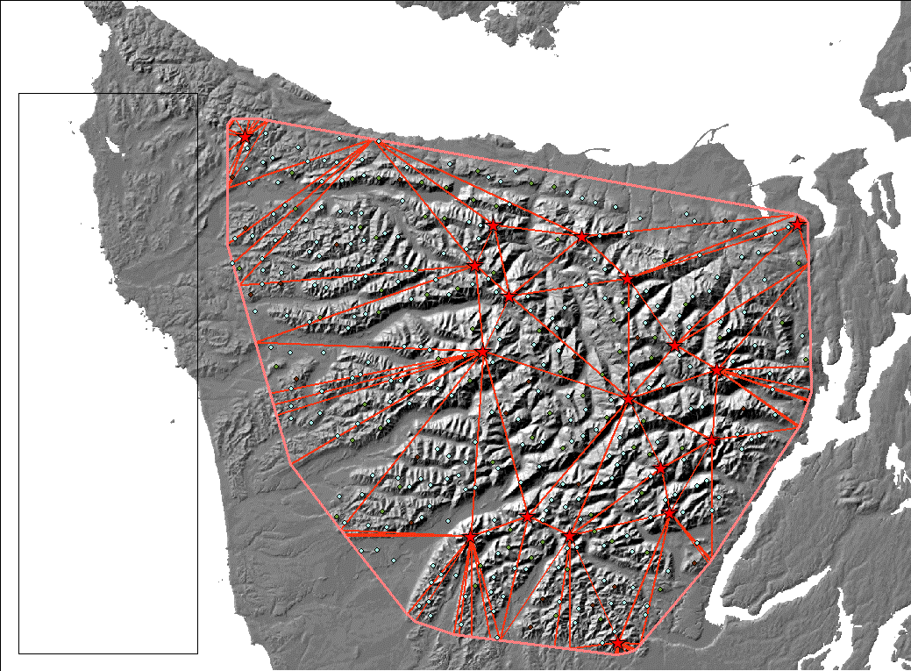

Slide 9
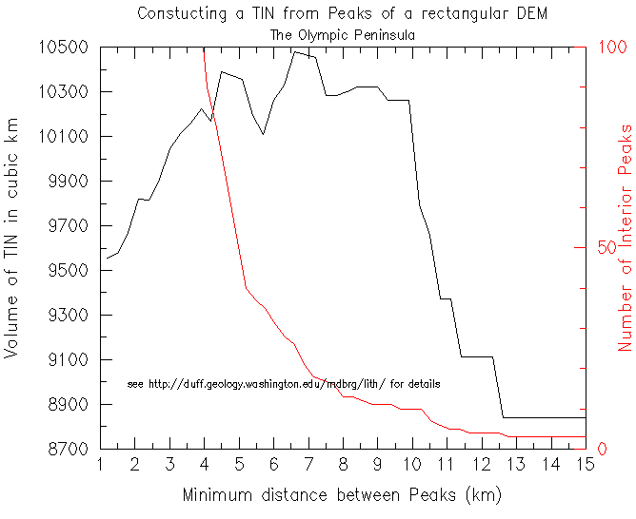
**********************************

Slide 11
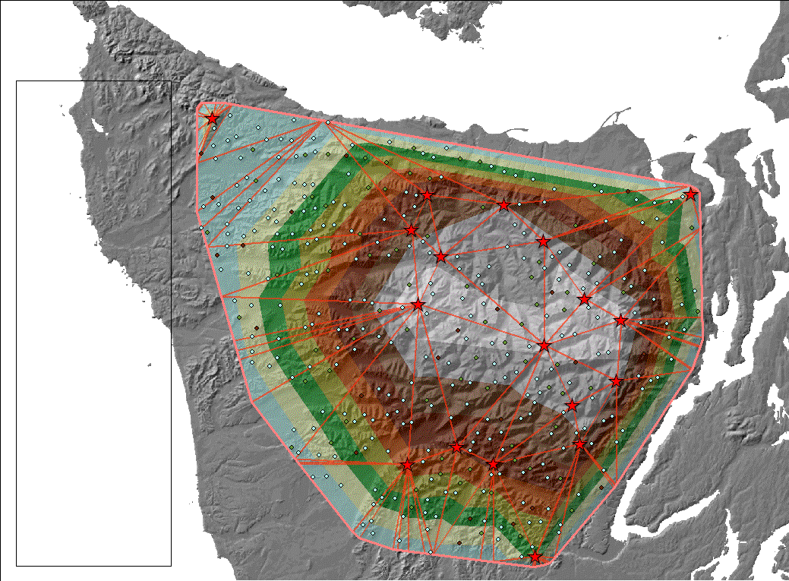

Slide 12
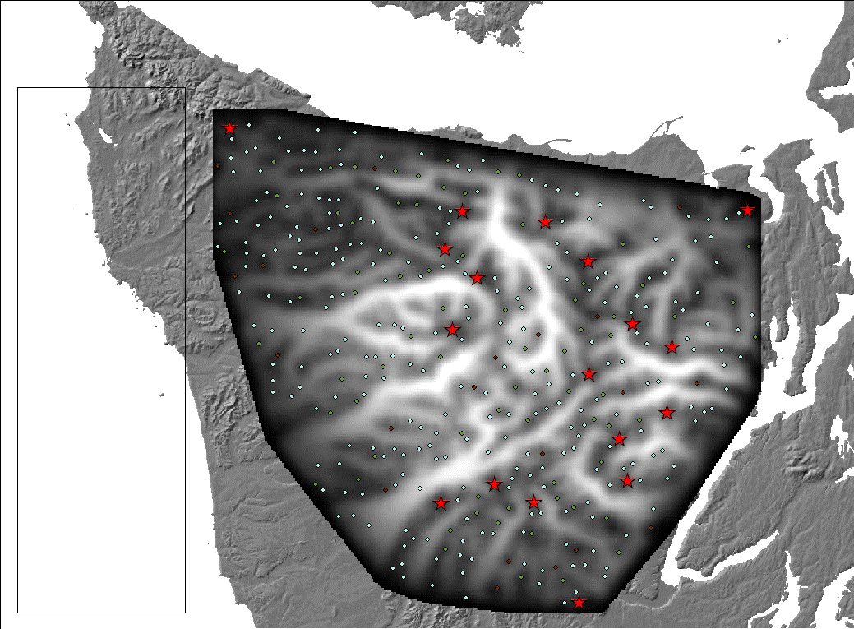

Slide 13
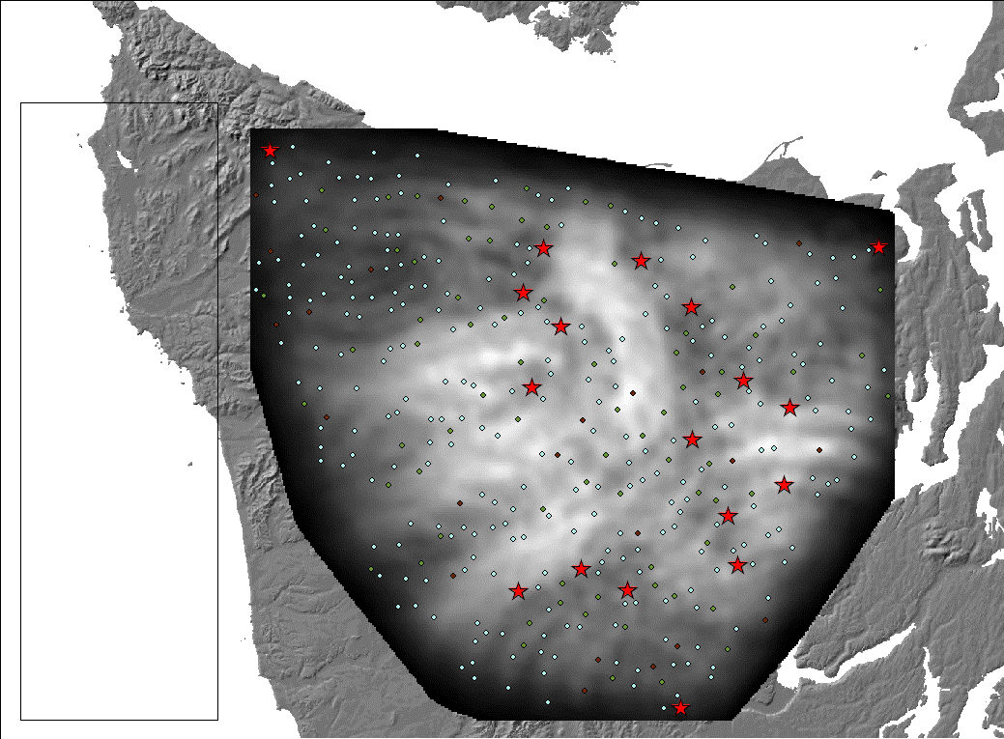

Slide 14
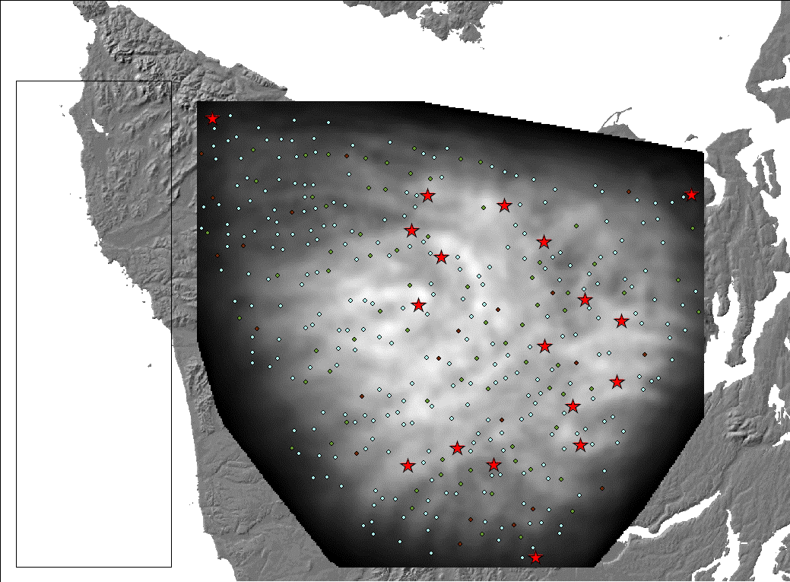

Slide 15
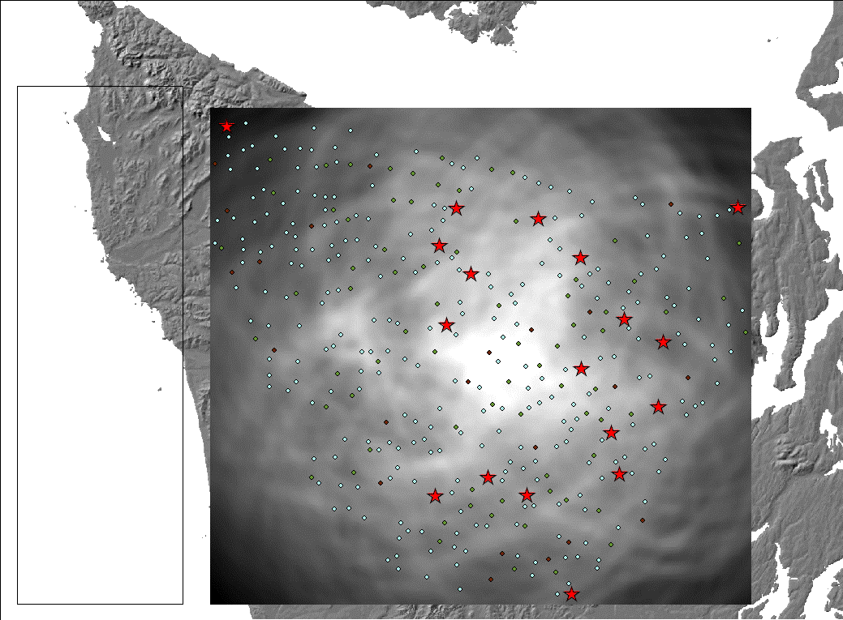
Notes:
volume120

Slide 16
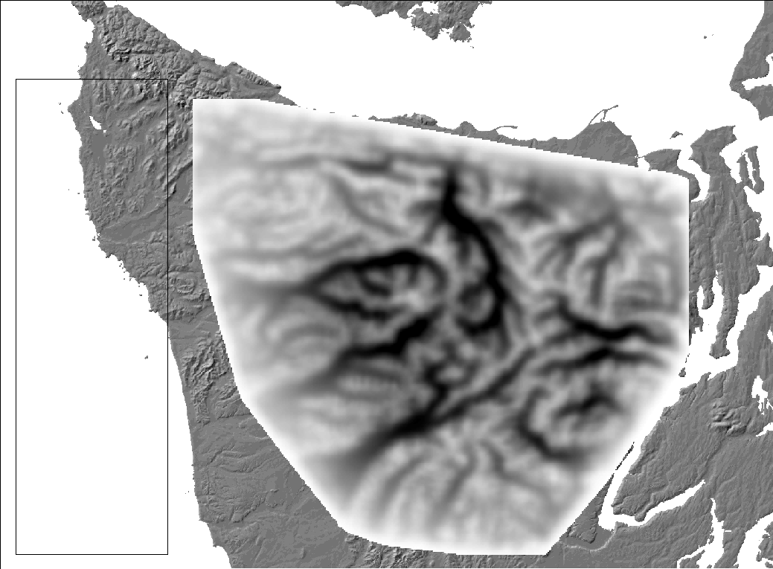
Notes:
Annulus 0-5 at 1.0e23

Slide 17
Notes:
Annulus at 1e19

Slide 18
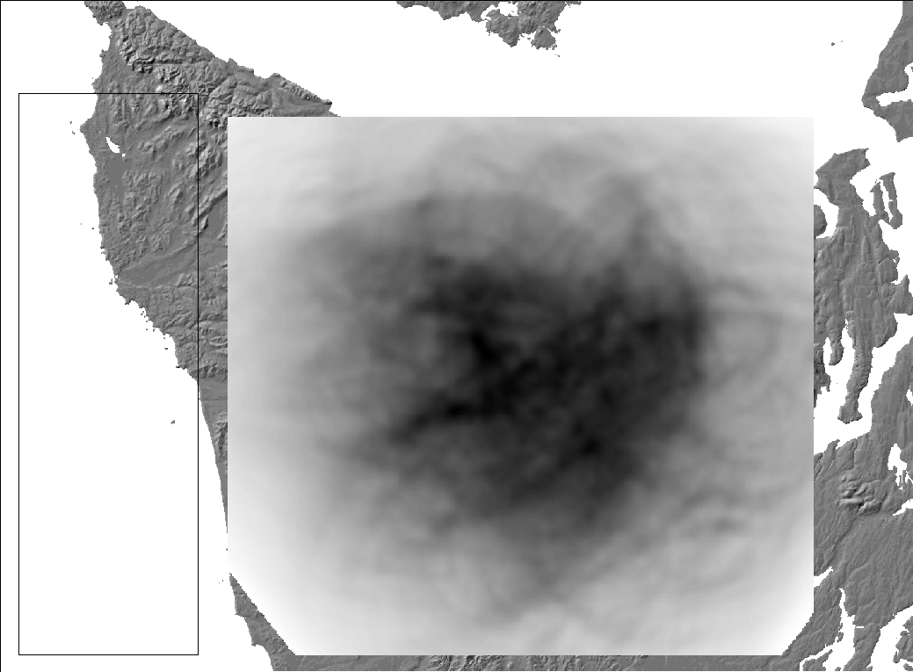
Notes:
Annulus 5-10 km at 1e23

Slide 19
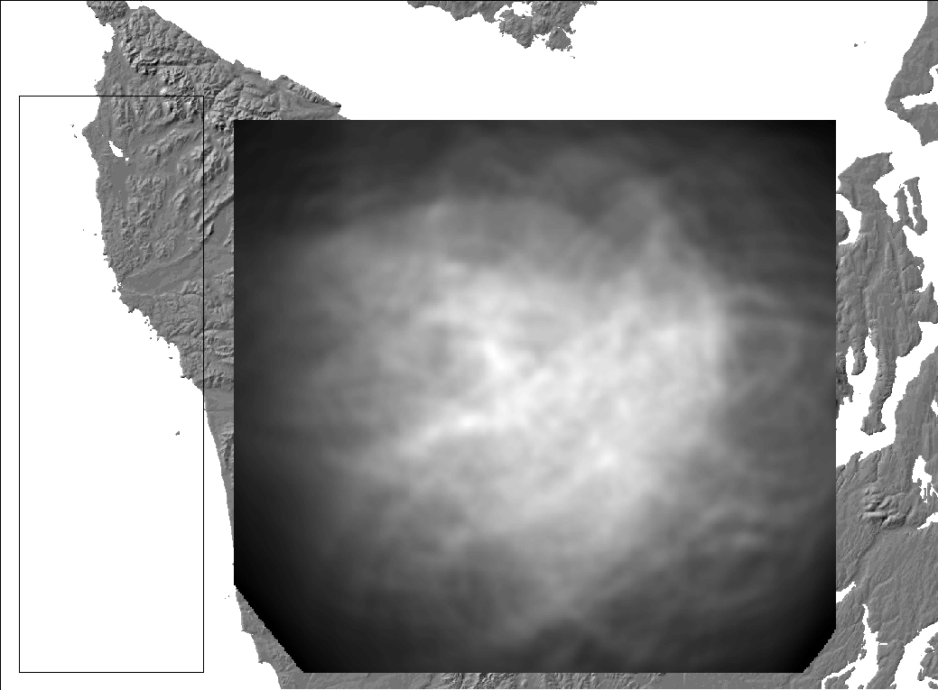
Notes:
Annulus 5-10 at 1e19

Slide 20
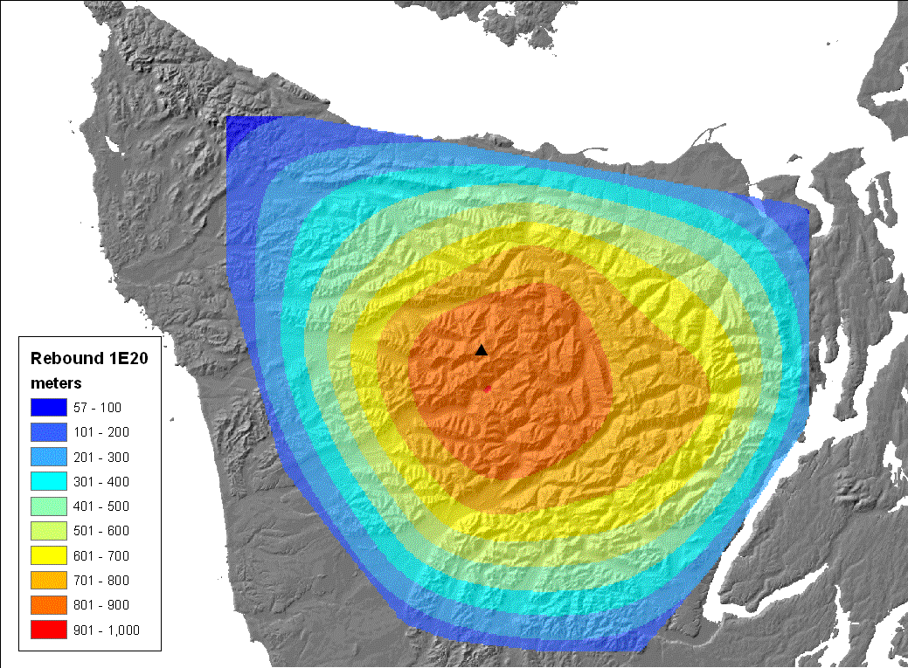

Slide 21
