Slide 1
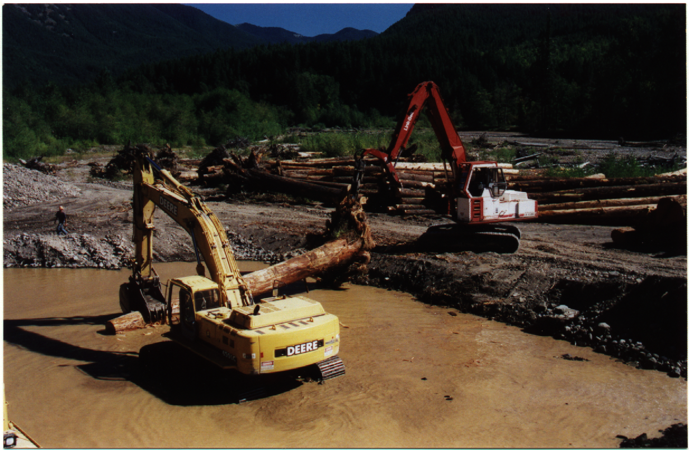
River restoration

Slide 2
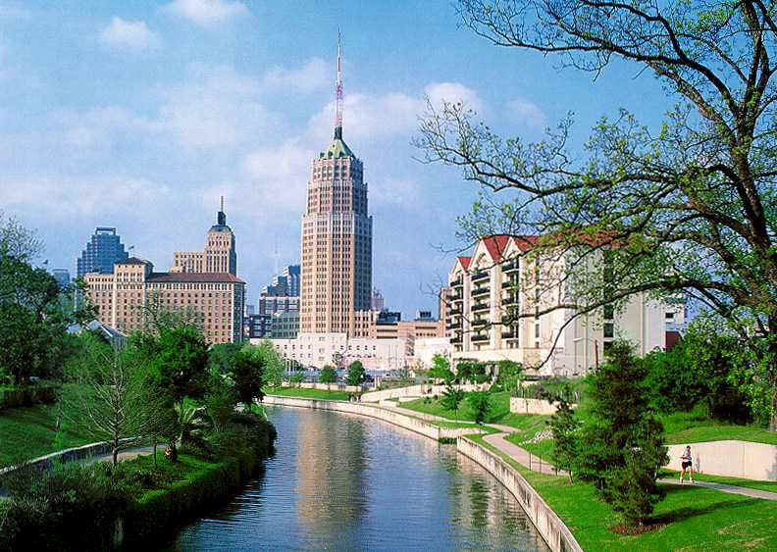
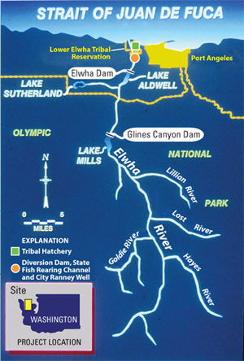
Restoration:
reestablishing structure and function of ecosystems (ecosystem as close as possible to pre-disturbance conditions)
Rehabilitation:
making land useful again after disturbance (not necessarily pre-disturbance condition)
Reclamation:
intended to change biological capacity of a system (ecosystem is definitely changed)

Slide 3
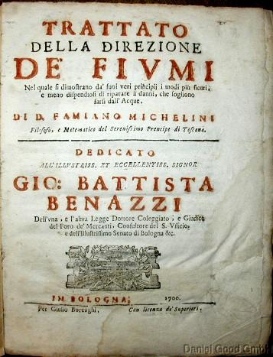
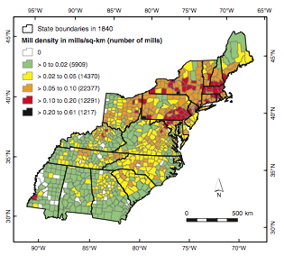
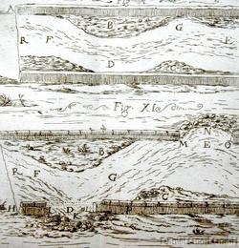
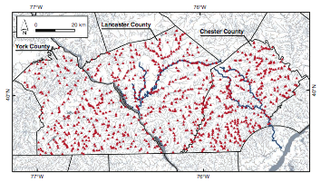
River engineering is an old idea
Flood control, power, etc…

Slide 4
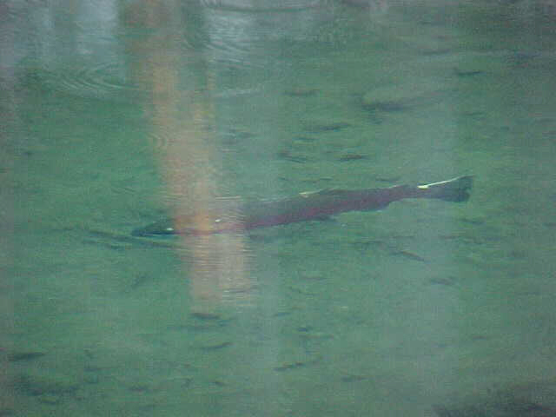
River restoration is newer
often driven by interest in restoring habitat

Slide 5
River restoration is newer
often driven by interest in restoring habitat
Environmental mitigation has also increased restoration efforts
But how do we do it?

Slide 6
What do we restore?
Depends on the goal of the restoration project, and the scale of the project.

Slide 7
Morphologic controls – what can we restore?
climate
catchment
vegetation
sediment& wood inputs
riparian
veg.
fast
hydrology
flow
obstructions
channel morphology
rate of change
geology
gradient
valley form
slow

Slide 8
General restoration considerations
Conceptual model #2 (more specific to restoration)
Geology
Climate
Regional Vegetation
Land Use
Pollution
River Engineering
Floodplain Development
Restoration/LWD
Biotic Condition
(creature viability)
Flow Regime
Sediment Regime
Wood Regime
Habitat
Structure &
Dynamics

Slide 9
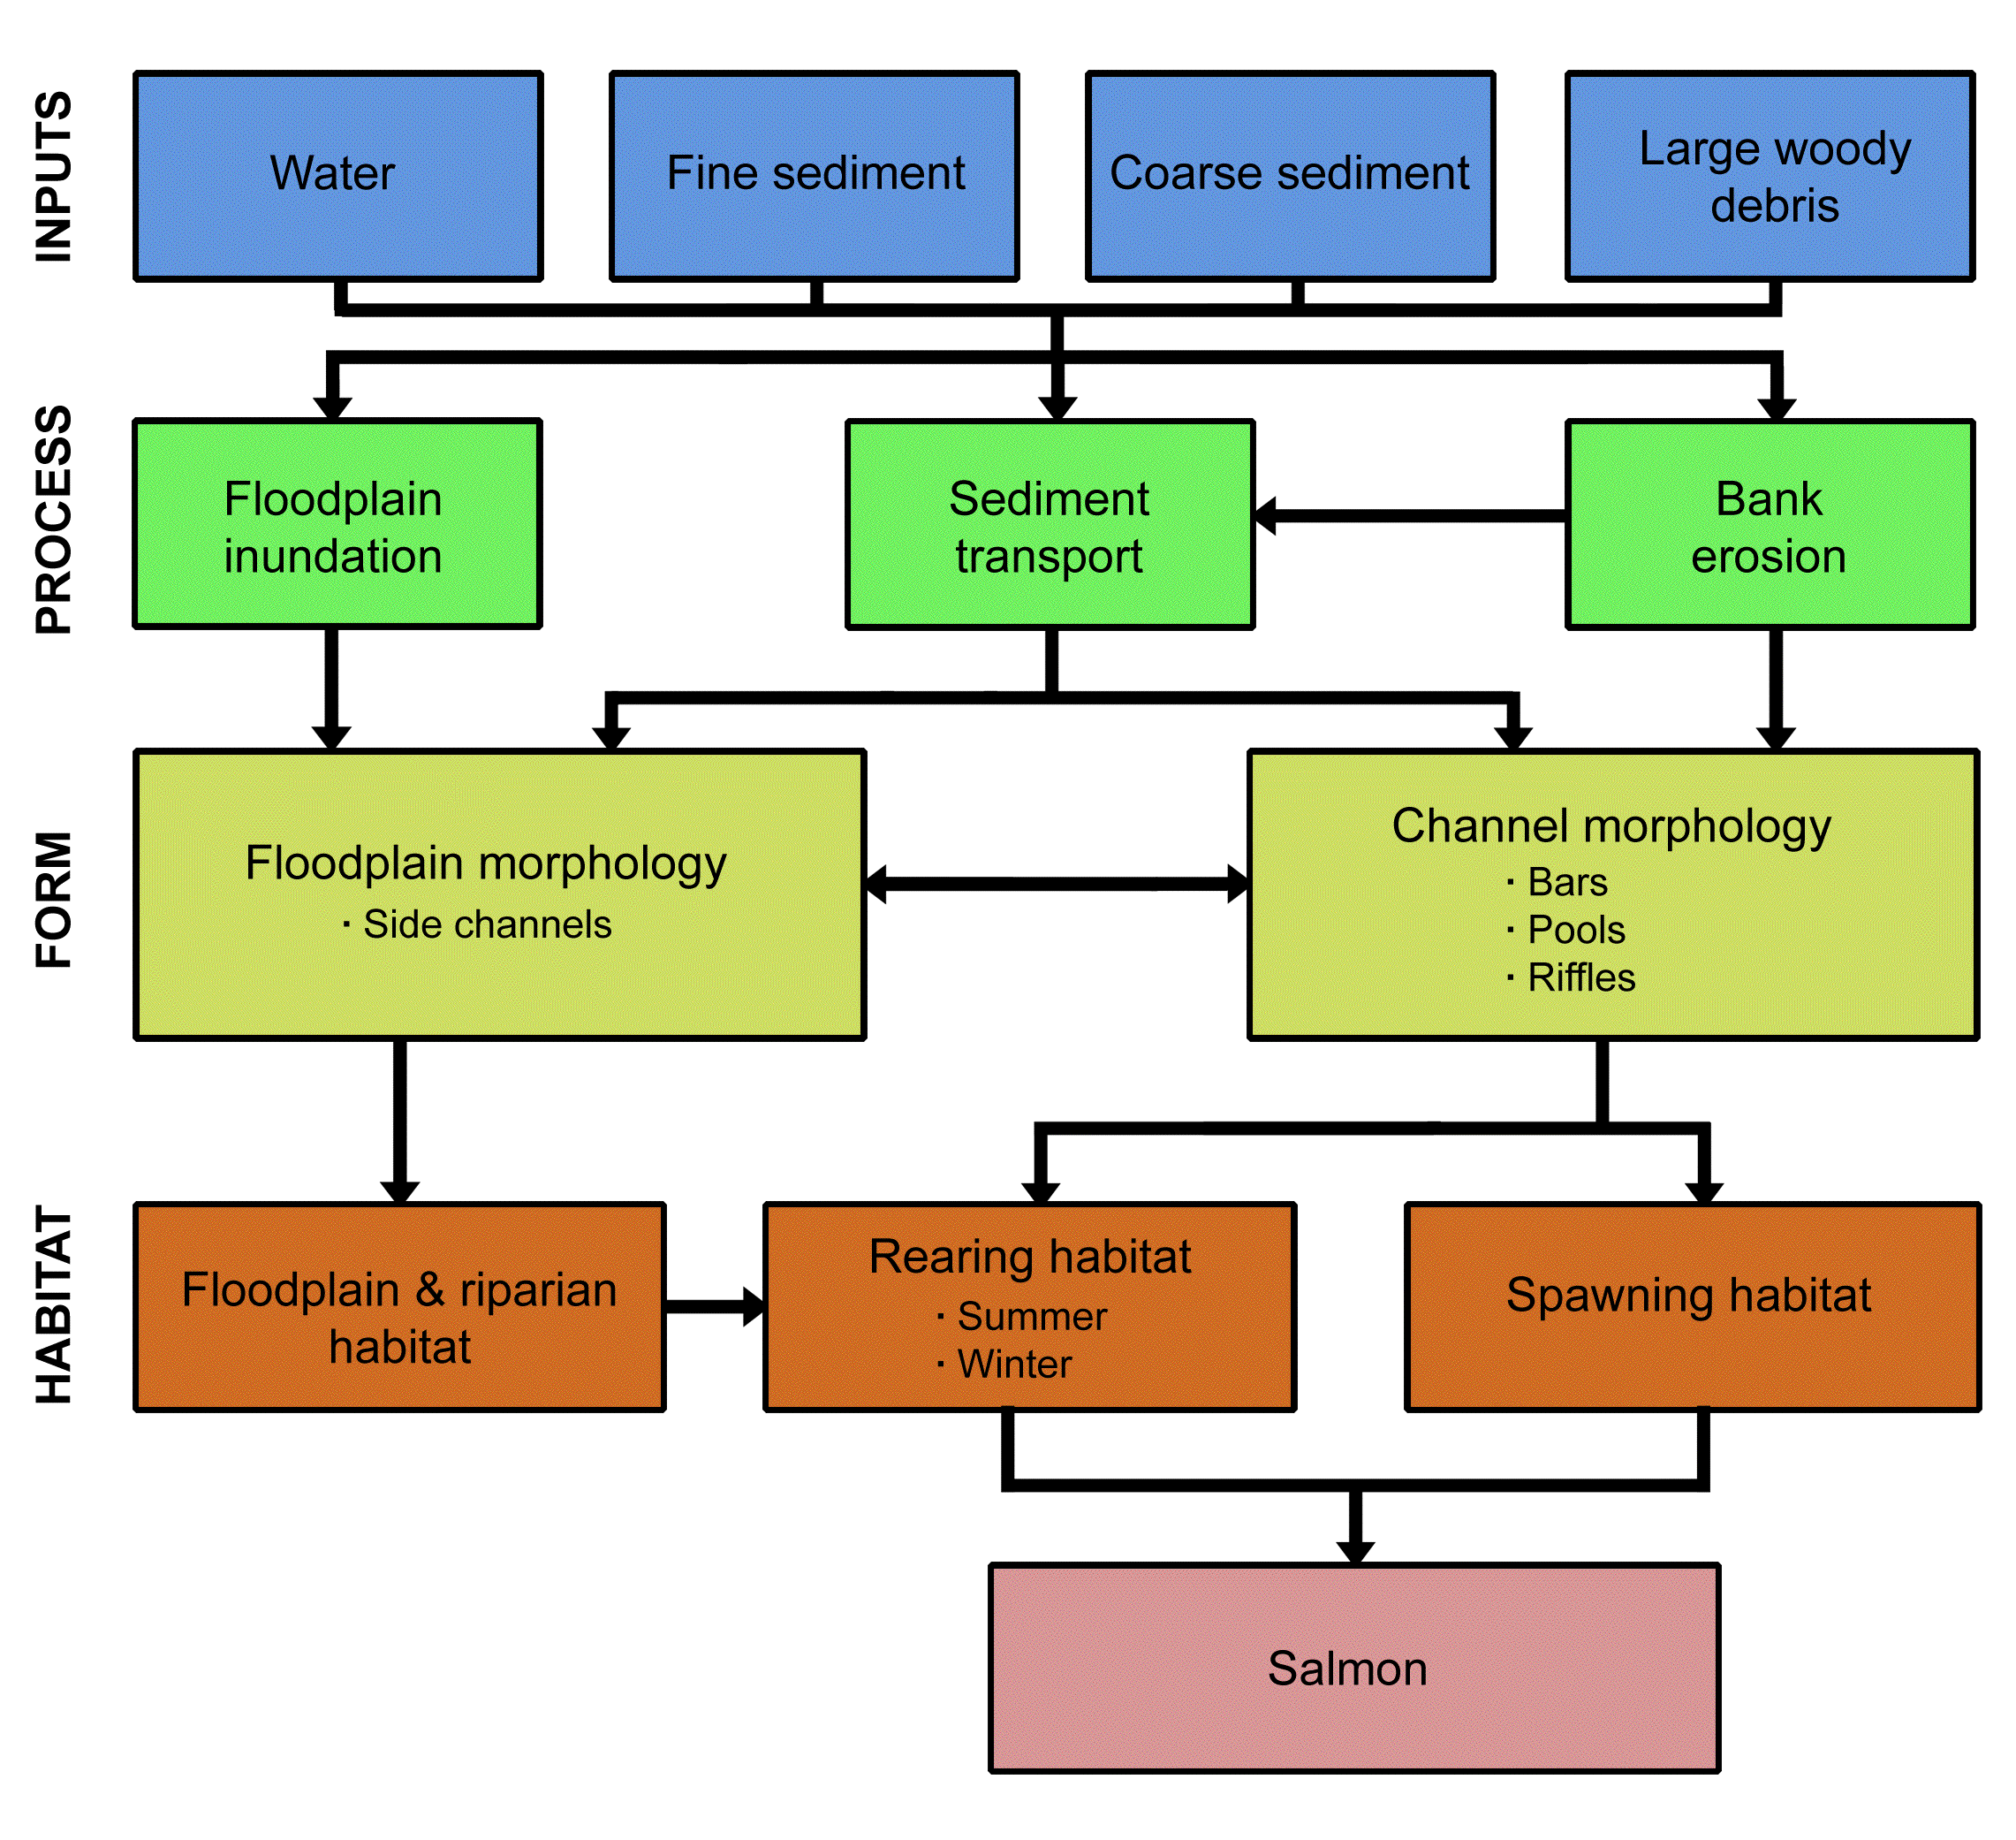
Salmon habitat restoration
supply of water, sediment & wood → salmon habitat

Slide 10
Where do we restore?
Again, depends on the goal of the restoration project, and the scale of the project.

Slide 11
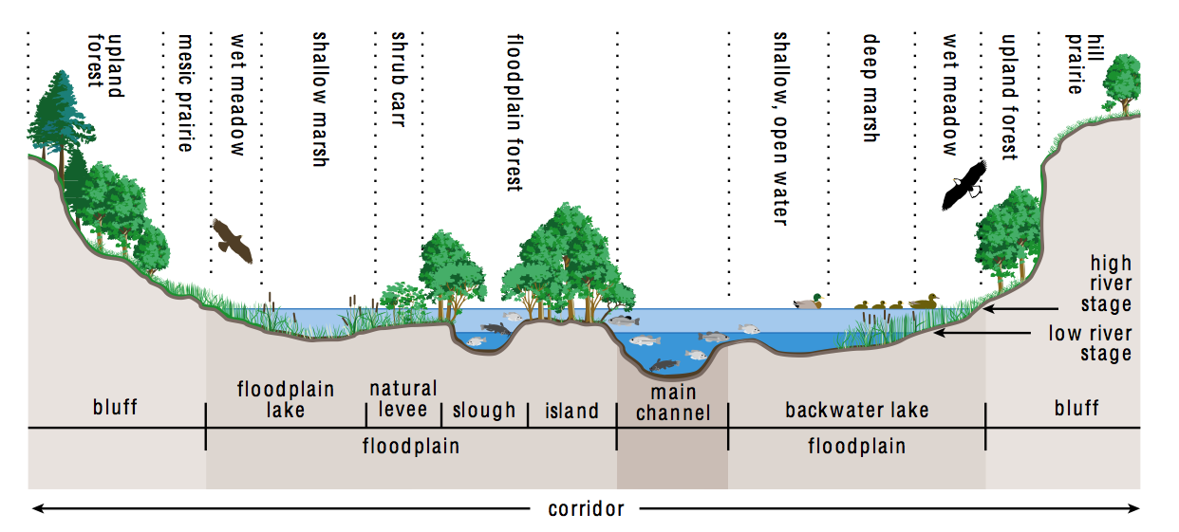
Fluvial sub-environments
River environments we might consider:

Slide 12
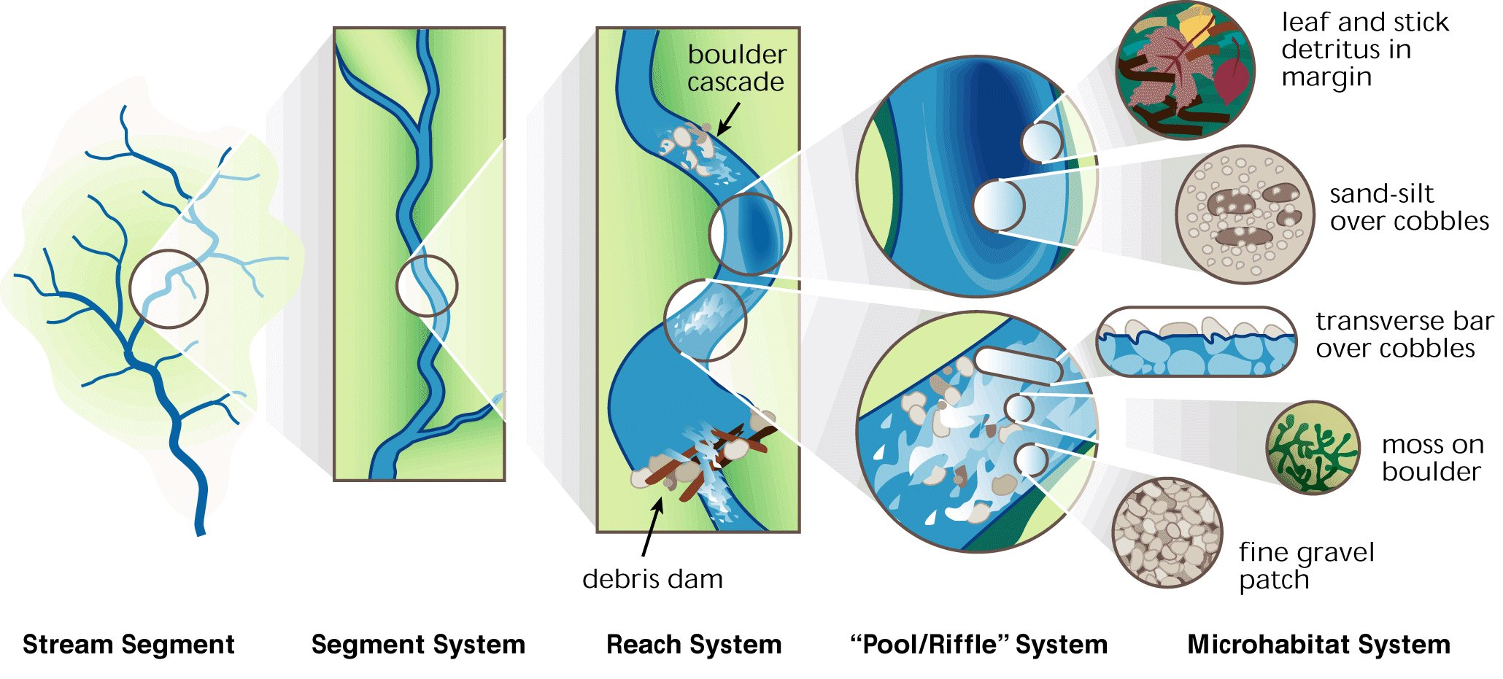
Stream & habitat scales
At what scale do we want to restore?

Slide 13
Basic river restoration steps
General steps for a particular site:
assessment/diagnosis: what needs restoring?
design: how to accomplish this
implementation: accomplishing it…can be pretty slow
monitoring: is it working?
Context, context, context
spatial: what kind of stream is this?
braided, meandering? cascade, step-pool, pool riffle?
temporal: what was the disturbance history?
dam? logging? channel management? when?

Slide 15
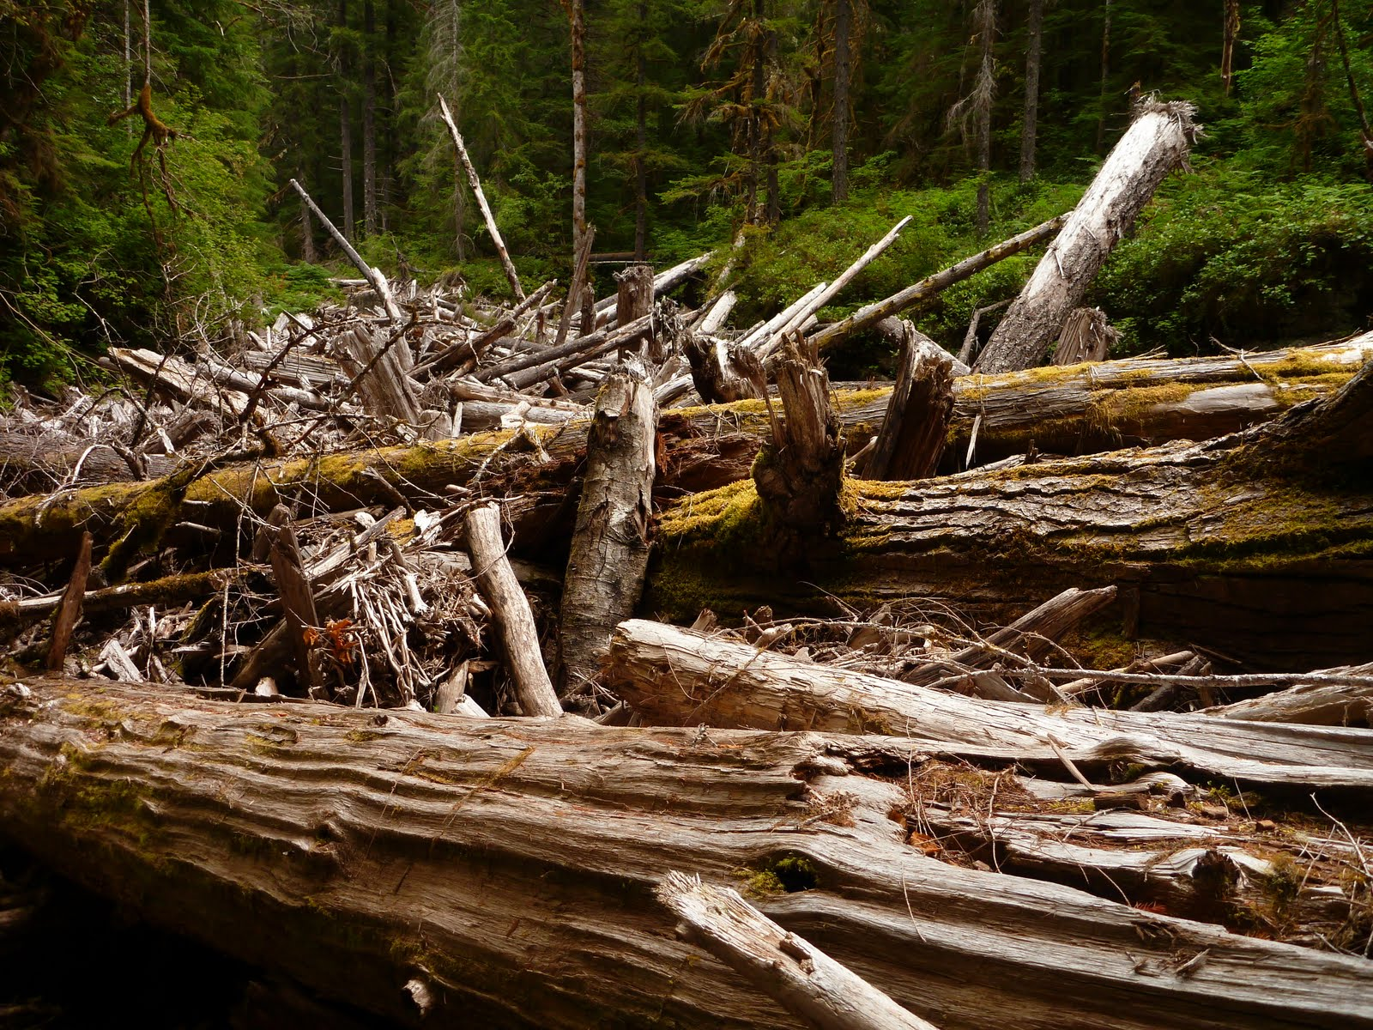
Large woody debris (LWD)
In the PNW, this has been implemented more and more in restoration work.
What happened to LWD?
What does LWD do for rivers
and ecosystems?
How do we restore it?

Slide 16
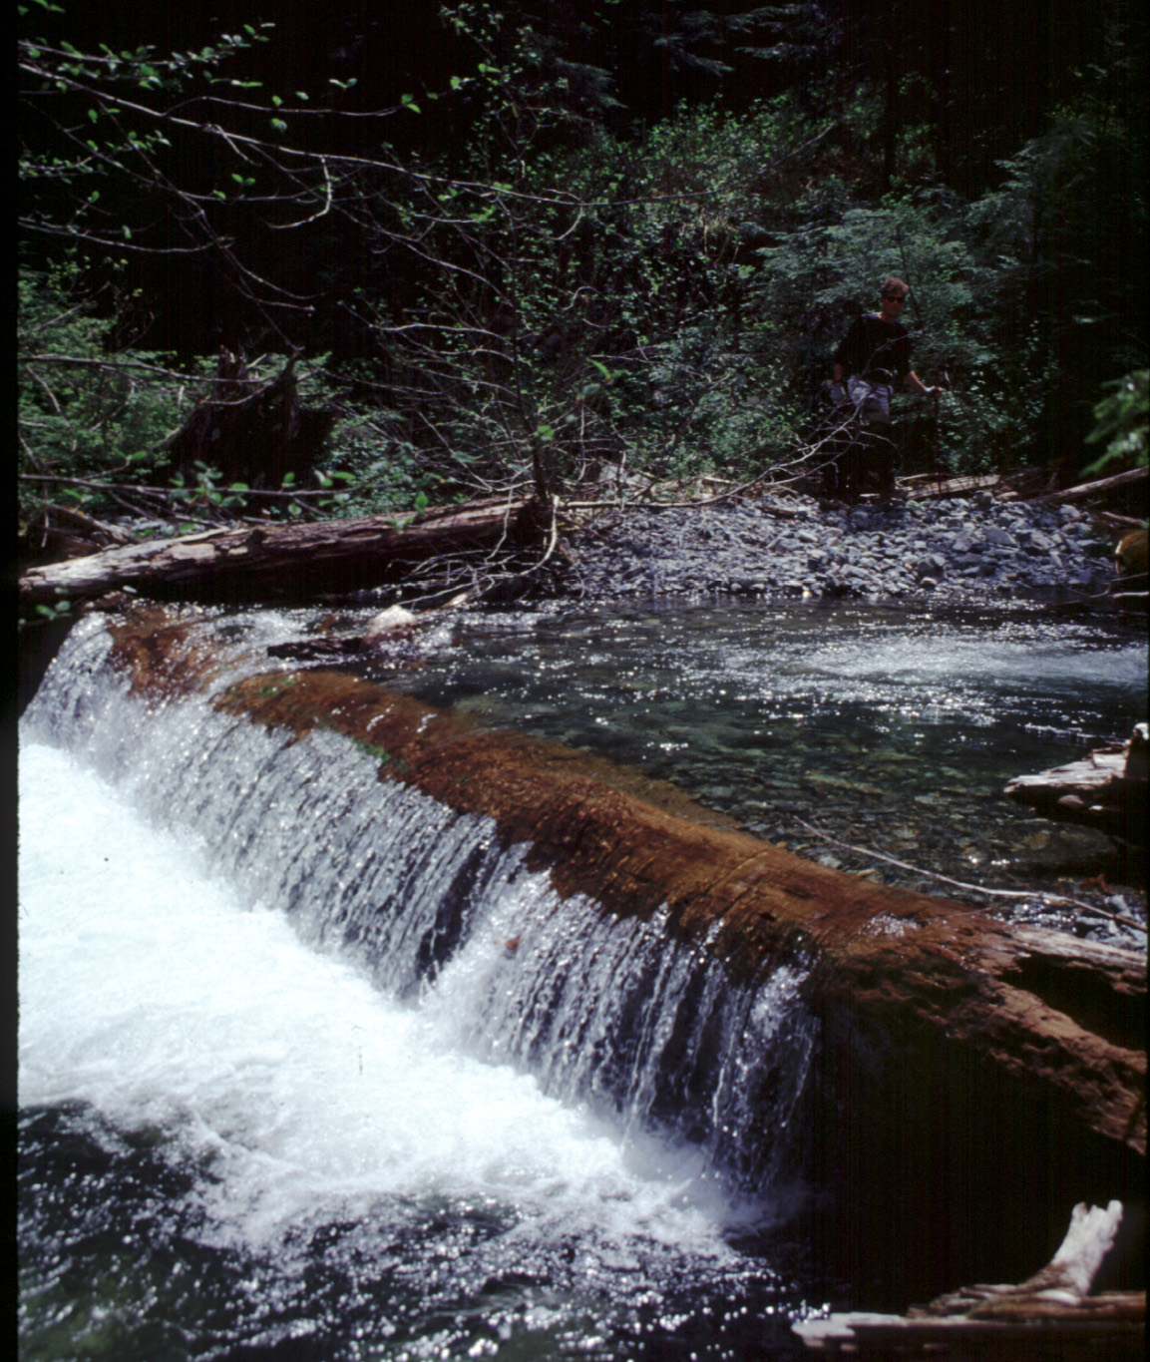
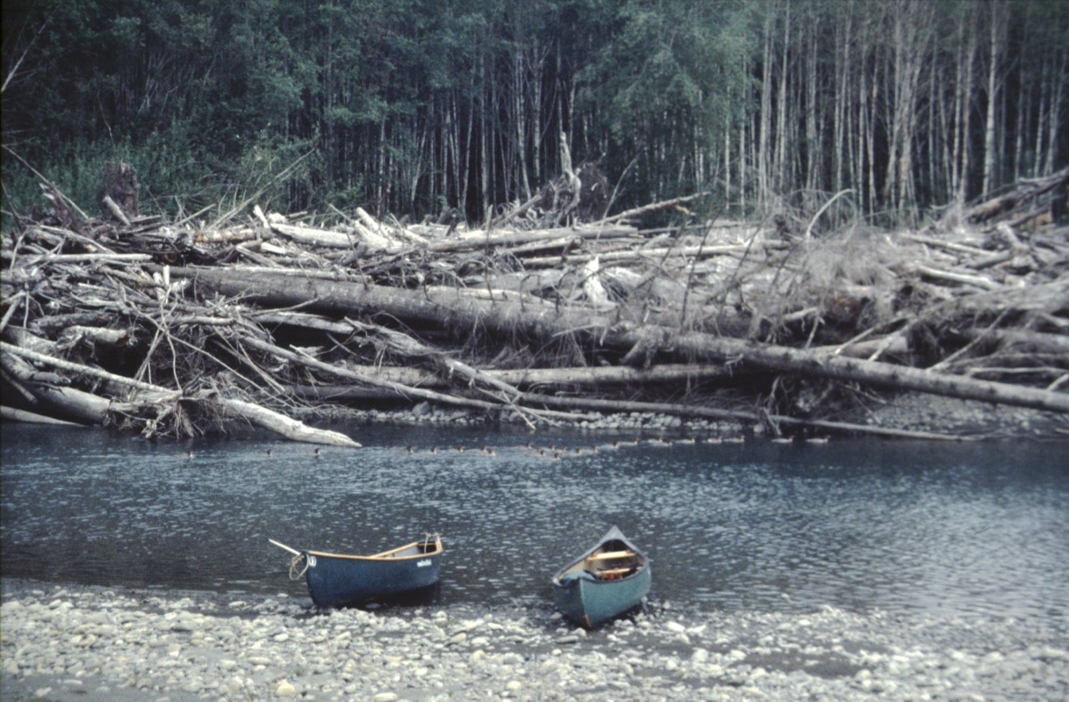
Restoration of LWD
LWD: large wood(y) debris
Wood acts as an impediment to flow:
can cause flow convergence and scour pools that provide important habitat
or, can cause slower flow & aggradation (sediment buildup)

Slide 17
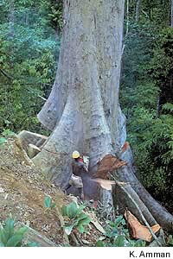
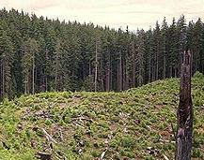
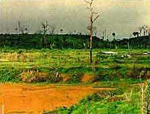
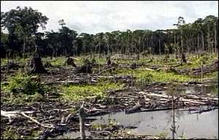
LWD supply: global forests
Forests have covered about one-third of the Earth’s land surface during the Holocene (last ~11,000 yrs)
But humans have changed the extent of forest cover substantially in the last few thousand years...
Oregon
Amazon
Cameroon

Slide 18
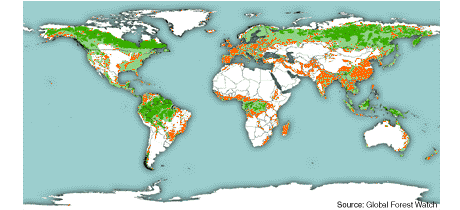
Global forests
Few of the world’s forests retain “frontier” conditions
Frontier: undisturbed, large intact natural forest ecosystems that are large enough to maintain all of their biodiversity

Slide 19
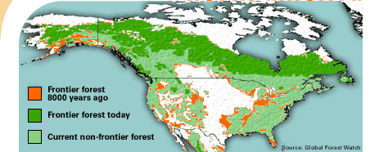
Global forests
Much of our understanding of river systems was developed in areas that either lacked large wood or that had been cleared of wood debris.
To what degree are our perceptions of rivers due to this legacy?

Slide 20
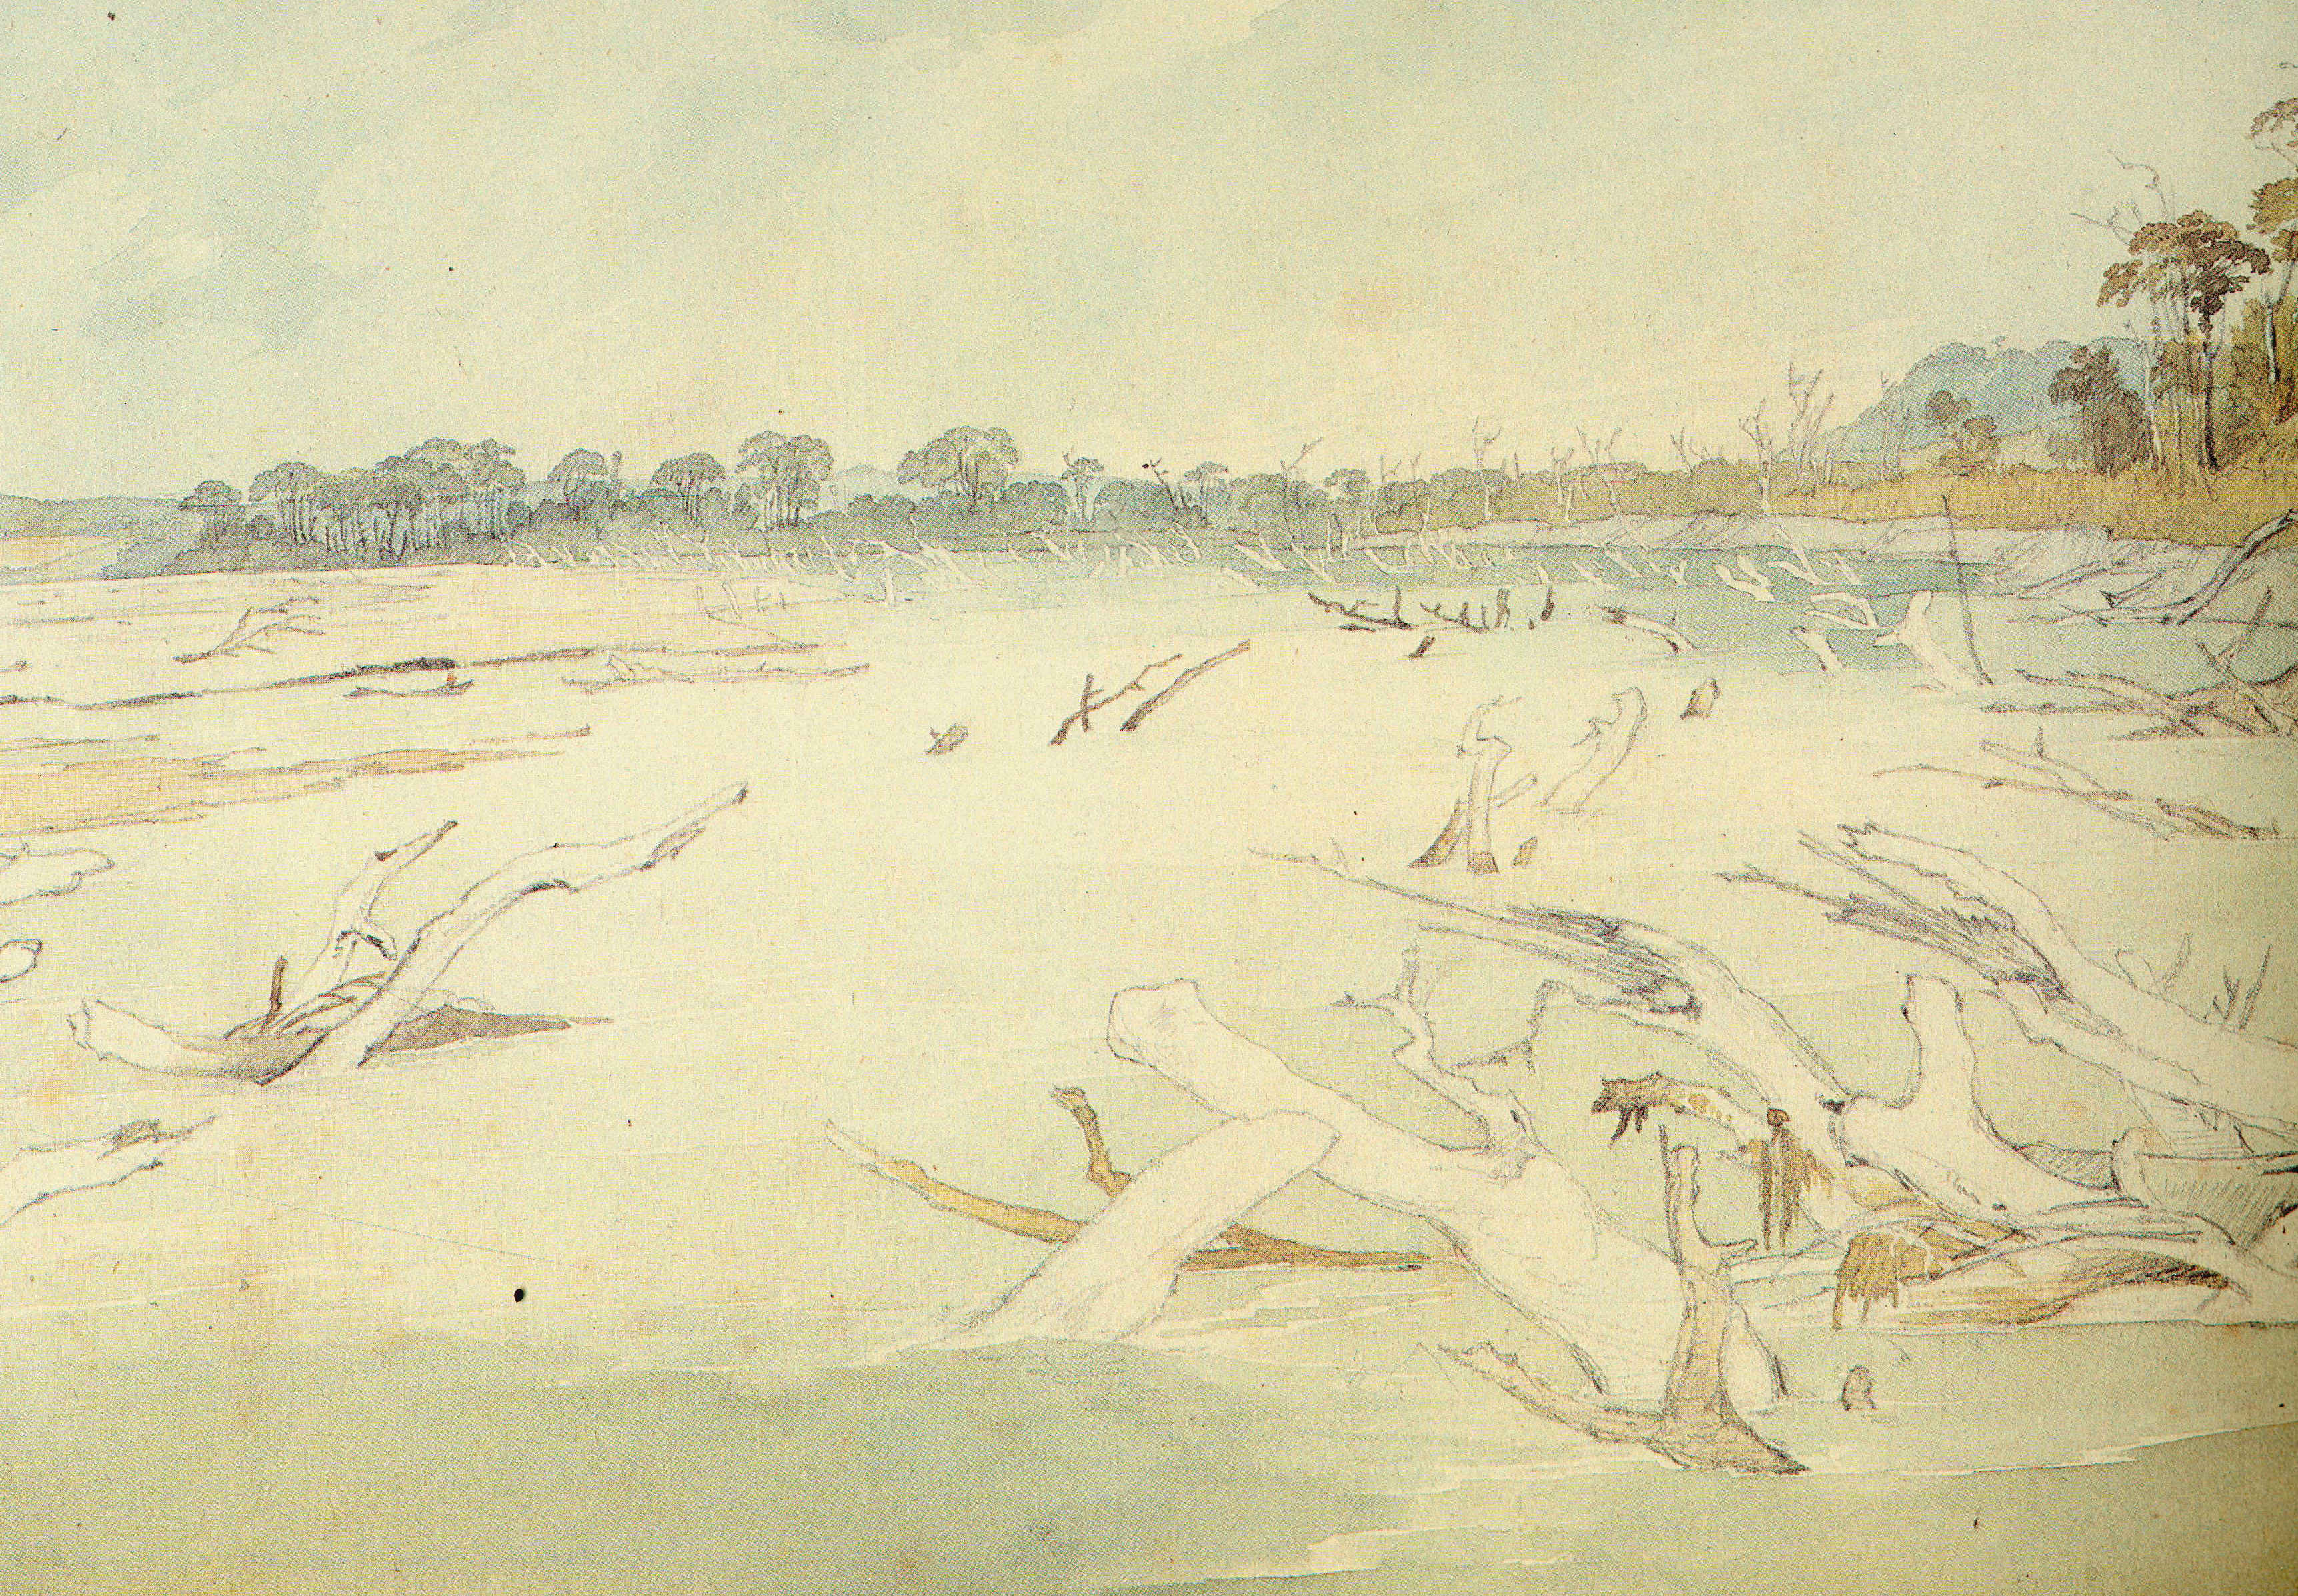
Snags on the Missouri Karl Bodmer, circa 1850

Slide 21
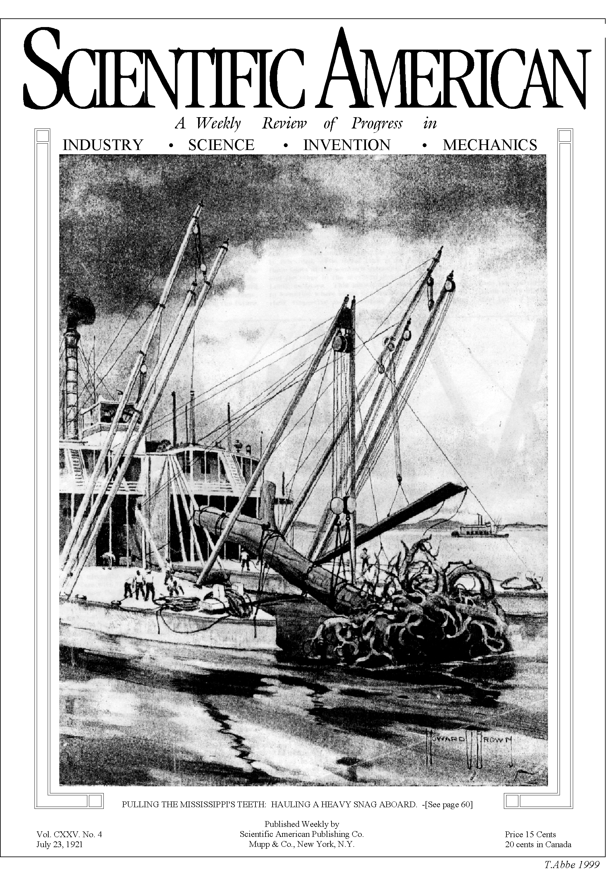
De-snagging
Log jams were significant obstacles to navigation and land development in the western US
Logs were taken out of most navigable rivers as a result.

Slide 22
What does LWD do for streams?
Using those remaining ‘frontier’ forest areas, we can get a good idea of how LWD interacts with the river and floodplain, and use this as a basis for restoration.
LWD acts at several scales.
We’ll start from channel scale and move outwards.

Slide 23
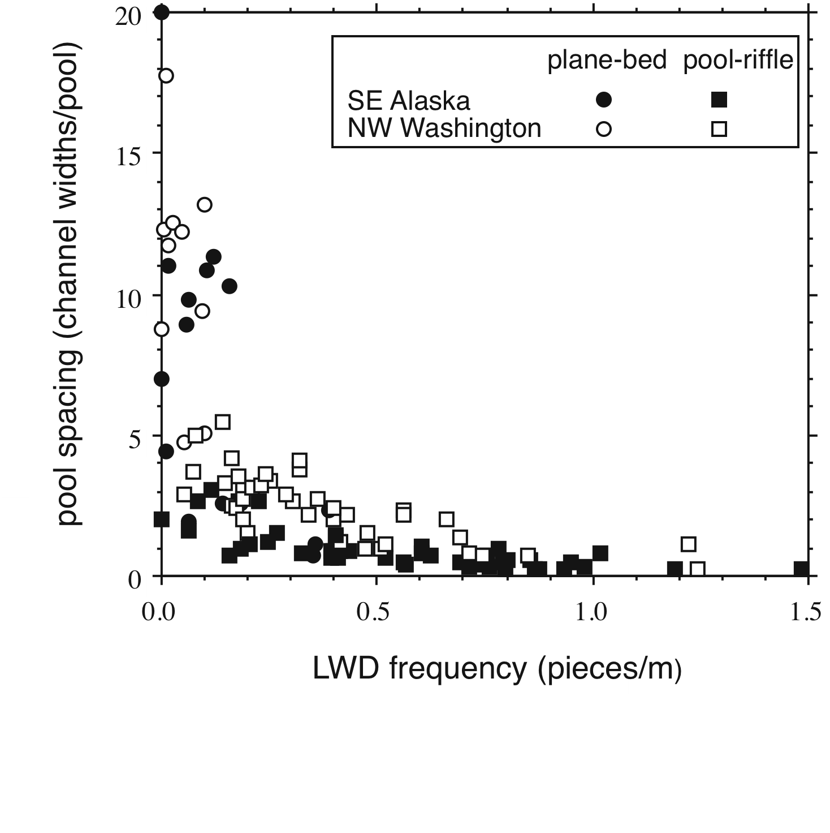
LWD at channel scale
more wood → more pools
For channels surveyed in AK and WA:
plane-bed morphology occurs only at low LWD loading
LWD can control the spacing of pools and bars, and thereby channel reach morphology

Slide 24
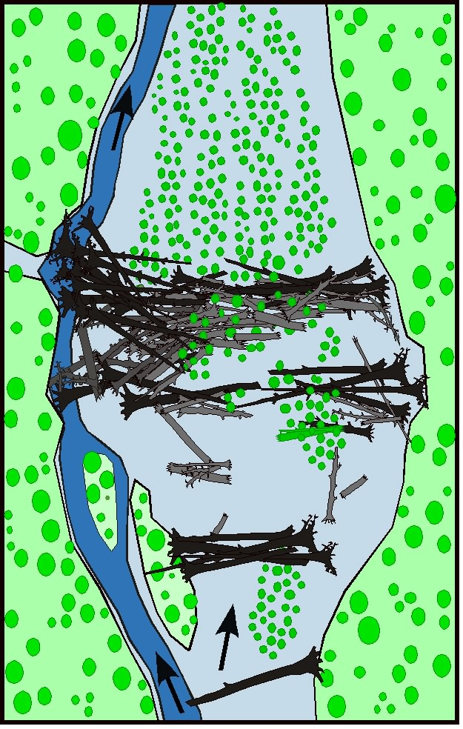
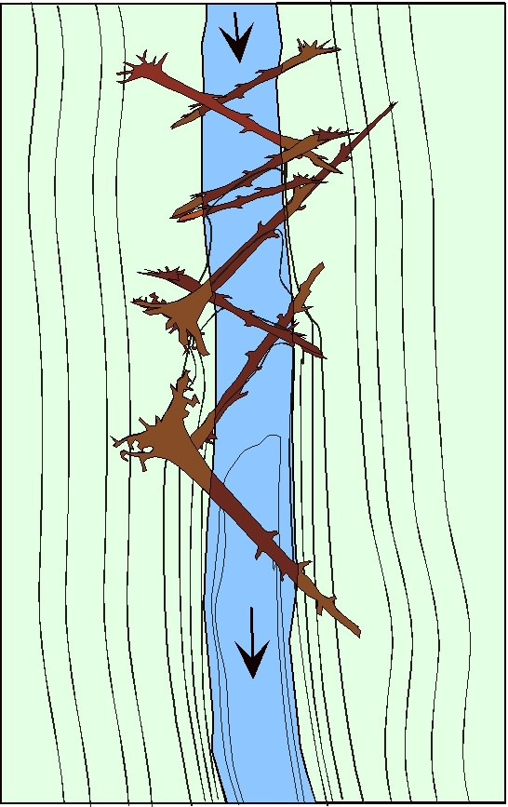
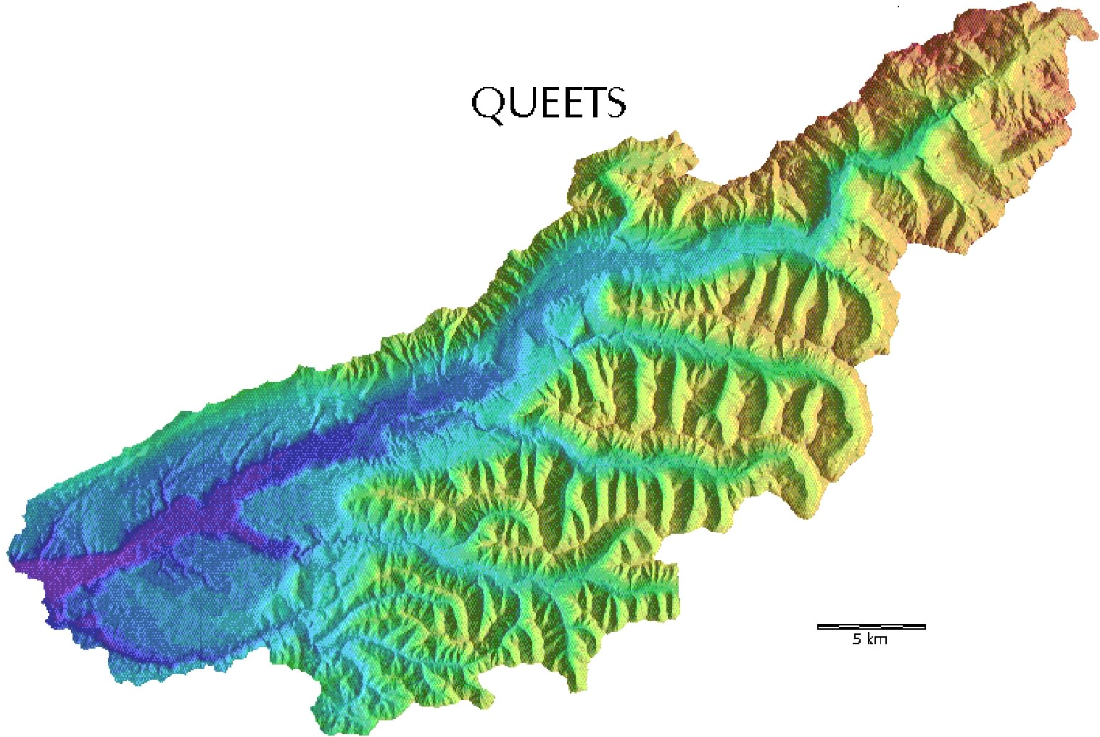
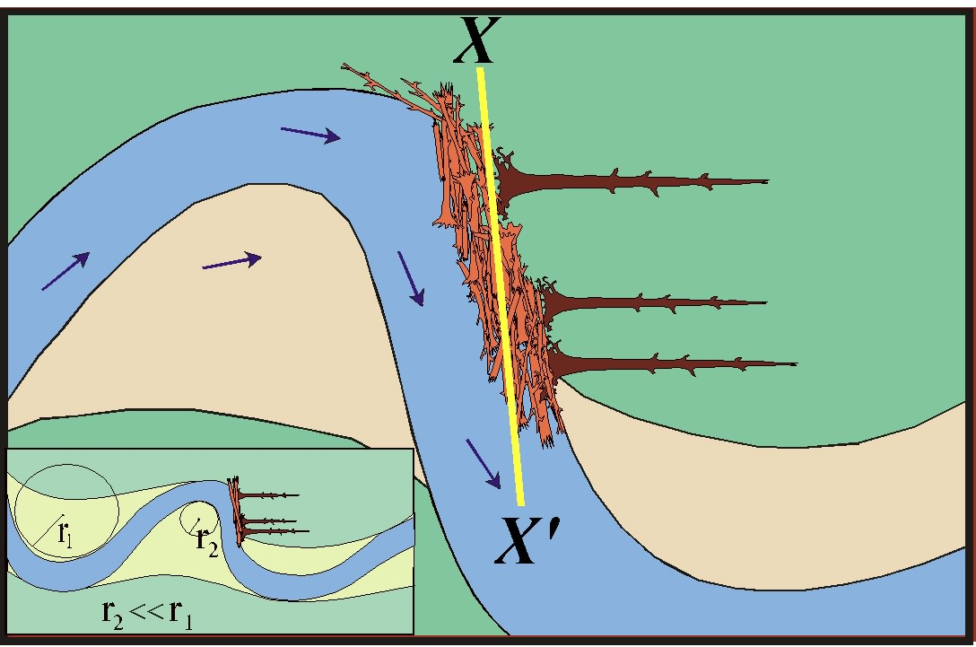
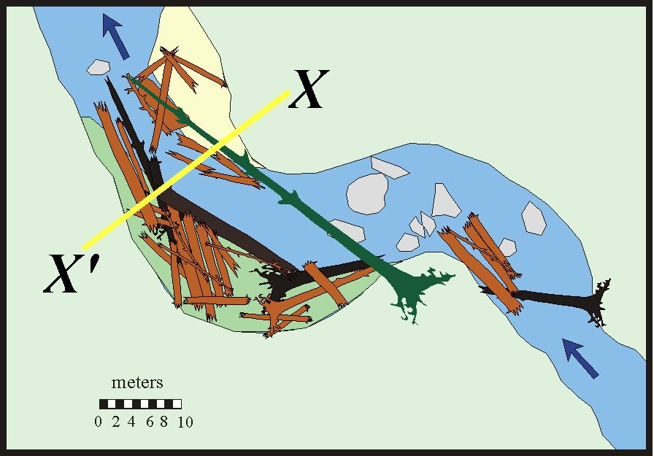
LWD at reach scale
Valley jam
Queets River, Washington
Log steps
Bankfull bench
Meander jam

Slide 25
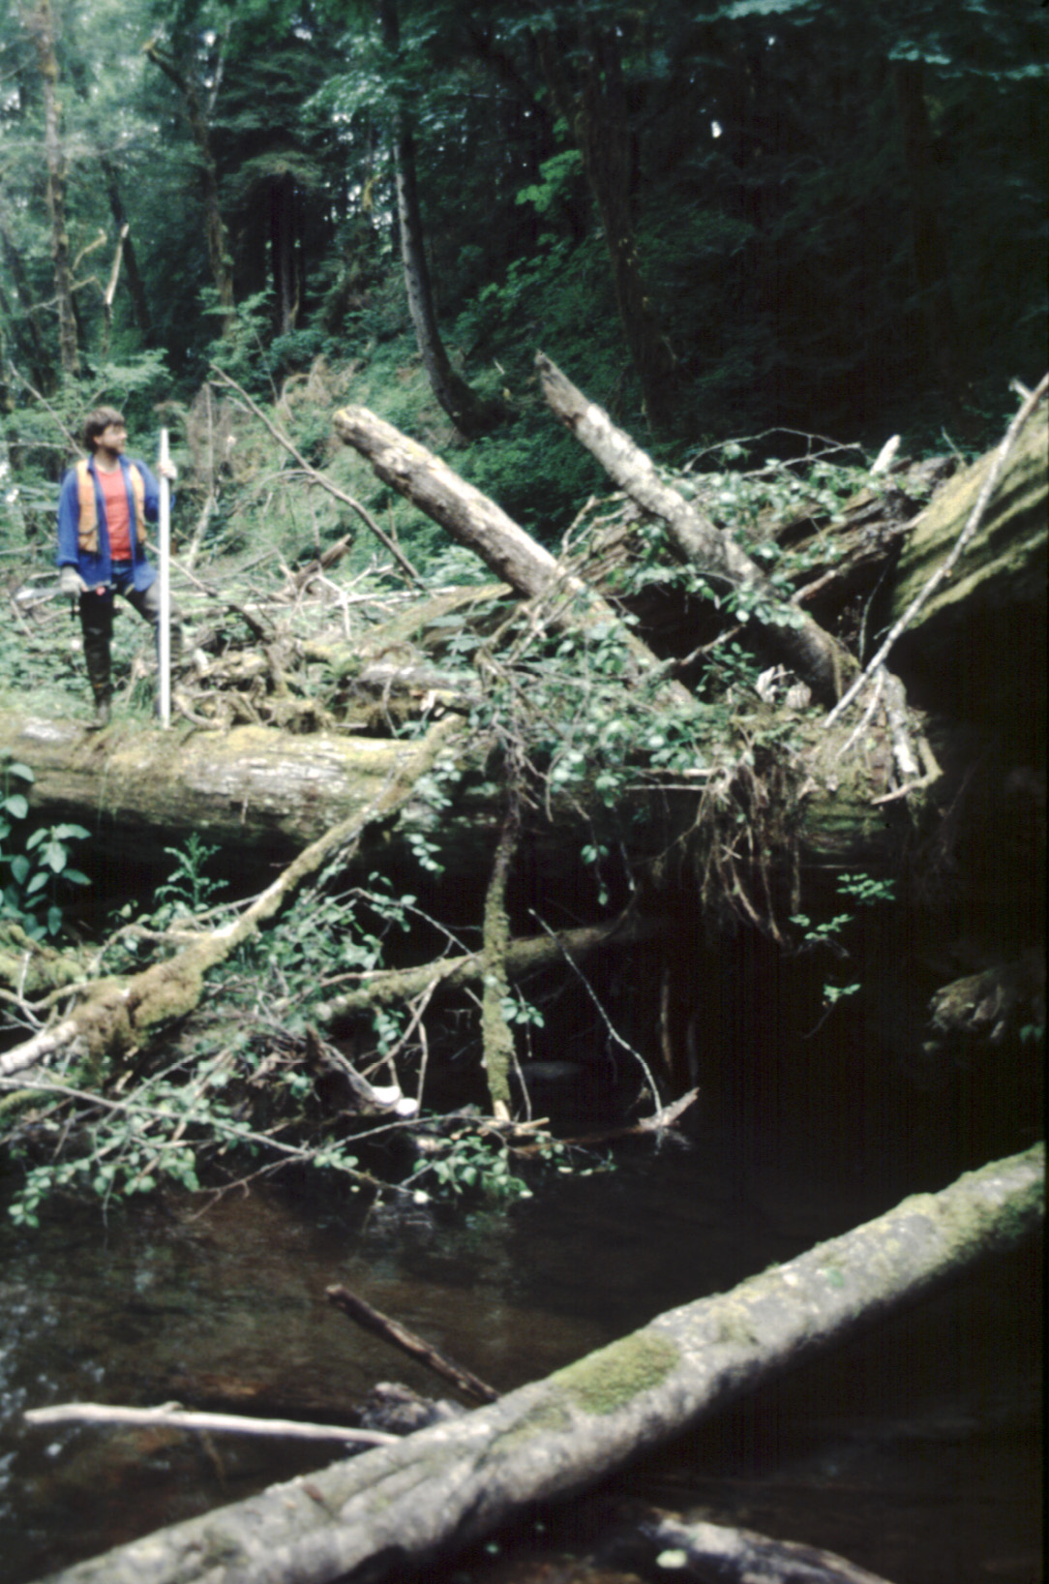
LWD at valley scale
Log jams trap large amounts of sediment and can lead to aggradation along entire channel reaches

Slide 26
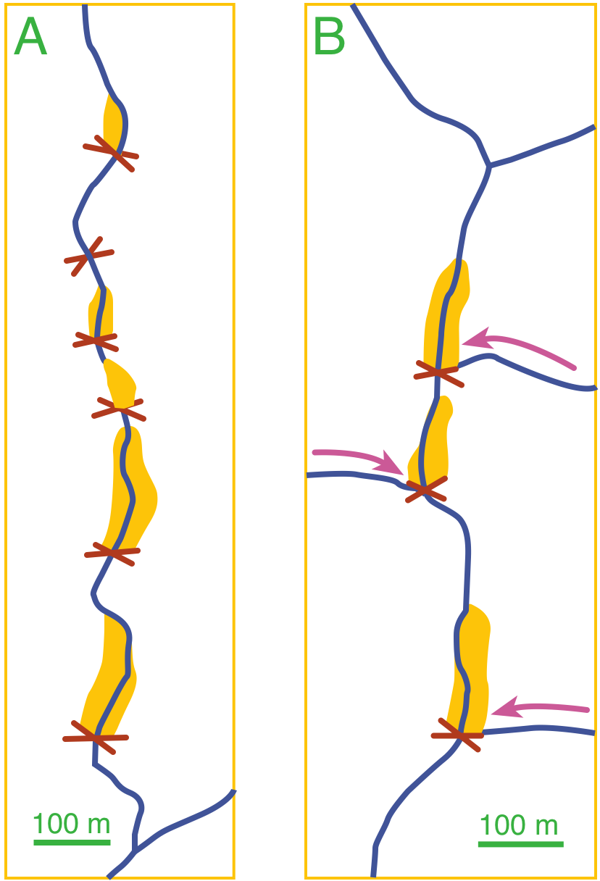
LWD at valley scale
Both locally recruited trees and log jams delivered by debris flows can create alluvial valley bottoms in confined mountain streams.

Slide 27
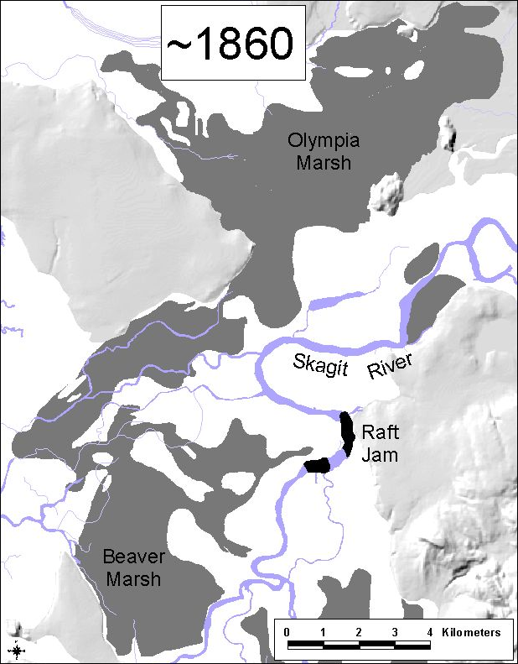
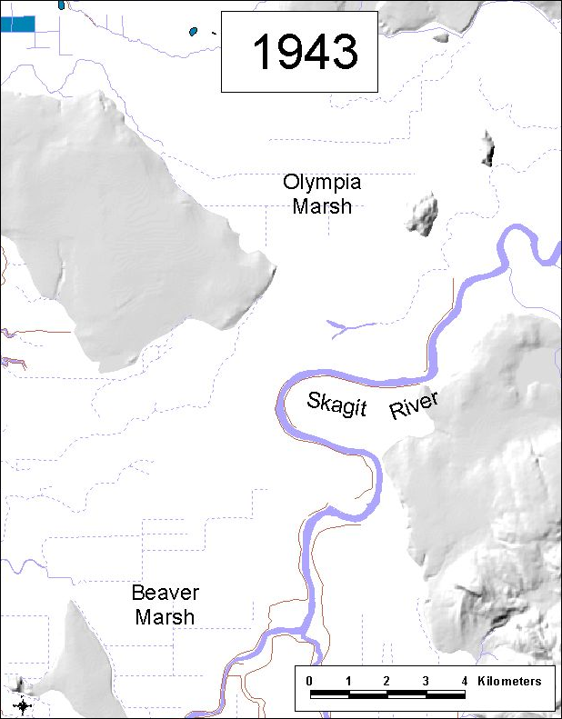
Watershed Scale
Absence of large jams narrows channel and lowers avulsion potential

Slide 28
LWD across scales
LWD is important for channel morphology
1000
Valley Bottom
100
Water,
Sediment
& Wood
Routing
Reach
Channel
Switching
Islands
Sloughs
Years
In-Channel
Pools
Cover
Bank
Complexity
10
1
1
100
10,000
Spatial scale (meters)

Slide 29
LWD size
Larger logs typically ‘key members’ of log jams that stabilize the jam and allow other logs to accumulate.
2
key
1
log diameter/channel depth
racked
loose
0
0
1
2
log length/channel width

Slide 30
LWD restoration
Restoration of natural wood loading would take centuries:
large key members take a long time to grow

Slide 31
so:
reintroduction of large woody debris

Slide 32
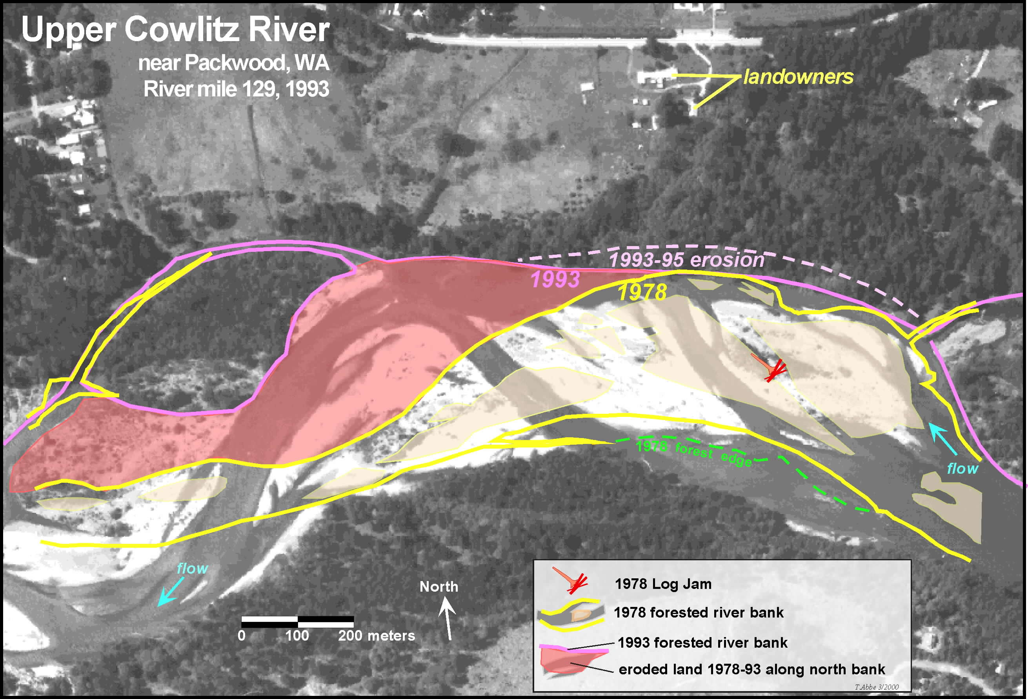

Slide 33
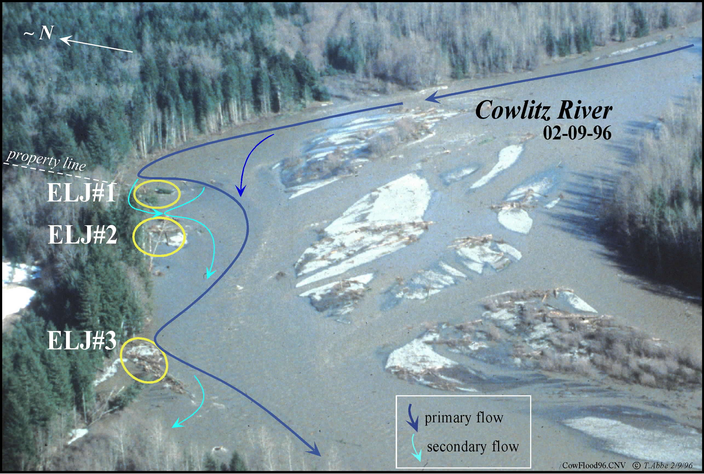
Cowlitz River Engineered Log Jams (ELJ),
25 yr flood event 5 weeks after construction

Slide 34
Changes at the Cowlitz Site: 12/95 to 04/97

Slide 35
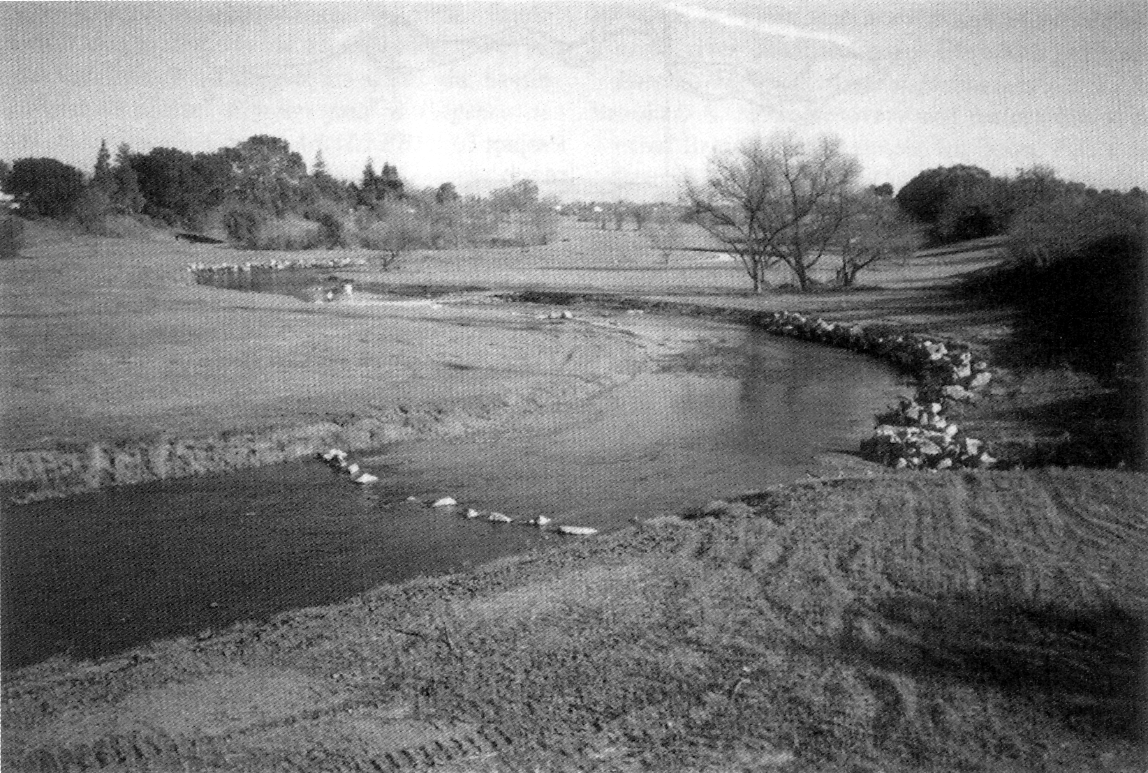
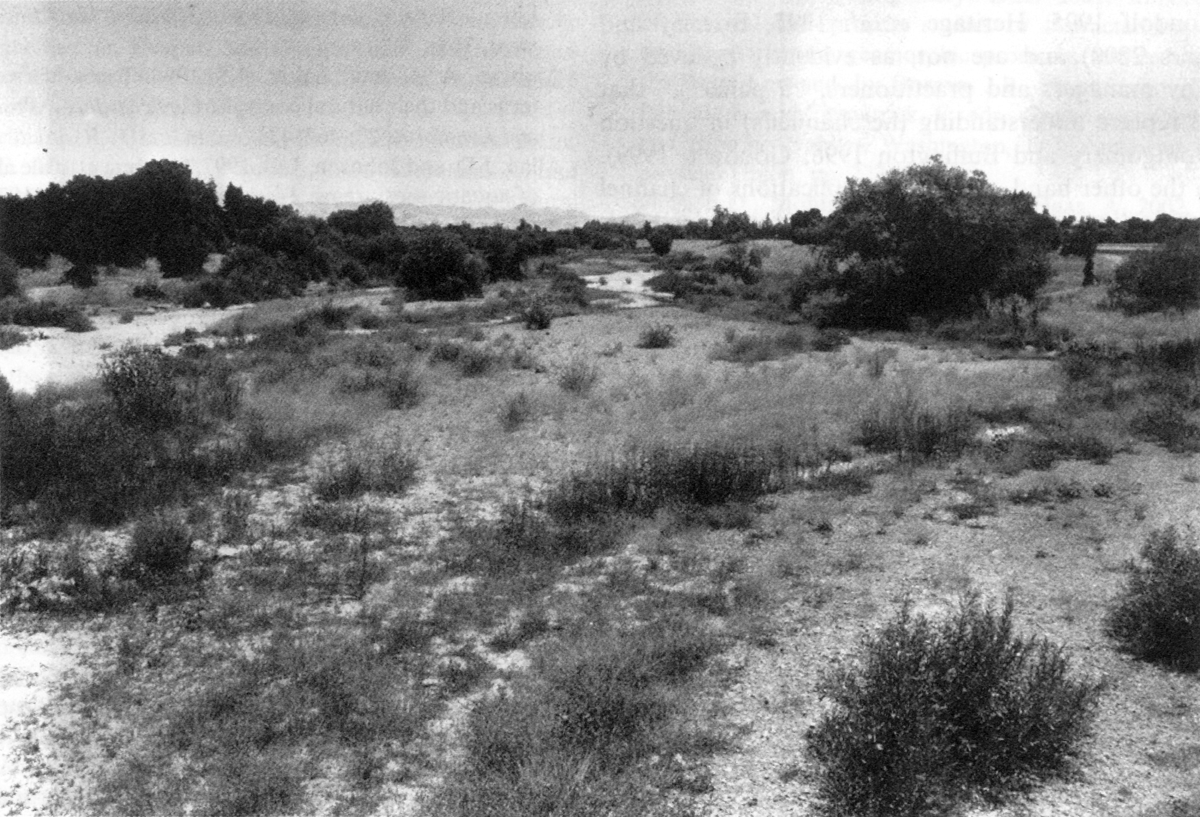
Uvas Creek
January 1996
Restoration aimed to turn a braided channel into a meandering channel.
July 1997
BUT: Uvas Creek was not a meandering channel!

Slide 36
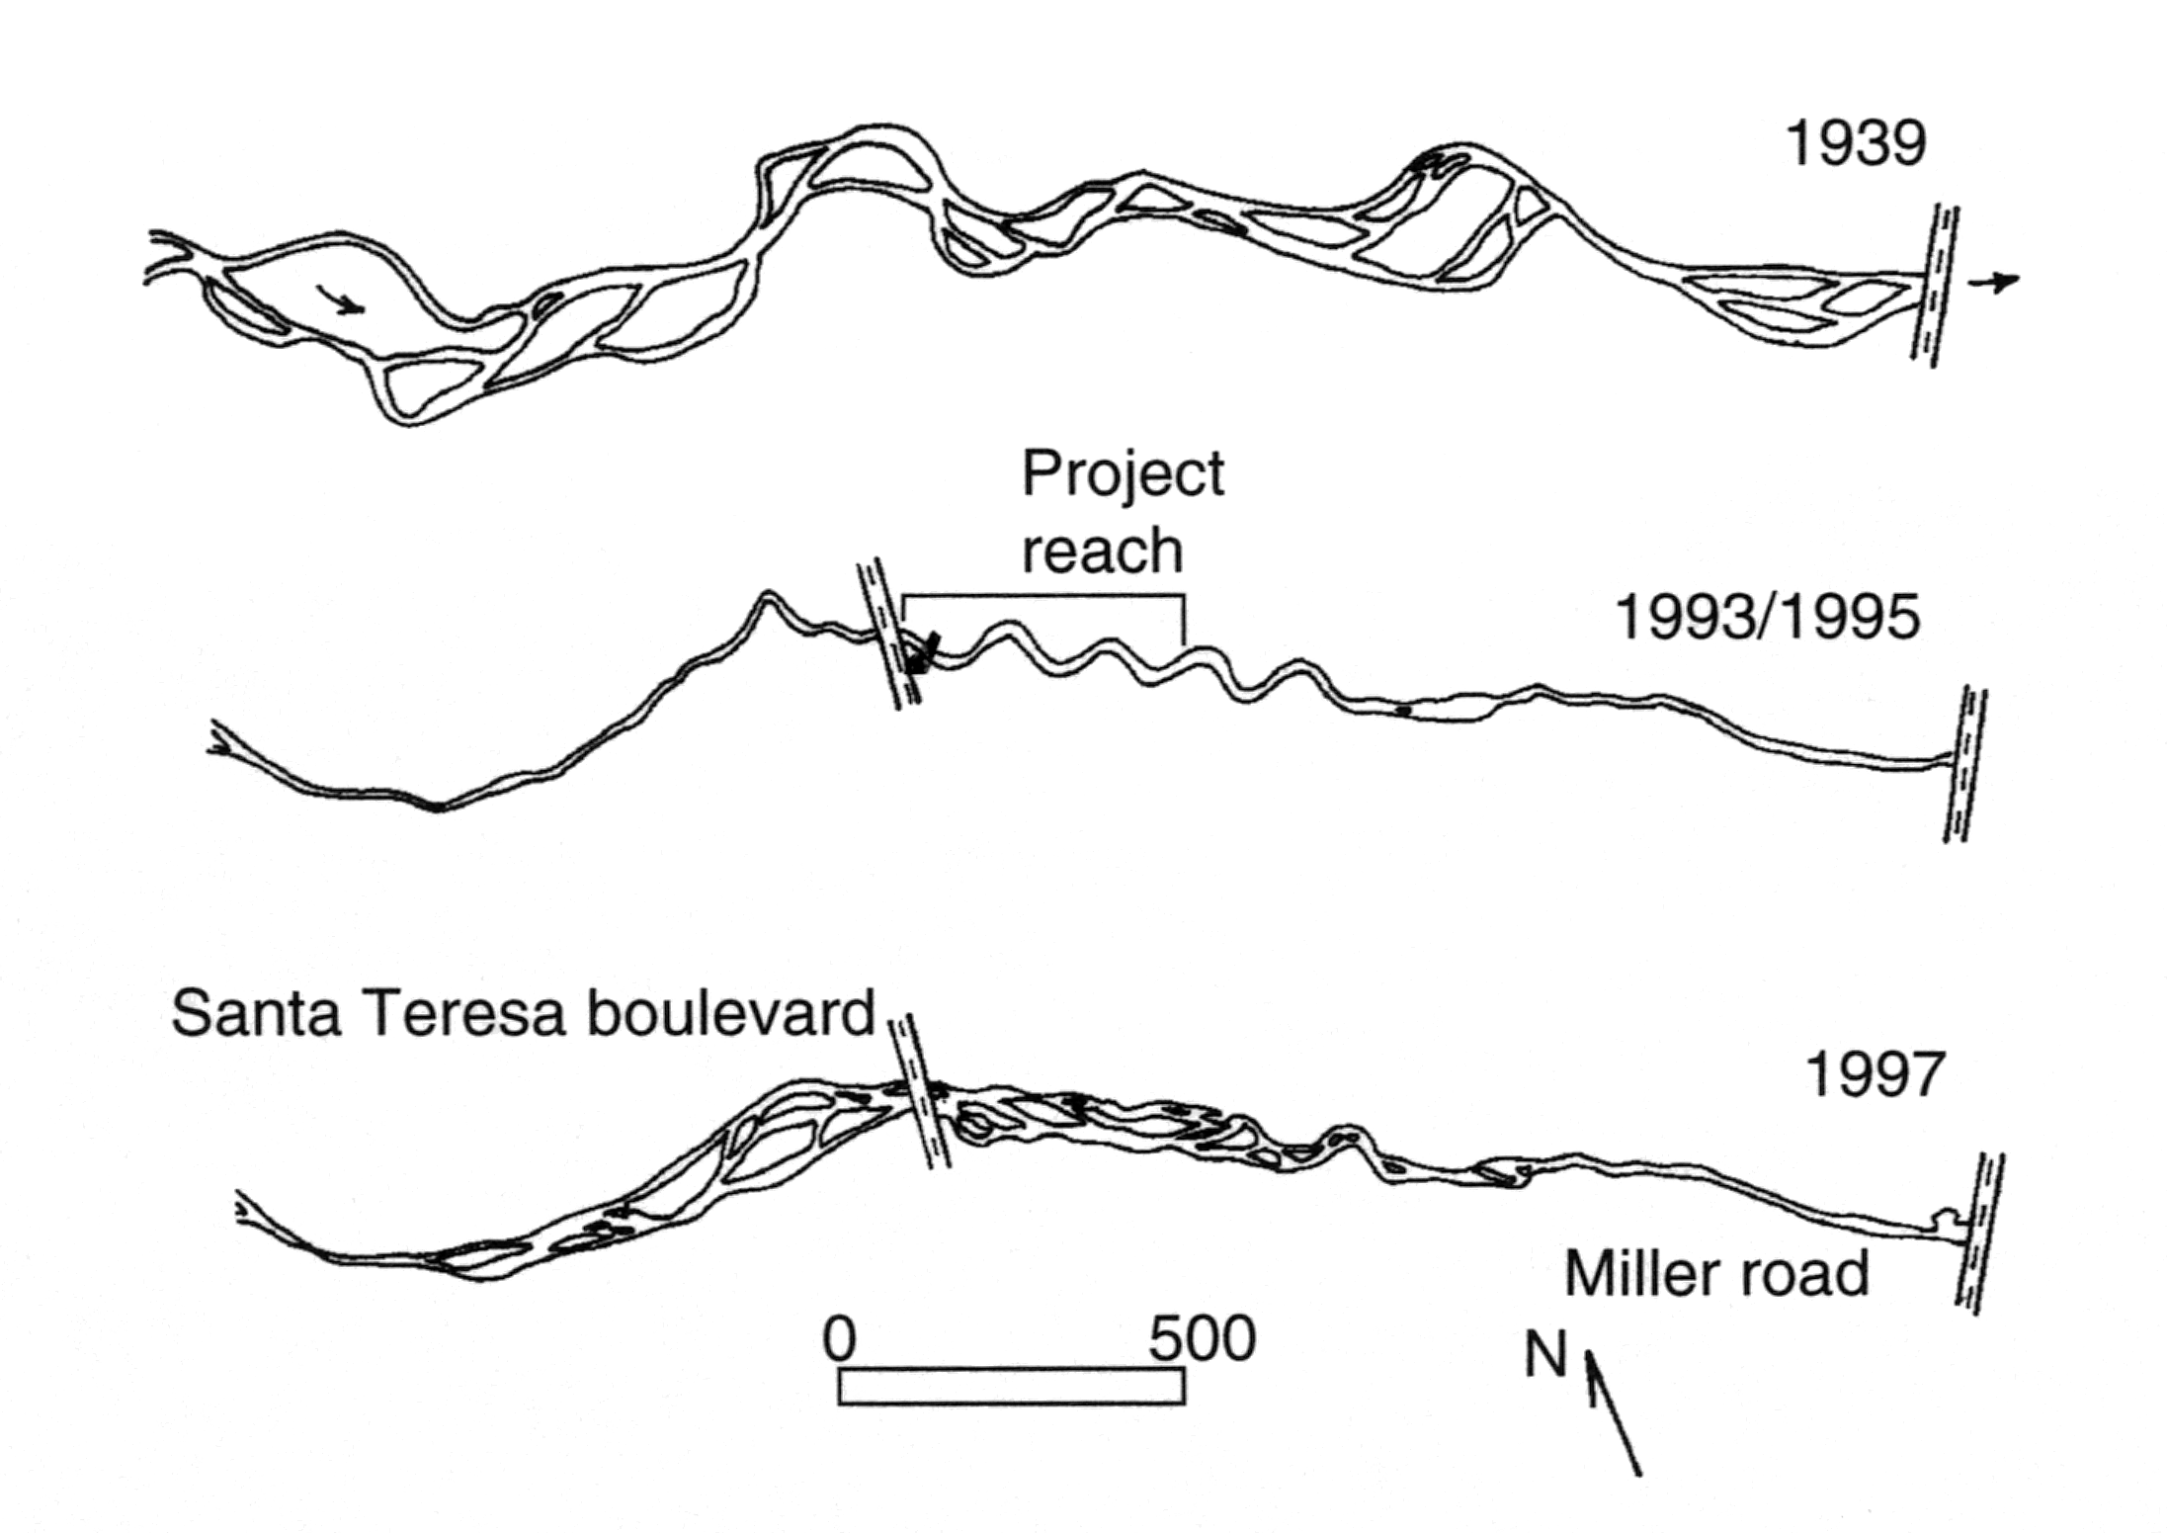
Uvas Creek ‘restoration’
Context, context, context!

Slide 37
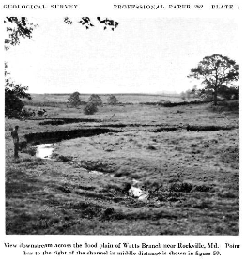
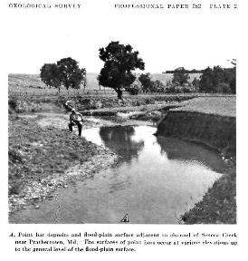
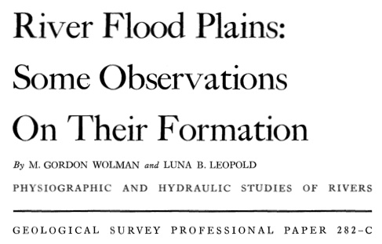
Where to look for context?
Earliest historical documents and photographs are a start.

Slide 38
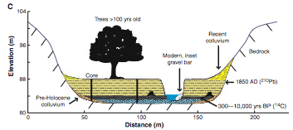
but…
Most ‘piedmont’ stream (i.e. East Coast streams) morphologies reflect incision through mill dam-related alluvium and not their ‘natural’ state

Slide 39
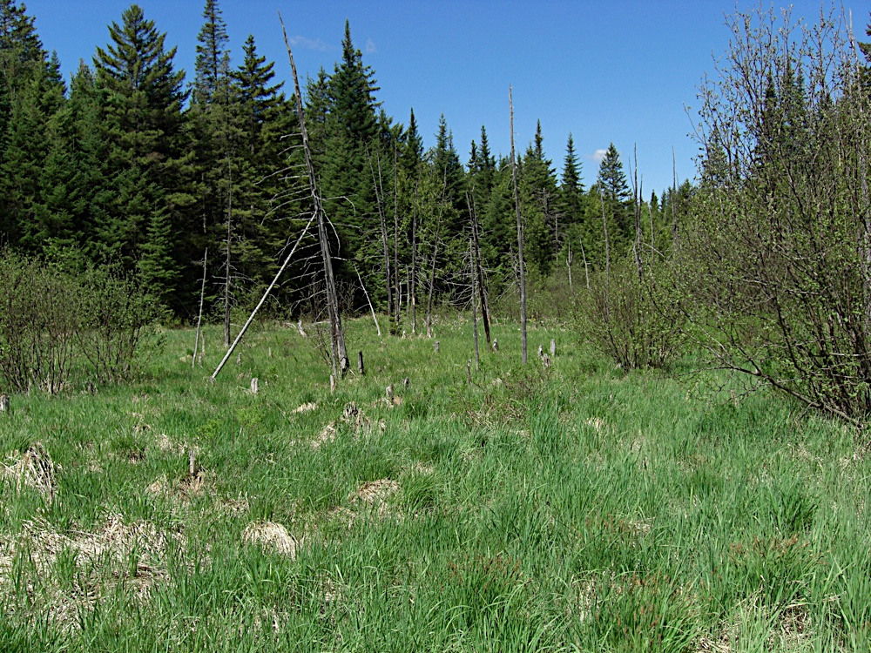
What should they look like?
‘should’ is a loaded word…
What is under the mill pond fill?
‘beaver meadow’
small, stable, vegetated channels & islands
lots of wood

Slide 40
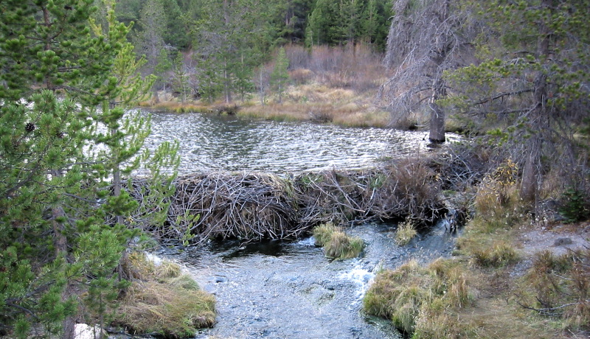
Beaver restoration
Just as LWD jams were integral in floodplain formation and channel morphology, beaver dams especially in smaller streams, were important ecologically and fluvially.

Slide 41
Beaver dam restoration
Beaver dams were removed to clear waterways and prevent backwater flooding behind the dams.
Without the dams, streams can incise, lowering the water table and drying out nearby farms and riparian areas.
The simplified channel is often not as hospitable for fish and other organisms.

Slide 42
Benewah Creek, Idaho
Lowered water table prevented riparian forests from developing, so beaver dams needed to be re-constructed with outside help.
Artificial weirs put it to form the basis for future beaver dams.
Post-restoration, overbank flows returned to normal frequencies and floodplain is regaining connectivity with the channel.
DeVries et al., 2012

Slide 43
What are some other restoration projects?
Let’s go back to three of the case studies from River Response:
Skokomish River
NF Skokomish River
Seattle Urban Streams
And let’s also go the Elwha River.

Slide 44
Skokomish River
Aggradation was leading to increased overbank flooding and fish swimming over roads. How can we decrease aggradation and increase fish passage?

Slide 45
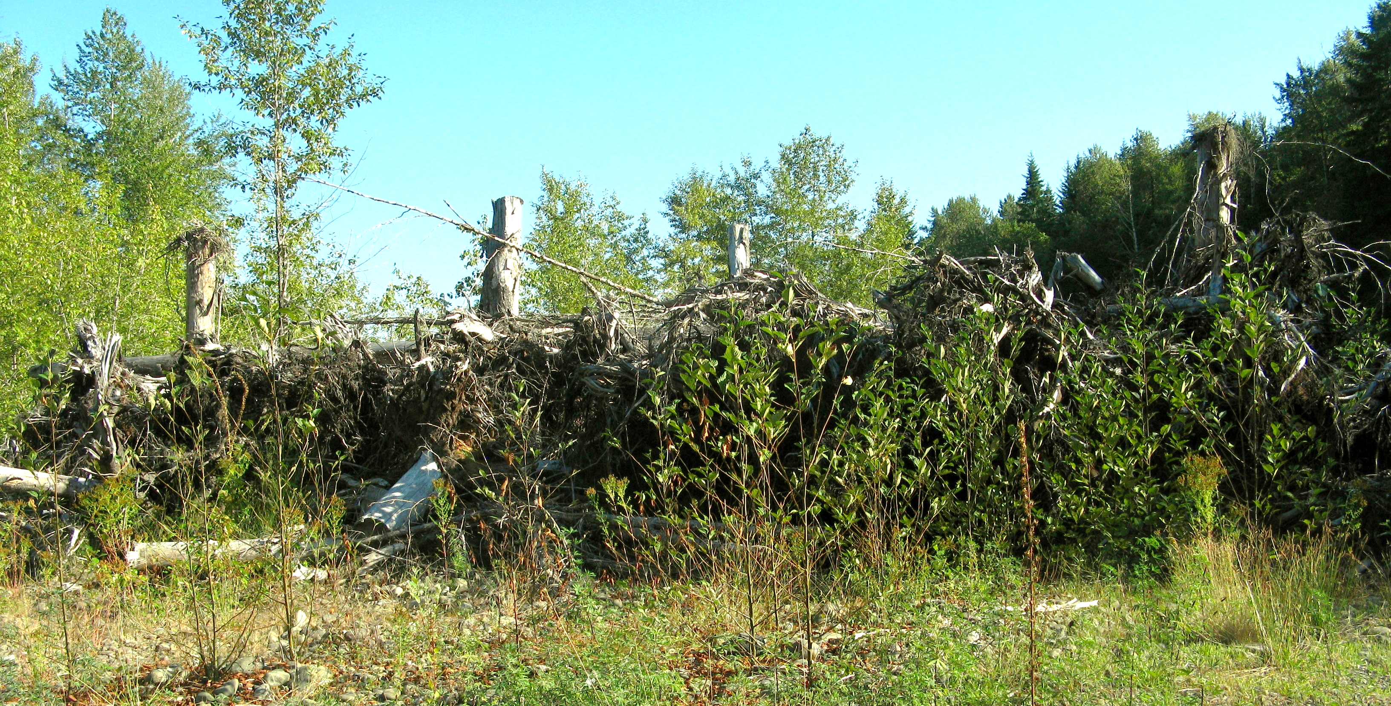
Skokomish River
Aggradation was leading to increased overbank flooding and fish swimming over roads. How can we decrease aggradation and increase fish passage?
Engineered log jams! (built in 2010)
stabilized streambanks, provided ecological diversity, and restored stream function (hopefully)
ELJ in summer 2013

Slide 46
Skokomish River
Aggradation was leading to increased overbank flooding and fish swimming over roads. How can we decrease aggradation and increase fish passage?
River dredging and levee set-back (set forth by USACE Jan. 2014)
Dredging the river will deepen it and help confine flows
Setting the levees back allows for a greater inundation area, so in theory the houses won’t get flooded.

Slide 47
NF Skokomish River
The reduced water flow had caused gravel armoring, leading to an immobile bed that is bad for salmon!

Slide 48
NF Skokomish River
The reduced water flow had caused gravel armoring, leading to an immobile bed that is bad for salmon!
Starting in 2009, higher flows were periodically released from the dam to mimic natural floods and move the armor layer.
Minimum discharge is higher.
When a flow threshold elsewhere in the basin is reached, more water is released to the North Fork and water levels kept elevated for 48 hours.
Higher flows for fish passage set.

Slide 49
NF Skokomish River
The reduced water flow had caused gravel armoring, leading to an immobile bed that is bad for salmon!
Starting in 2009, higher flows were periodically released from the dam to mimic natural floods and move the armor layer.
Minimum discharge is higher.
When a flow threshold elsewhere in the basin is reached, more water is released to the North Fork and water levels kept elevated for 48 hours.
Higher flows for fish passage set.
Did it work?
Hasn’t been evaluated yet…BUT, as of 2014, there was still armoring of the channel. May take time for the increased flows’ influence to travel downstream.

Slide 50
Seattle Urban Streams
The problem: Urbanization increased water routing to streams resulting in flashy streams with lots of erosion (and pollutants)
The fix:
Don’t route the water directly to the streams!
Use retention and detention ponds to store stormwater and gradually release it into the stream

Slide 51
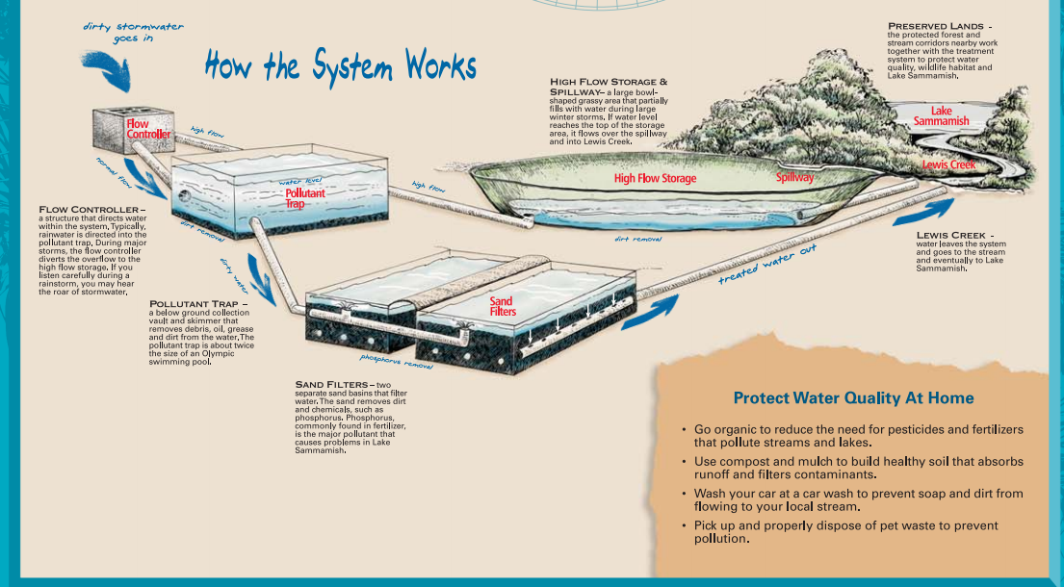
Seattle Urban Streams
The problem: Urbanization increased water routing to streams resulting in flashy streams with lots of erosion (and pollutants)
The fix:
Don’t route the water directly to the streams!
Use retention and detention ponds to store stormwater and gradually release it into the stream
Lakemont, Bellevue

Slide 52
Seattle Urban Streams
The problem: Urbanization increased water routing to streams resulting in flashy streams with lots of erosion (and pollutants)
The fix:
Don’t route the water directly to the streams!
Use retention and detention ponds to store stormwater and gradually release it into the stream
Underground stormwater storage!
Under the tennis courts is a large water storage basin for storms that slowly drains to Lewis Creek.

Slide 53
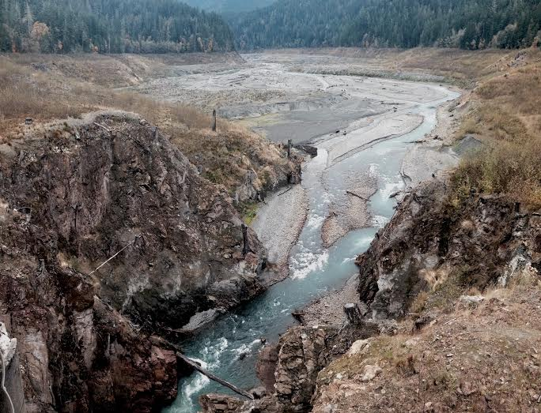
Elwha River
Two dams were removed, and with them, a huge reservoir of sediment was activated.
Concerns:
Too much sediment causes aggradation, which leads to avulsions…not good in a floodplain where people live!
Pre-dam removal conditions were too simple for salmon
Project goals:
Improve current habitat conditions and prepare for the increased sediment supply
Achieve this through maintaining existing side-channels, activating new and abandoned side-channels, and capturing wood and sediment from upstream.

Slide 54
General restoration considerations
Conceptual model #2 (more specific to restoration)
Geology
Climate
Regional Vegetation
Land Use
Pollution
River Engineering
Floodplain Development
Restoration/LWD
Biotic Condition
(creature viability)
Flow Regime
Sediment Regime
Wood Regime
Habitat
Structure &
Dynamics

Slide 55
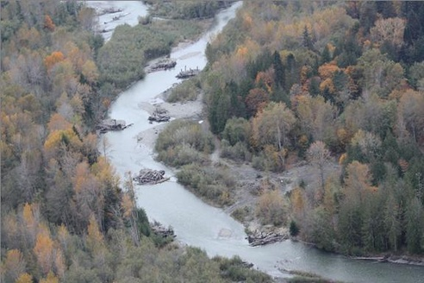
Elwha River
Restoration: construction and placement of several engineered log jams

Slide 56
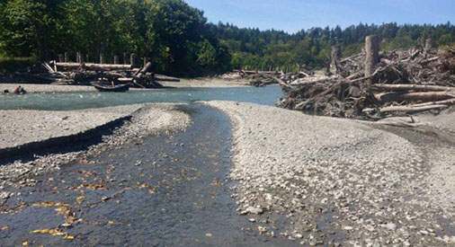
Elwha River
There are now several generations of ELJs on the lower Elwha, and not all of them have been evaluated for success.
BUT, initial work pre-dam removal showed that juvenile salmon were responding well to the first wave of ELJs.

Slide 57
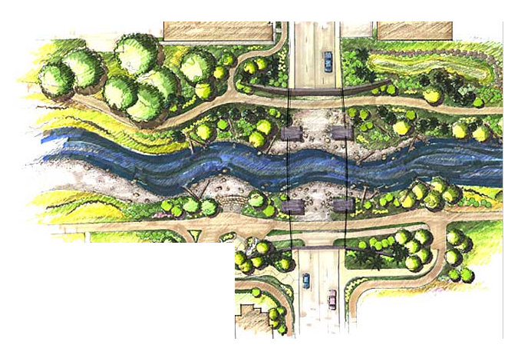
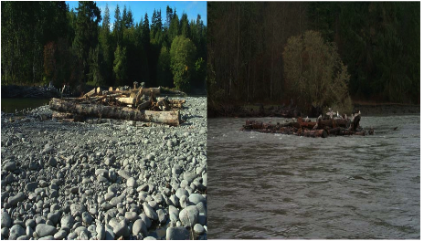
10 commandments of river restoration (according to Dave):
Do no harm
Look beyond the channel to assess it in its context
Use native materials
Emulate natural analogs
Let channels do the work
Let the channel use its floodplain
Manage inputs to the system so that the river can fix itself
Use direct manipulation of the channel as a last resort
Allow for the river to make its own changes
Use qualified/appropriate personnel to design restoration efforts

