Slide 1
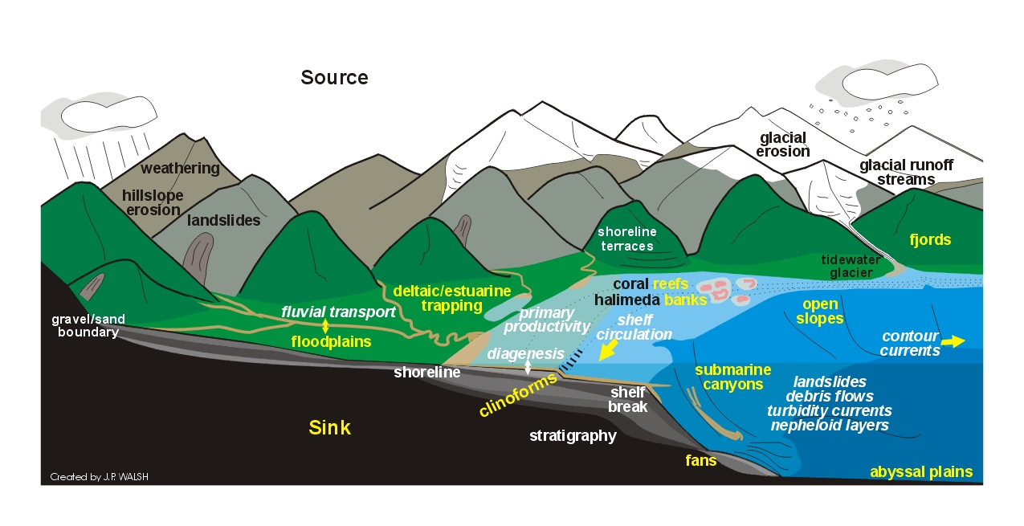
Floodplains

Slide 2
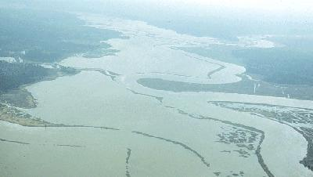
A floodplain is the flat land immediately
surrounding a stream channel and innundated at times of high flow.

Slide 3
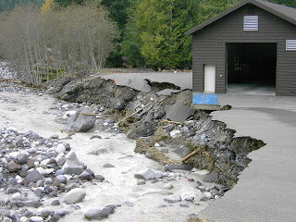
Incision occurs when erosion is greater than deposition.
Longmire Emergency
Operations Building,
Nisqually River

Slide 4
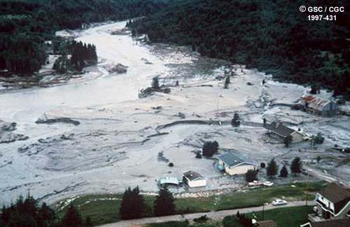
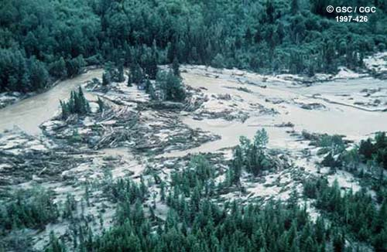
Aggradation occurs when deposition is greater than erosion.
Aggradation of the Rivière des Ha! Ha! in Quebec
Notes:
*haha means unexpected obstacle, not laughing

Slide 5
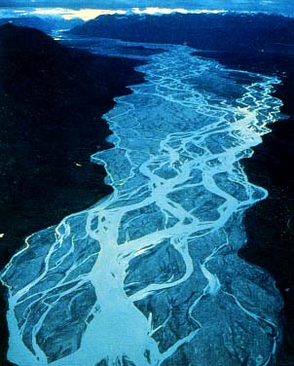
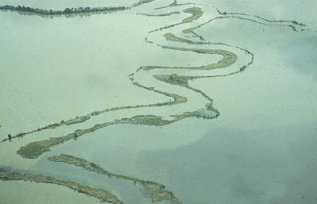
Floodplain sediments form by either:
1. deposition of overbank suspended sediment, or
2. deposition of bedload as the channel migrates across its valley

Slide 6
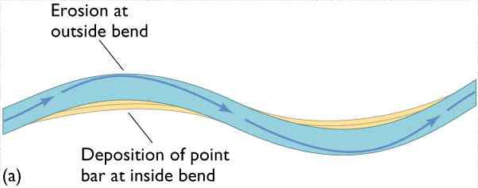
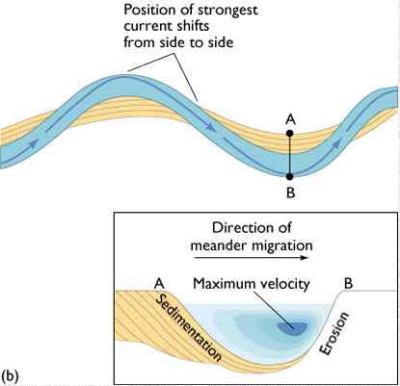
Meander review!
higher velocities on outside of bends lead to cutbank erosion
lower velocities on insides of bends lead to point bar deposition

Slide 7
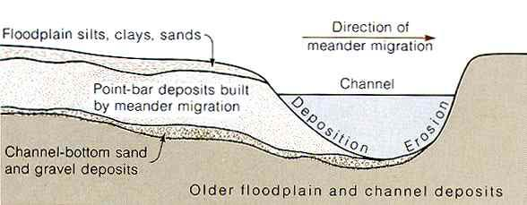
Point Bar Deposits

Slide 8
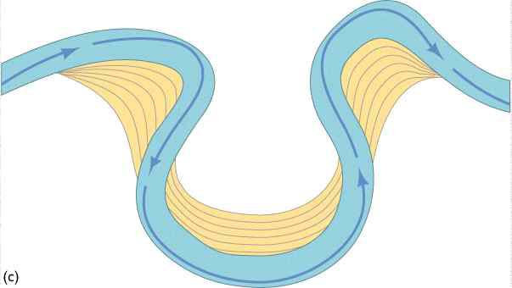
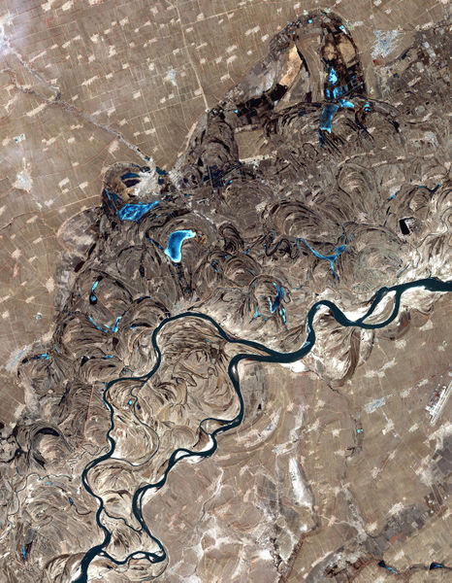
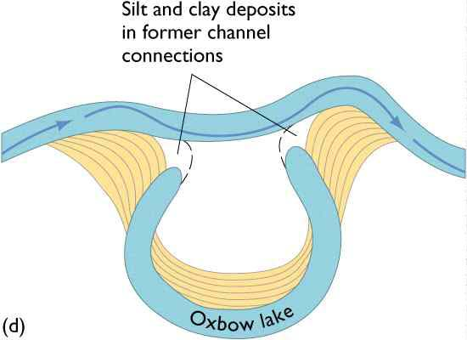
Meandering
oxbows (sloughs)
meander belts
songhua r., china

Slide 9
Meandering stream
flowing from
top of screen
to bottom

Slide 10
Maximum
deposition
Maximum
erosion

Slide 20
Meander scars
(scroll bars)
Oxbow Lake
cutoff

Slide 21
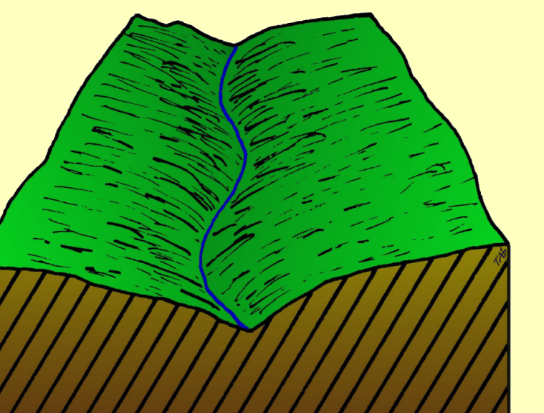
The river cuts downward to form a ‘V’-shaped valley.
The river starts
to meander

Slide 22
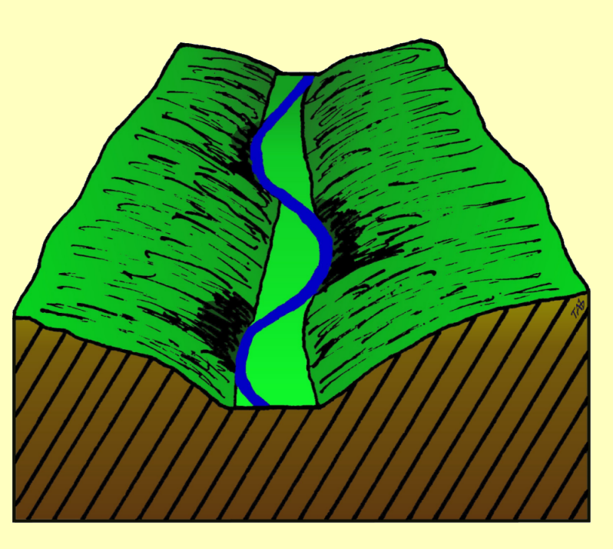
River cuts from side
to side eating into
the valley walls
Floodplain starts to form

Slide 23
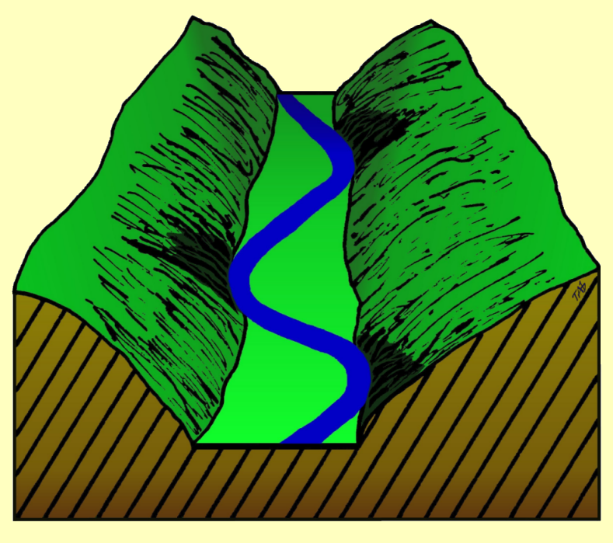
Floodplain continues forming, increased sinuosity

Slide 24
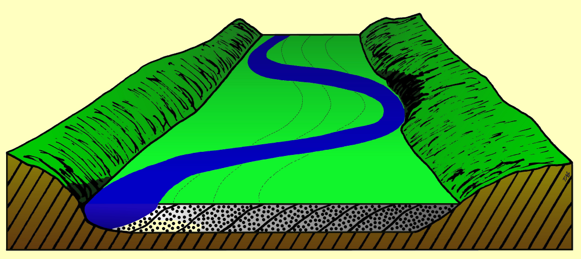
Floodplain
Alluvial
deposits

Slide 25
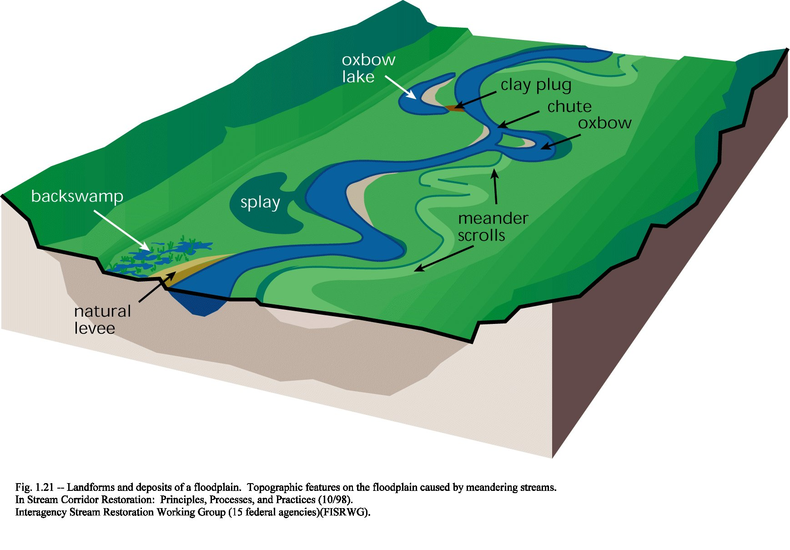
Floodplain landforms
Oxbow
Levee
Splay
Scroll bars
Backswamp

Slide 26
Oxbow

Slide 27
Oxbow

Slide 28
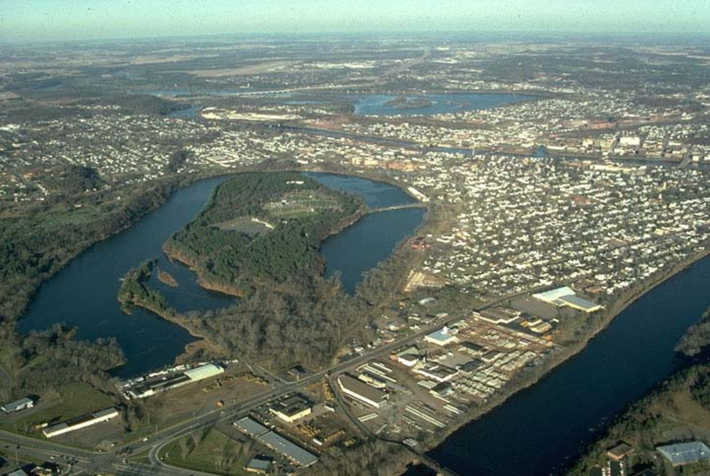
Oxbow lake near the Chippewa River, Eau Claire, Wisconsin

Slide 29
Levees
The boundary between channel and floodplain may be the site of a natural levee (a broad, low ridge of alluvium built along the side of a channel)
Levees form when debris-laden floodwater overflows the channel and slows as it moves onto the floodplain.

Slide 30
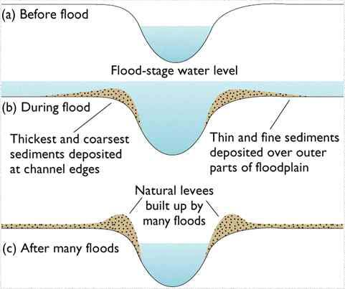
Levee formation

Slide 31
Levee Deposits
Coarser sediment
Flood stage
Finer sediment
Finer sediment
The area adjacent to and outside of the channel serves as an overflow area for excess water and sediment

Slide 32
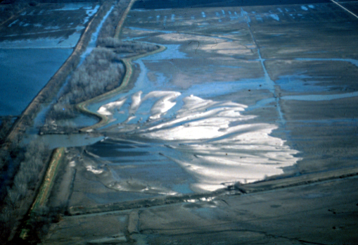
Splay
A deposit of coarse material resulting from a levee breach during a flood.

Slide 33
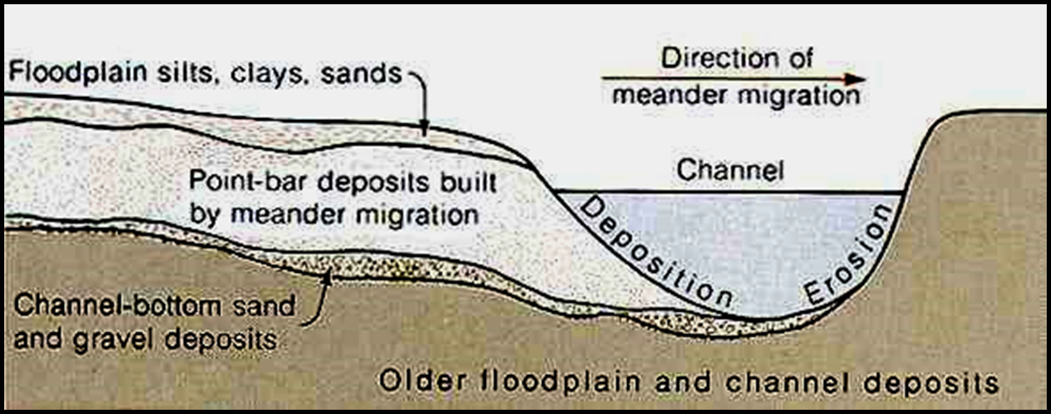
Scroll bars
A meander scroll consists of long, curving, parallel ridges (scroll bars) that are deposited during point bar growth
Songhua R, China

Slide 34
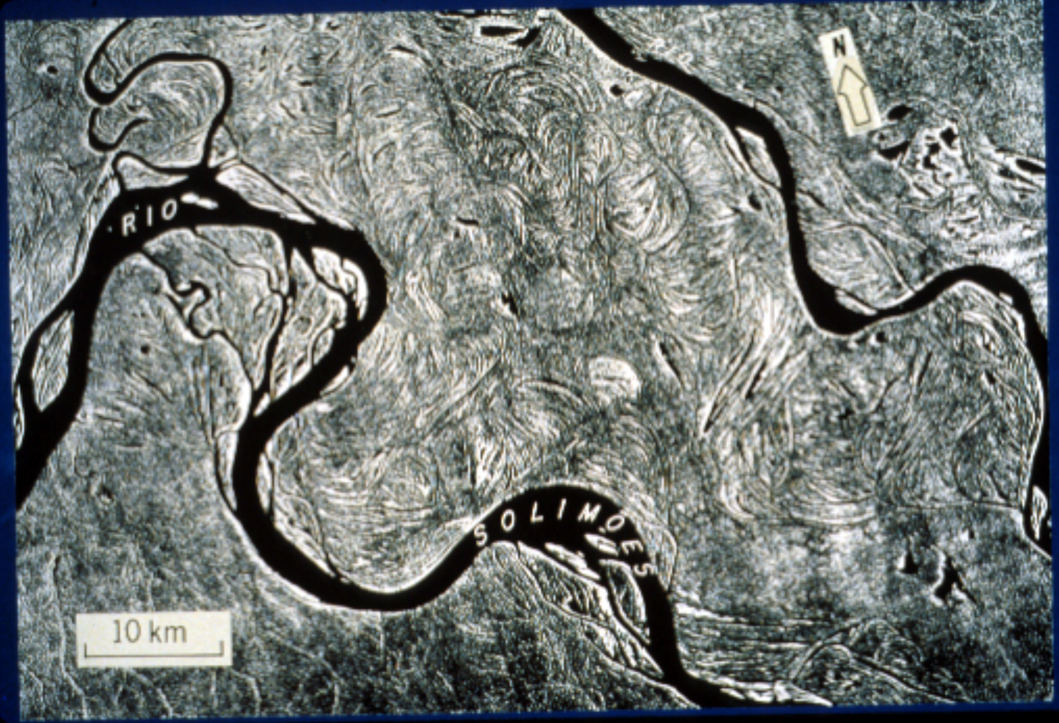
Scroll bars
Side looking radar (SLAR) image of floodplain of an Amazon River tributary in 1971/2; flow is toward lower right.

Slide 35
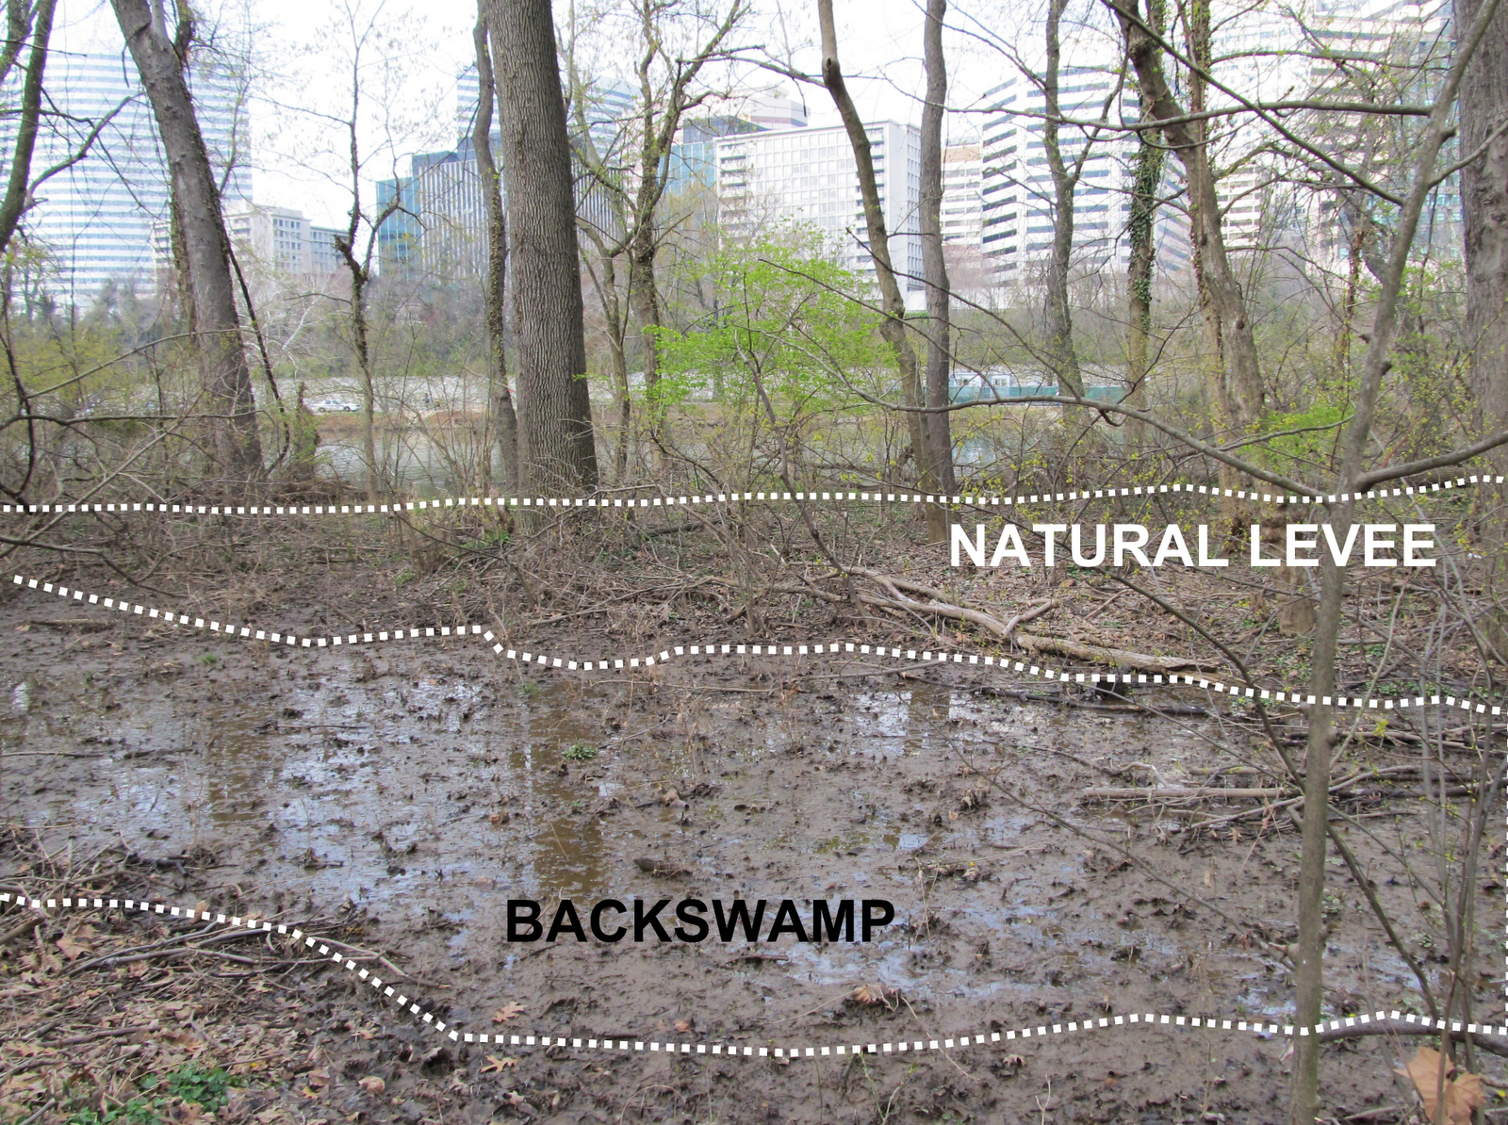
Backswamp
backswamp: low-lying area separated from channel by natural levee

Slide 36
Floodplain landforms
Oxbow
Levee
Splay
Scroll bars
Backswamp
What other features are present on the floodplain?

Slide 37
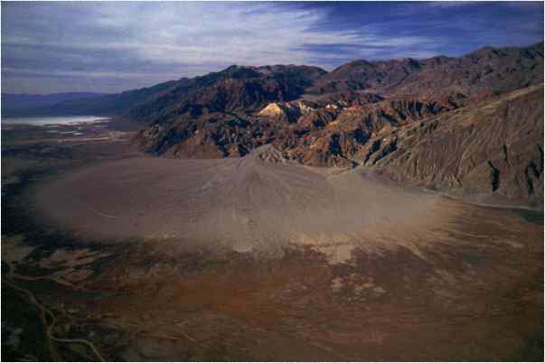
Alluvial Fans
What? fan shaped deposits at the mouth of valleys and gulleys, unsorted with boulders to sands
When? streams encounter a sudden change in gradient and confinement, e.g. leaving mountains, they often deposit alluvial fans
Why? transport capacity suddenly decreases…

Slide 38
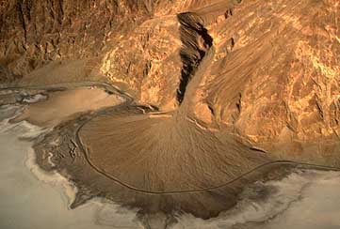
Alluvial fans tend to be coarse-grained at their head. At their edges, however, they can be relatively fine-grained.
Why?
Initial loss of energy deposits large grains near valley, leftover energy can carry smaller particles farther

Slide 39
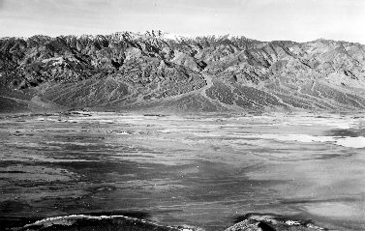
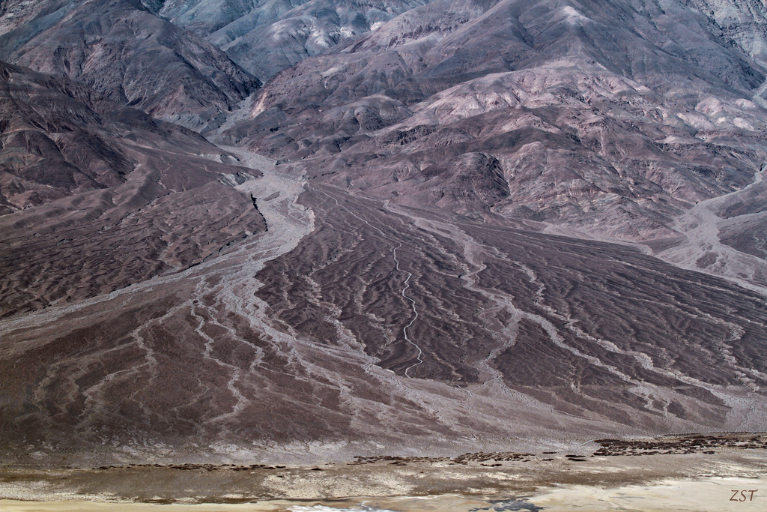
Alluvial Fans
As fans join together and coalesce, they form a surface called a “bajada”
Death Valley bajada and fan

Slide 40
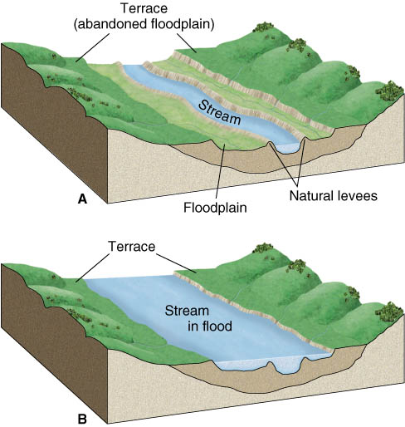
River Terraces
Many stream valleys contain one or more relatively flat alluvial terraces that lie above the floodplain.

Slide 41
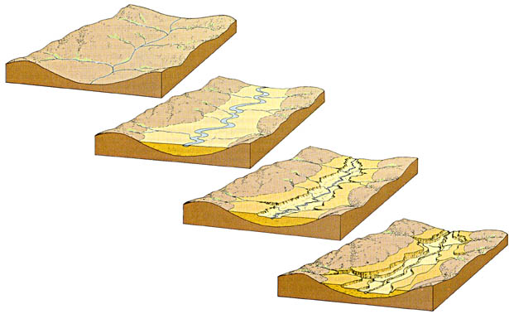
River Terraces
Streams may create depositional landforms (especially floodplains) and then start to incise
Terraces are abandoned floodplains

Slide 42
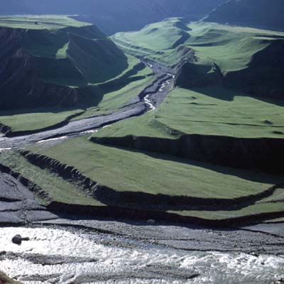
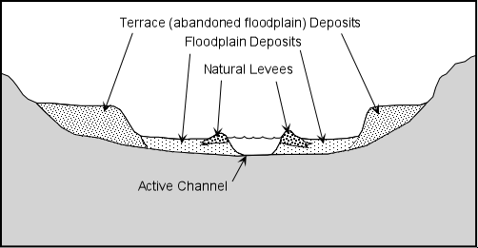
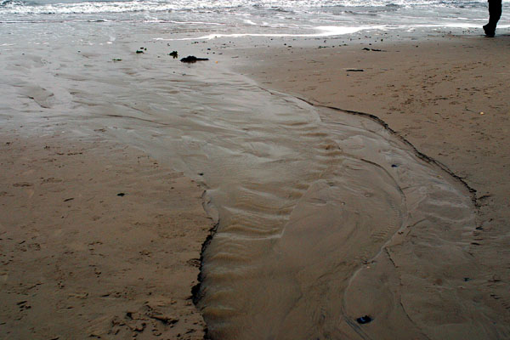
River Terraces

Slide 43
River Terraces
Changes in whether a stream is eroding or depositing in a given location can be caused by several different phenomena:
tectonic uplift
change in base level downstream
change in climate modifying system’s discharge and sediment supply
Which brings us to river response…(in 2 weeks)

