Slide 1
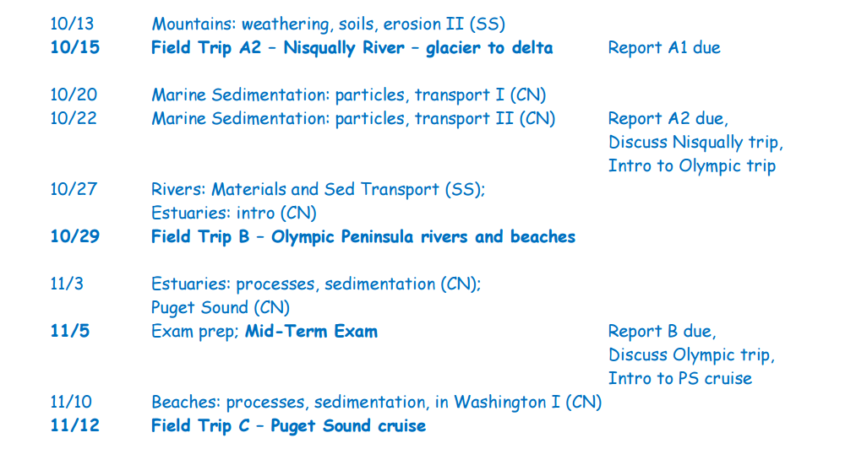
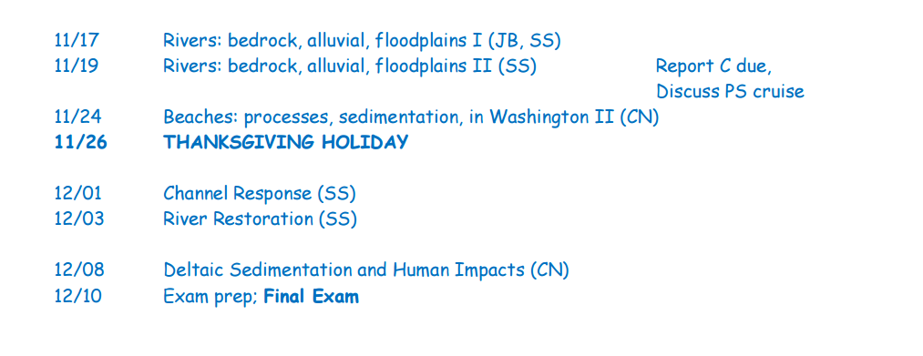
Olympic trip
Discuss PS cruise

Slide 2
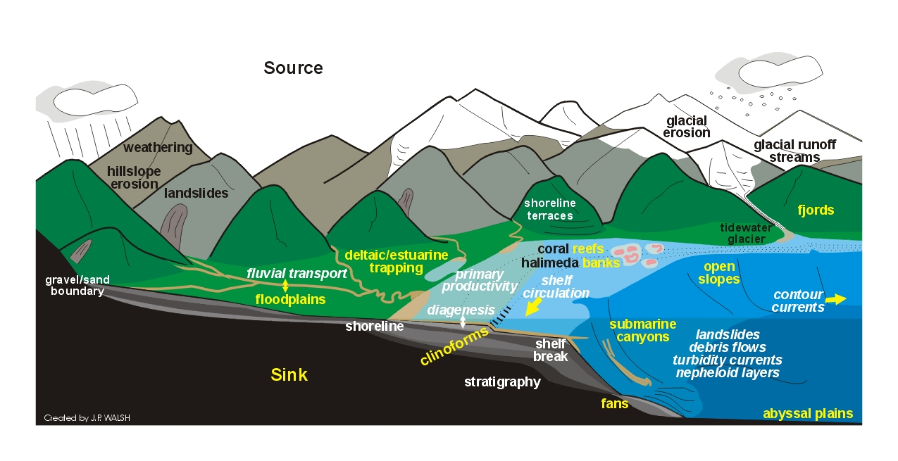
Rivers

Slide 3
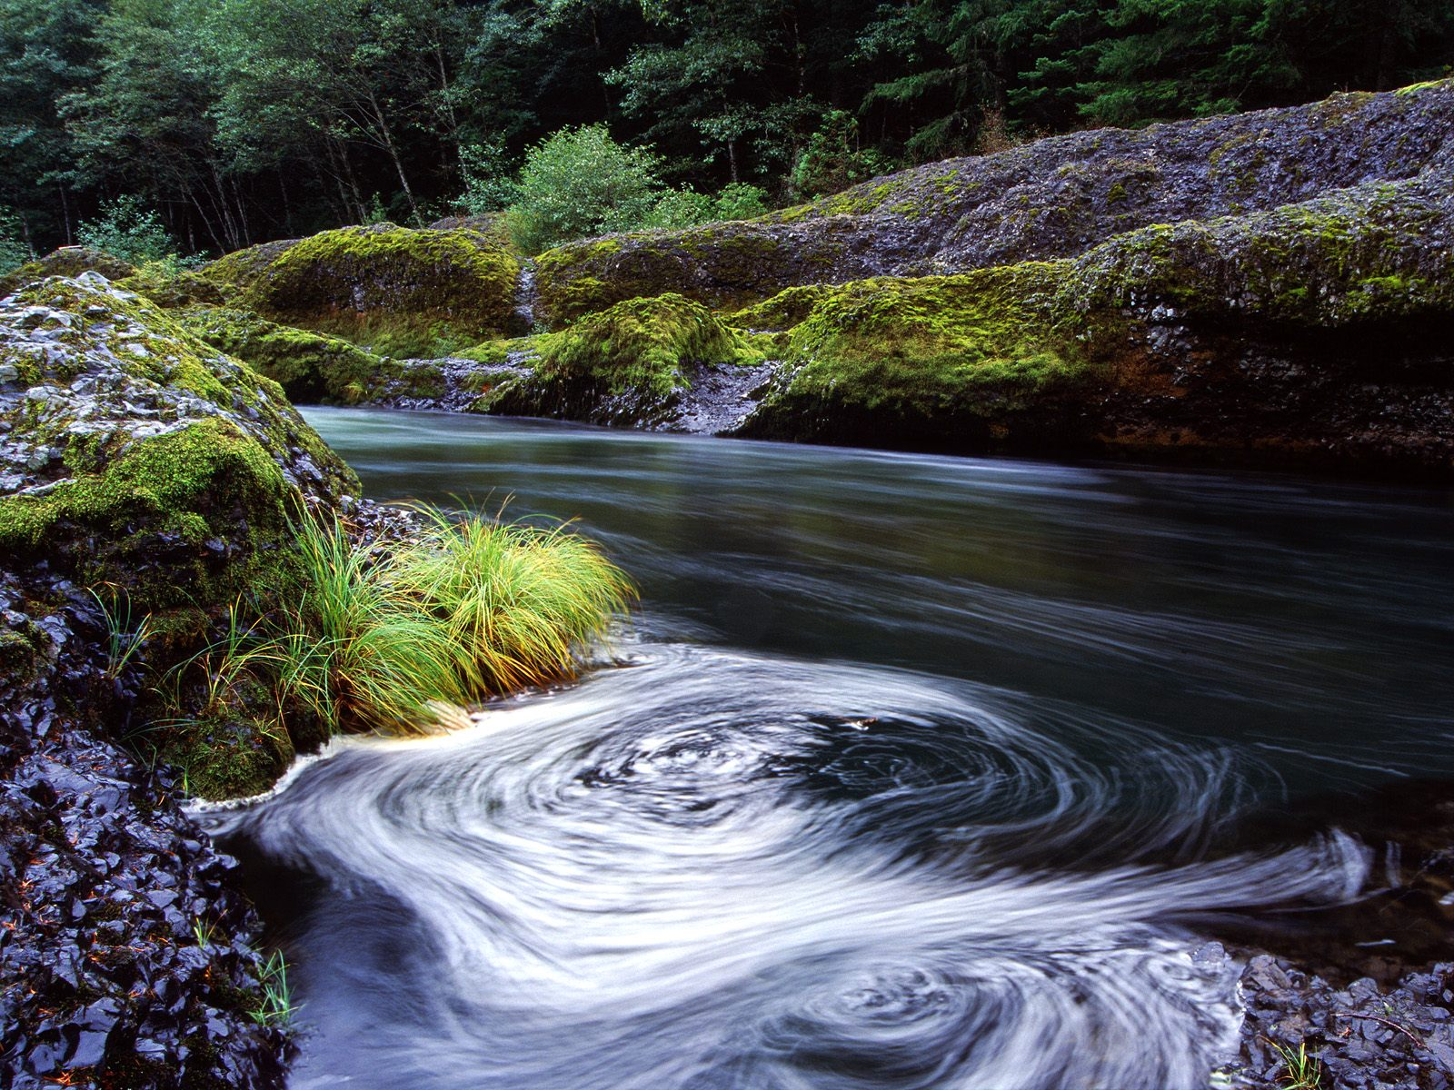
Why study rivers?
• Water and nutrients
• Habitat to diverse flora and fauna
• Routes for commerce
• Electricity
• Recreation
• They’re beautiful!

Slide 4
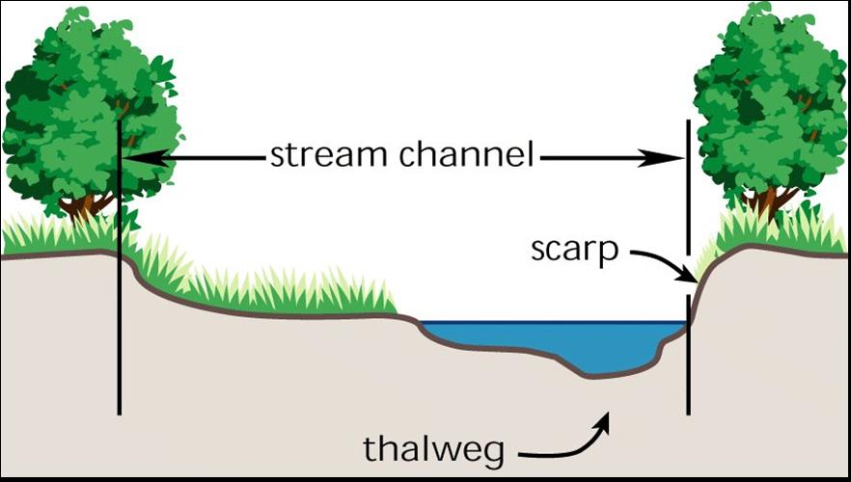
A Few River Terms
bank
bank
Notes:
Active stream channels change over time, eroding and depositing sediments in predictable patterns that are apparent in stream cross sections.
Scarp – active, eroding side of stream channel
Thalweg – path of deepest channel
Fig. 1.12 - Cross section of a stream channel. The thalweg is the deepest part of the channel.
In Stream Corridor Restoration: Principles, Processes, and Practices (10/98).
Interagency Stream Restoration Working Group (15 federal agencies)(FISRWG).

Slide 5
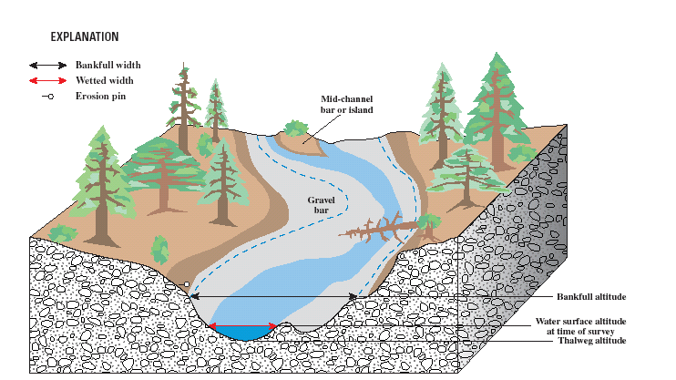
Bankfull Discharge
Bankfull discharge typically equates to a roughly 2-year recurrence interval flow.

Slide 6
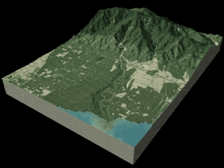
River systems
can be subdivided into major segments:
  bedrock/mountain
  alluvial
  deltaic
Notes:
** find a new animation or replace animation on this slide

Slide 7
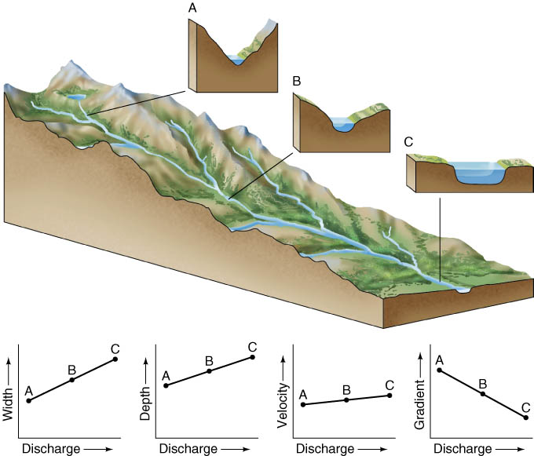
Major downstream trends
discharge ↑
width ↑
depth ↑
velocity ↑
gradient ↓
grain size ↓

Slide 8
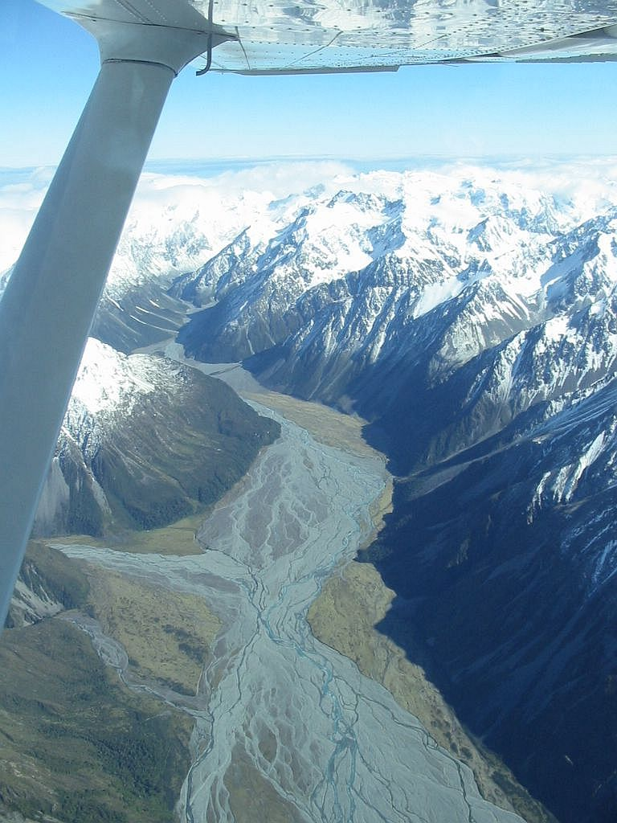
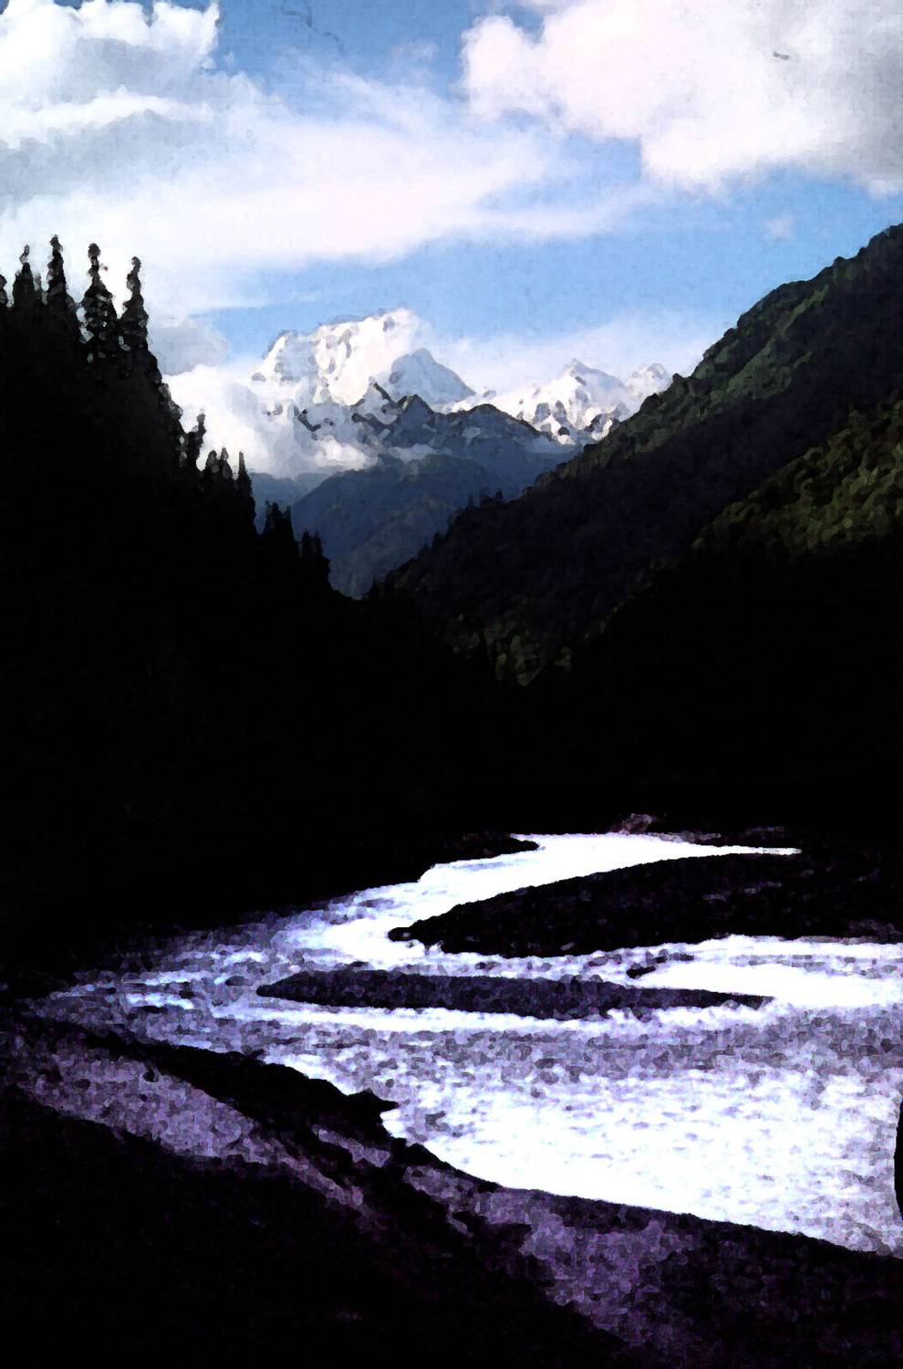
Alluvial Rivers
erodible channel boundaries (alluvial banks and bed)
transport capacity ≤ sediment supply
Input ≥ Output
sed. storage can be big
channel forms/patterns reflect self-organization to deal with this…

Slide 9
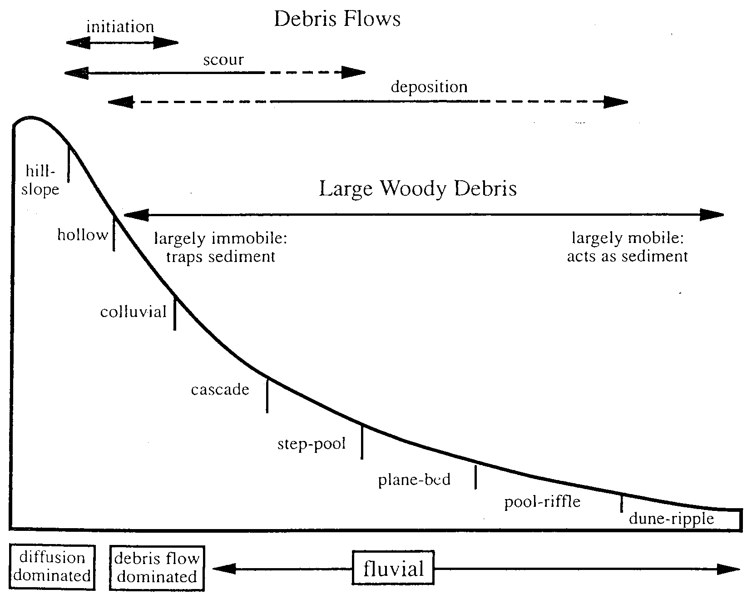
Longitudinal Profile
Typical mountain stream

Slide 10
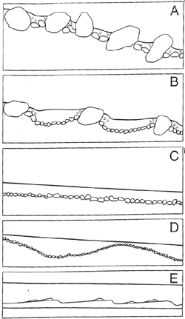
Channel Types
  Colluvial (sediment from hillslope)
  Alluvial (fluvial sediment)
    A. Cascade
    B. Step-pool
    C. Plane-bed
    D. Pool & riffle (most common)
    E. Dune – ripple
    ordered by decreasing gradient
    and degree to which everyday flow can carry sediments
flow
[Montgomery & Buffington 1997]
Notes:
Image: Montgomery & Buffington 1997, Figure 3
Colluvial Channel: Bed sediments are a result of mass wasting; not transported by the river. Common in small headwater streams
Alluvial Channel: Channel bed sediments transported by the river
Cascades: have “tumbling flow” due to dissipation of energy by large boulders in channel. High Gradient. Large bed materials are immobile during average flows while small grains are transported quickly.
Step-Pool: have longitudinal “steps” made of boulders and cobbles. High Gradient. Steps are removed by large floods and reconstructed when flood waters recede.
Plane-bed – moderate gradient streams that lack discrete bars. Typically have armored beds indicating that transport capacity > sediment supply
Pool & Riffle – low gradient streams undulating beds. Bar/pool riffle sequences.
Dune-ripple – low gradient streams with ripples or dunes in the bed. Sediment transport at most flows.

Slide 11
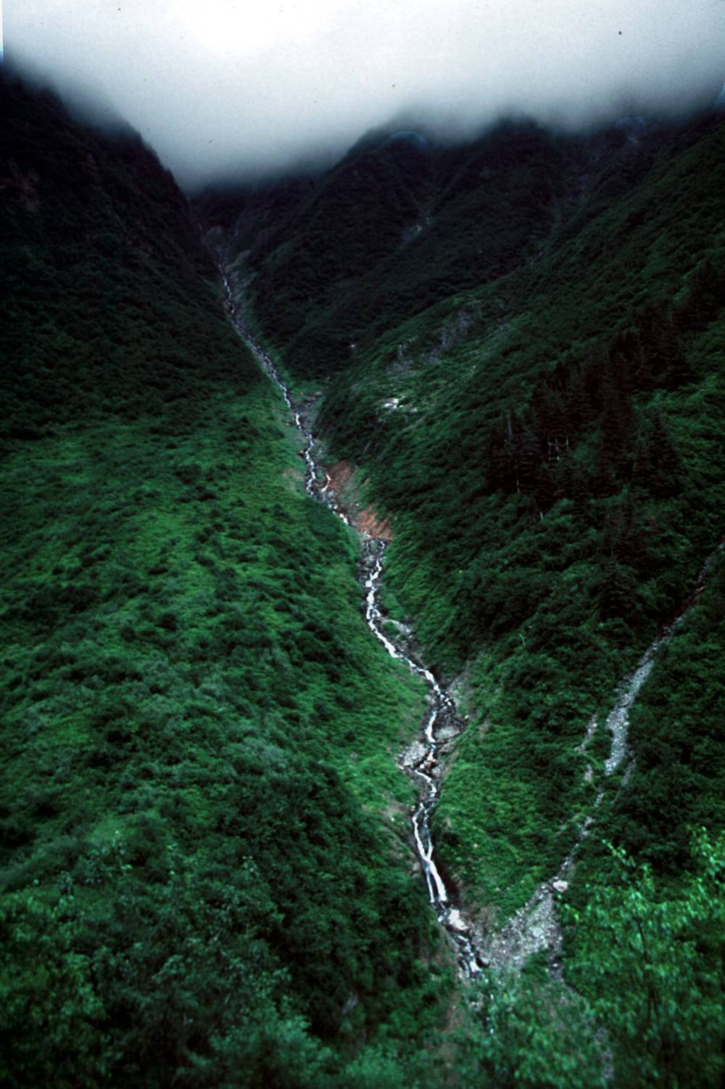
Colluvial Channels
Small headwater channels at the tips of the channel network where sediment transport is dominated by landslide processes.

Slide 12
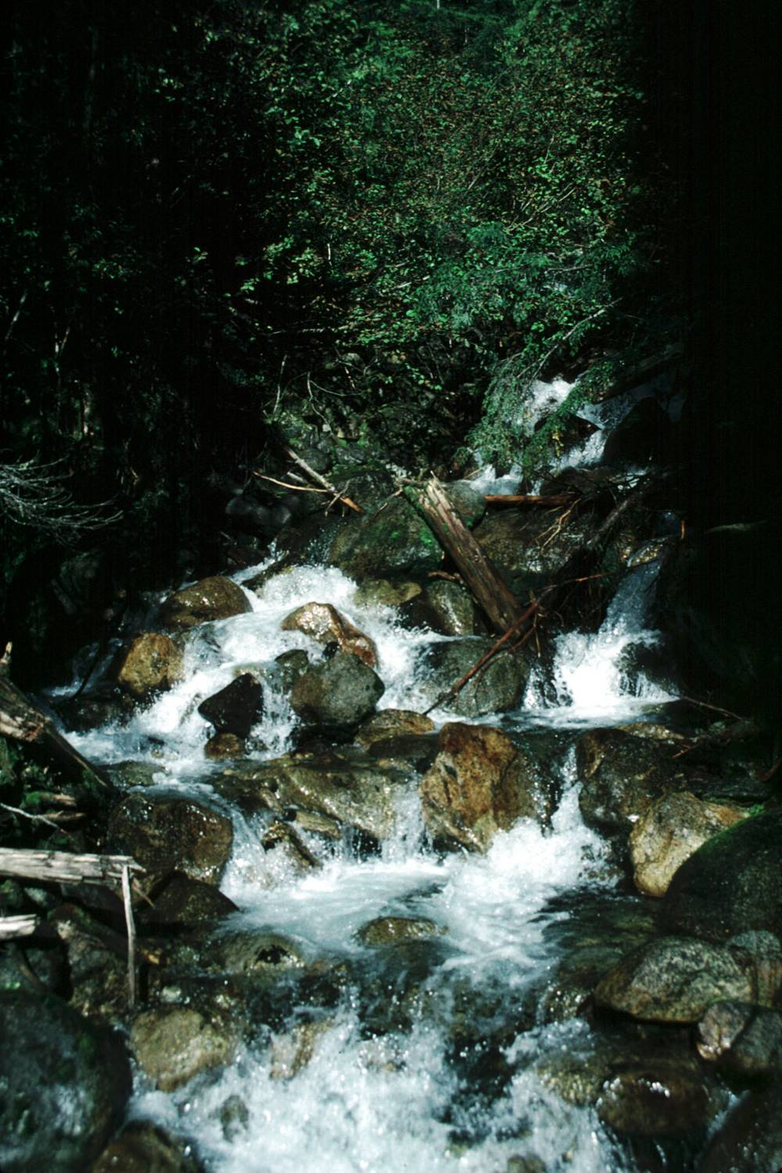
Cascade Channels
The steepest of mountain channels, characterized by tumbling flow around individual boulders; disorganized streambed structure.

Slide 13
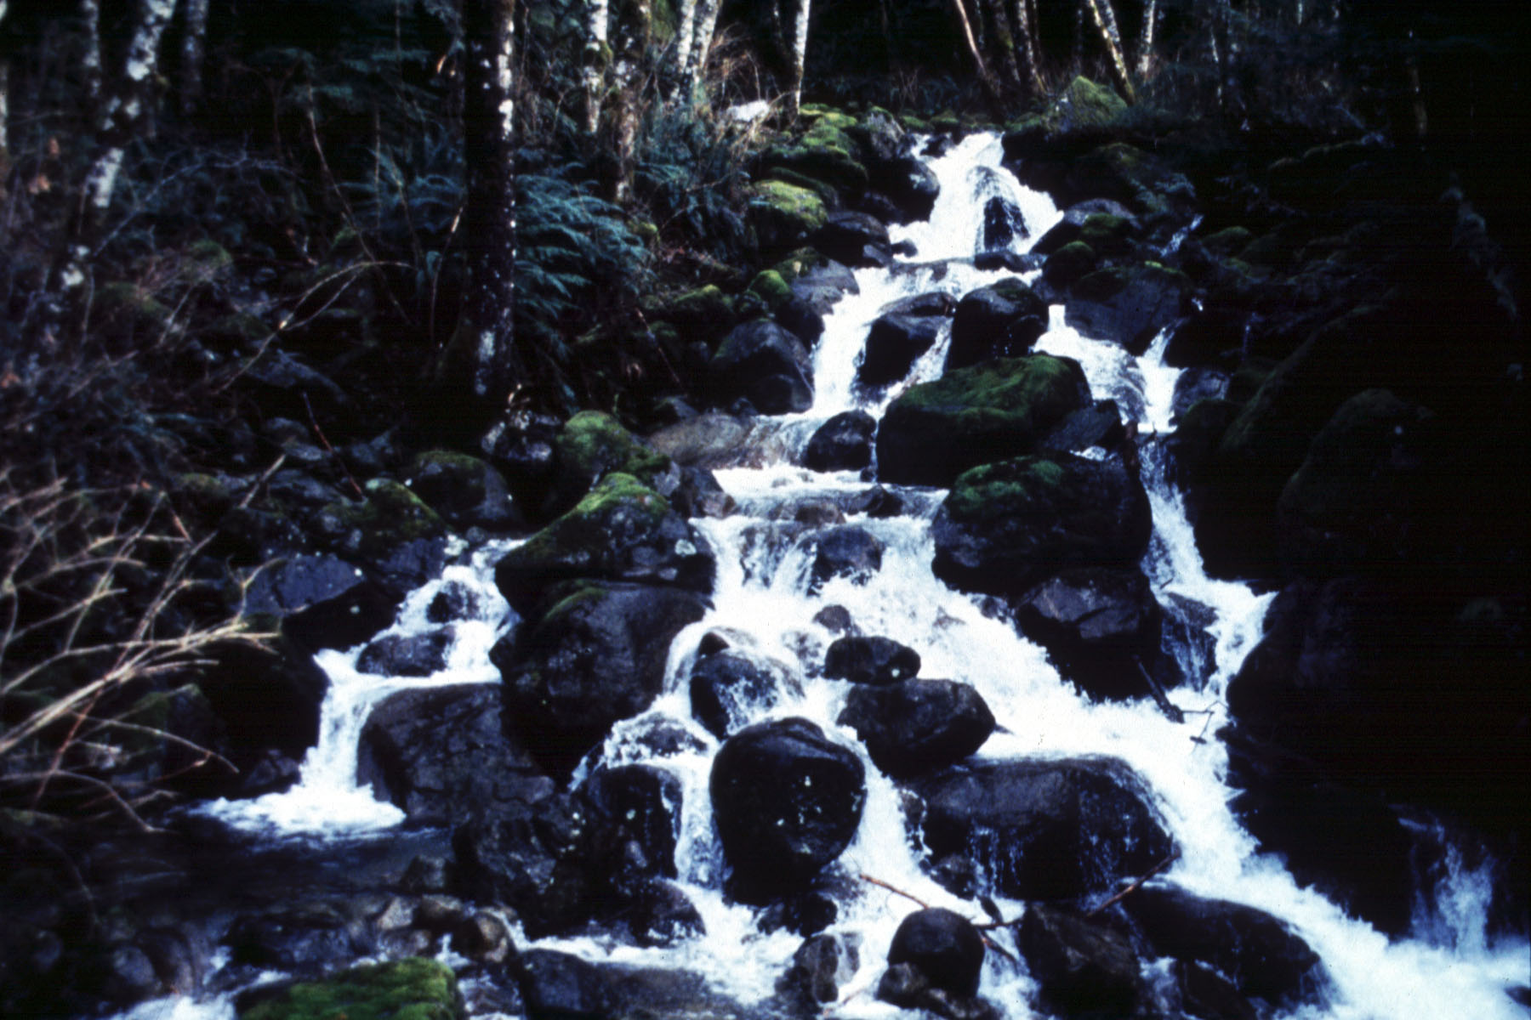

Slide 14
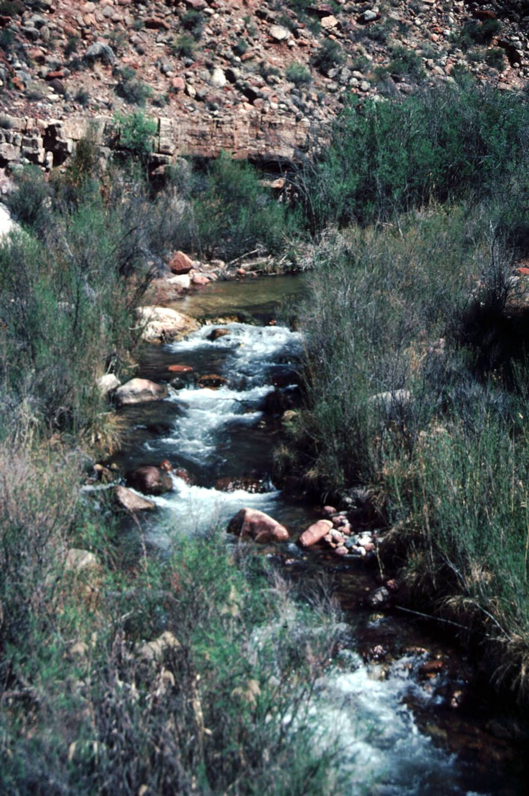
Step-Pool Channels
pools
Channels displaying full-width-spanning accumulations of coarse sediment that forms a sequence of steps.
steps

Slide 15
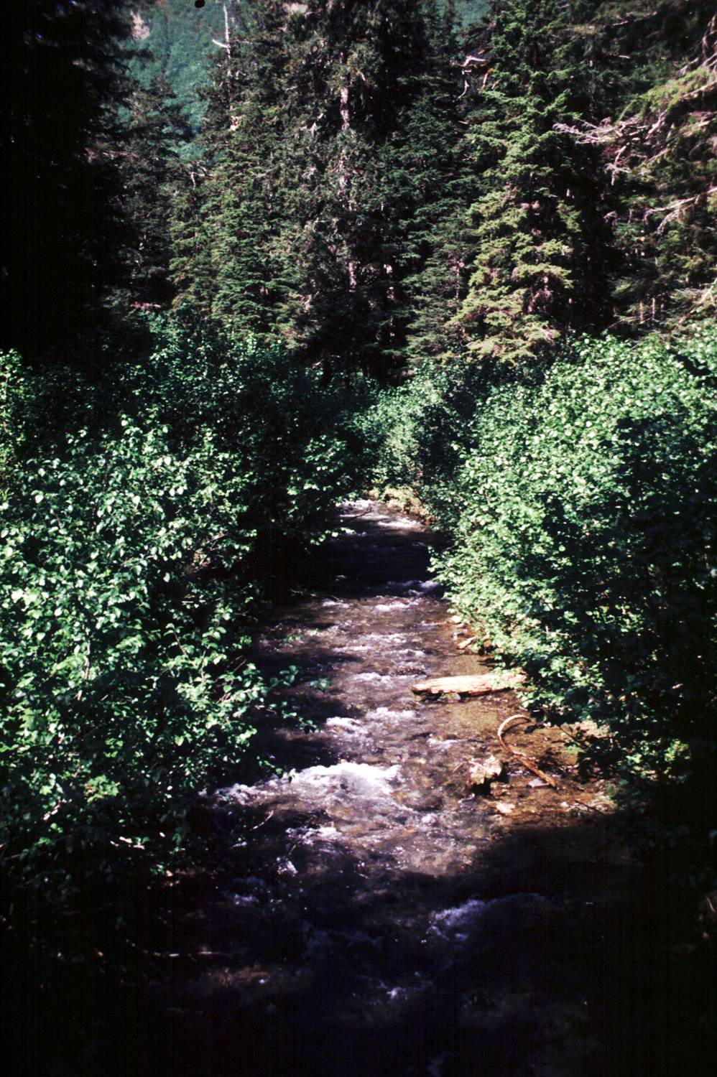
Plane-Bed Channels
Channels lacking well-defined bedforms and instead displaying long reaches lacking pools.

Slide 16
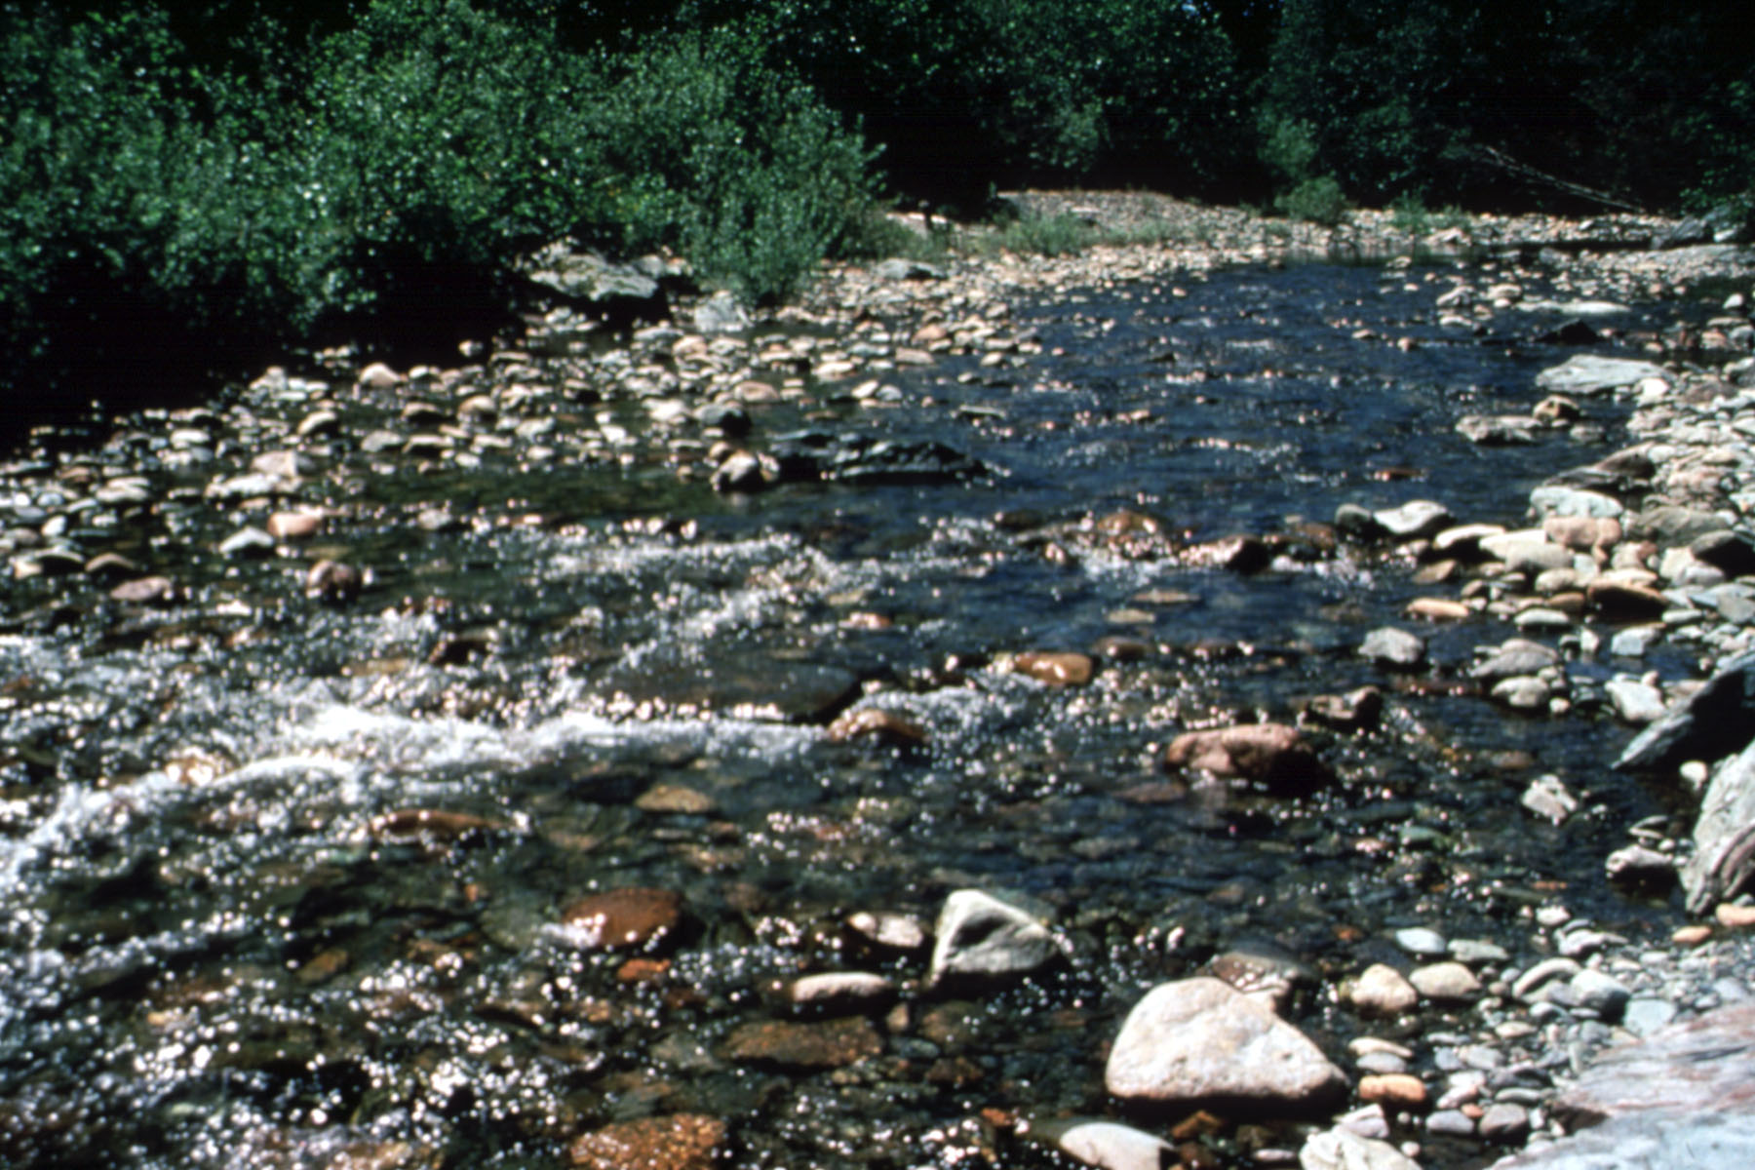

Slide 17
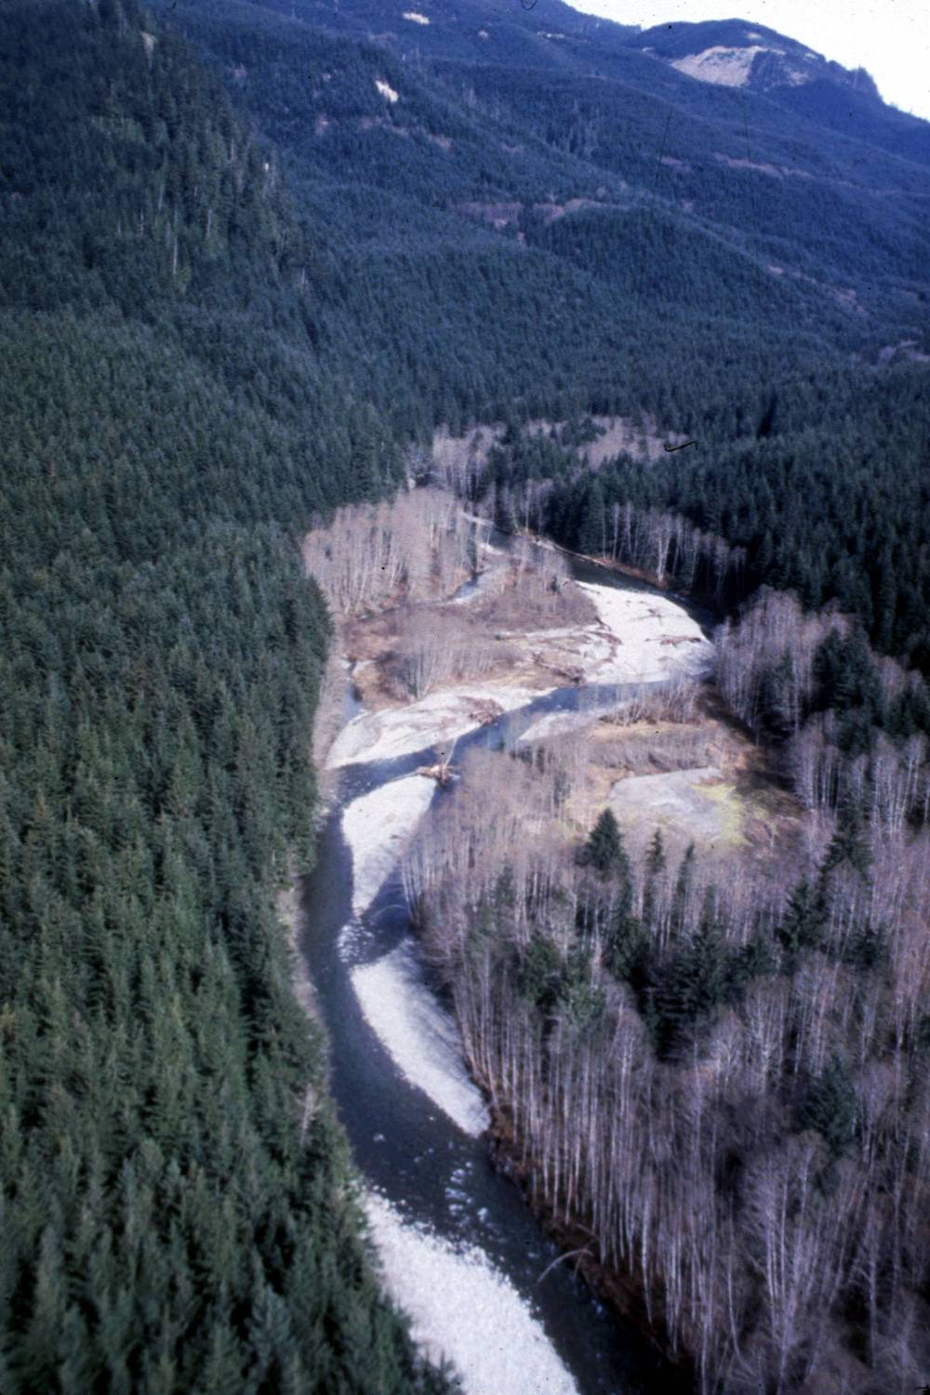
Pool-Riffle Channels
The most common mountain river morphology; characterized by alternating sequence of pools and bars.
pools
bars/
riffles

Slide 18
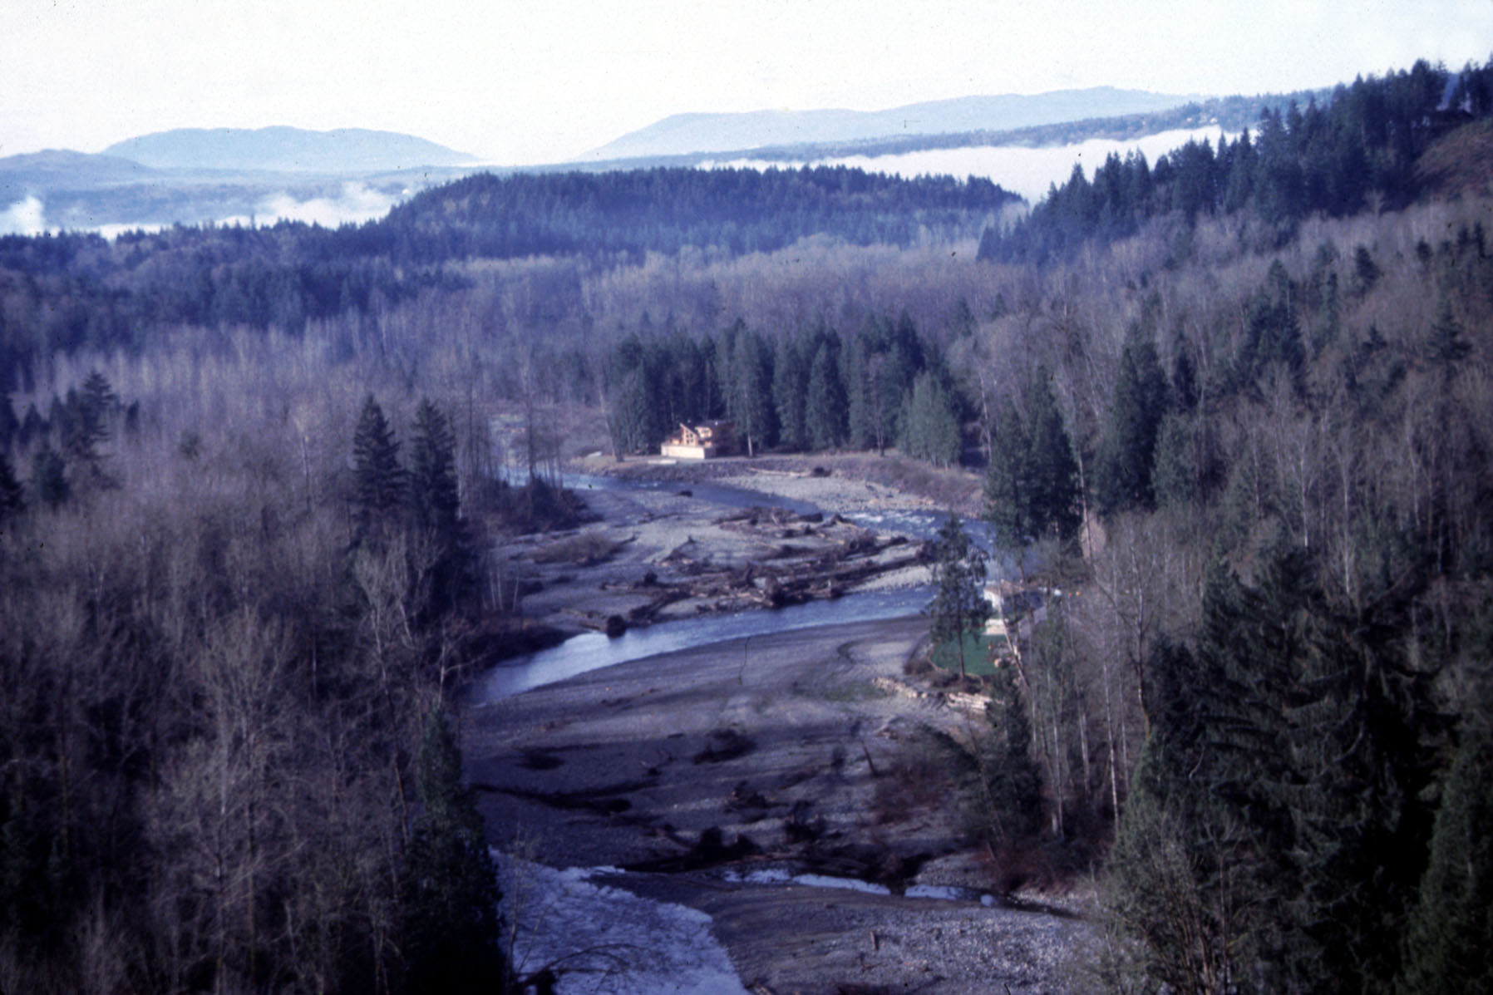

Slide 19
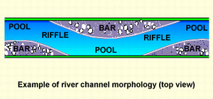
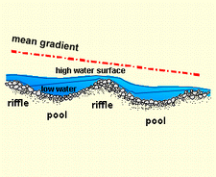
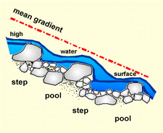
Riffles, Pools, and Cascades
Riffles and pools alternate in somewhat predictable patterns
Associated with optimal flow organization to move sediment

Slide 20
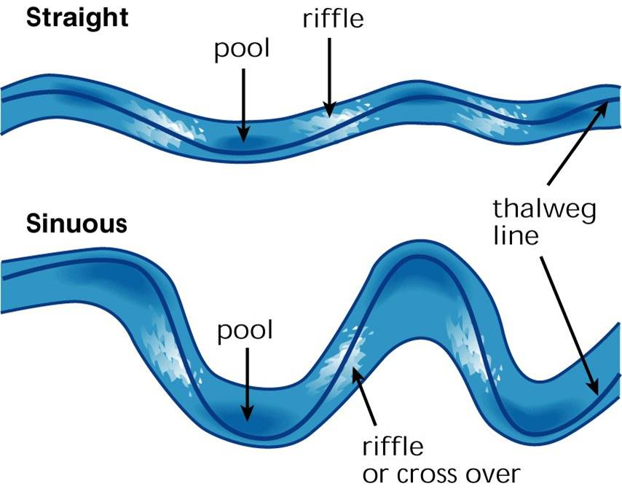
Pool - Riffle Sequence
Riffle to riffle = 5 - 7 channel widths
Notes:
Pools and riffles appear in a somewhat regular pattern. Riffles are separated by distances of approximately 5-7 channels widths in streams with a gravel dominated substrate.
Riffles form where the deposition of gravel bars occurs. This relates the occurrence of riffles to the sinuosity of the stream.

Slide 21
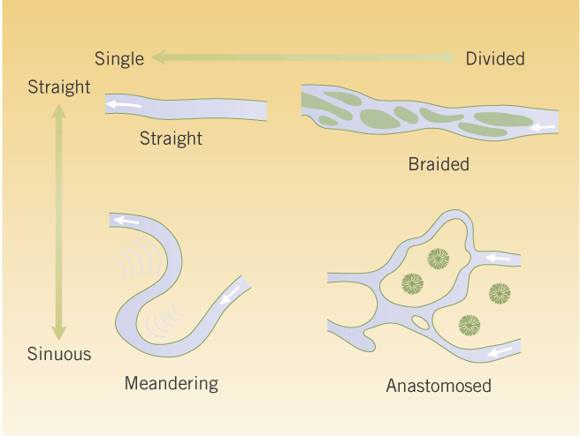
Channel Patterns
1. Straight
3. Braided
2. Meandering
4. Anastomosing

Slide 22
Channel Patterns
1. Straight
3. Braided
2. Meandering
4. Anastomosing

Slide 23
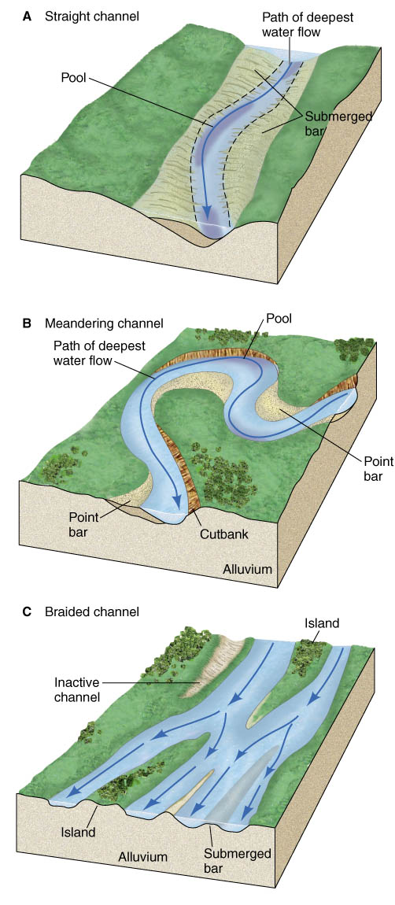
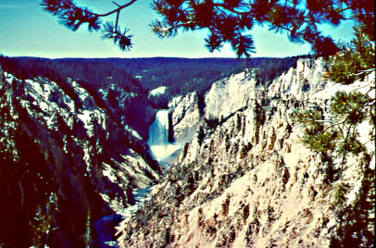
Straight Channels
Relatively rare:
represent a relatively immature channel form
straight channels common where streams are confined by topography or follow geologic structures
often mountain streams

Slide 24
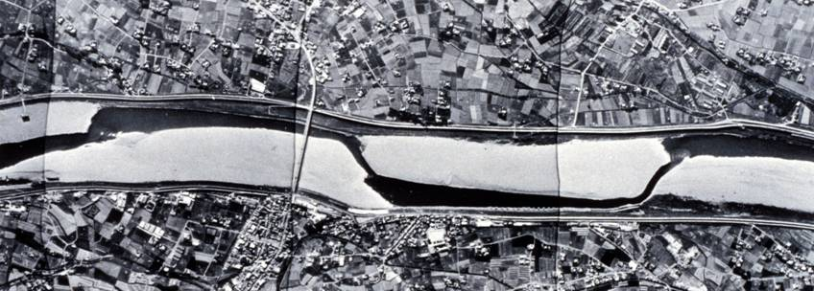
Alternate Bars
Why are straight channels uncommon?
  interaction between flow & eroding/depositing bed causes organized periodic bar deposition
  bar → local width⬇ → local velocity ⬆ → local erosion → excess sediment → new bar … rivers don’t want to be straight!
Naka R., Japan

Slide 25
Channel Patterns
1. Straight
3. Braided
2. Meandering
4. Anastomosing

Slide 26
Meandering
What if the banks are erodible?
  higher velocity near bars → erosion
  erosion → deposition …
Flow & sedimentation patterns self-reinforcing

Slide 27
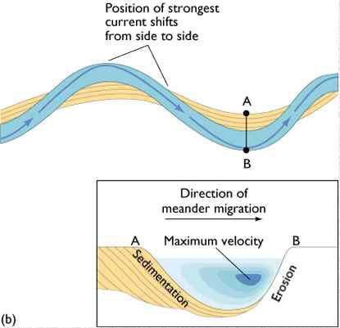
Meandering leads to formation of:
  cut banks
  point bars
Note velocity patterns:
  highest on outside of bends

Slide 28
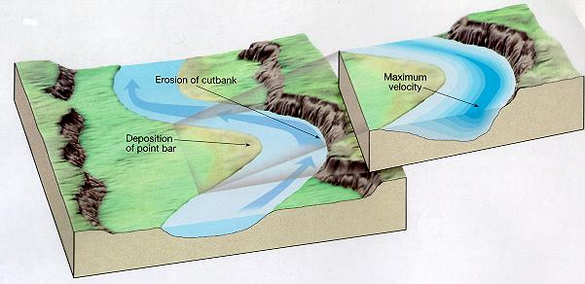
Meandering
Erosion on outside of bends (cut banks) where velocity is greatest
Deposition on the inner sides of bends where velocity is slower
Meanders grow through time…

Slide 29
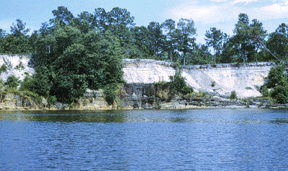
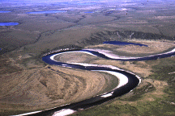
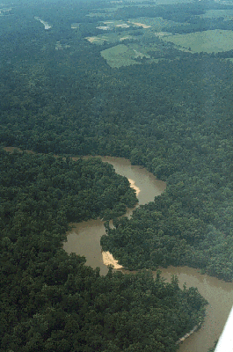
Meandering
Cut Banks
Point Bars

Slide 30
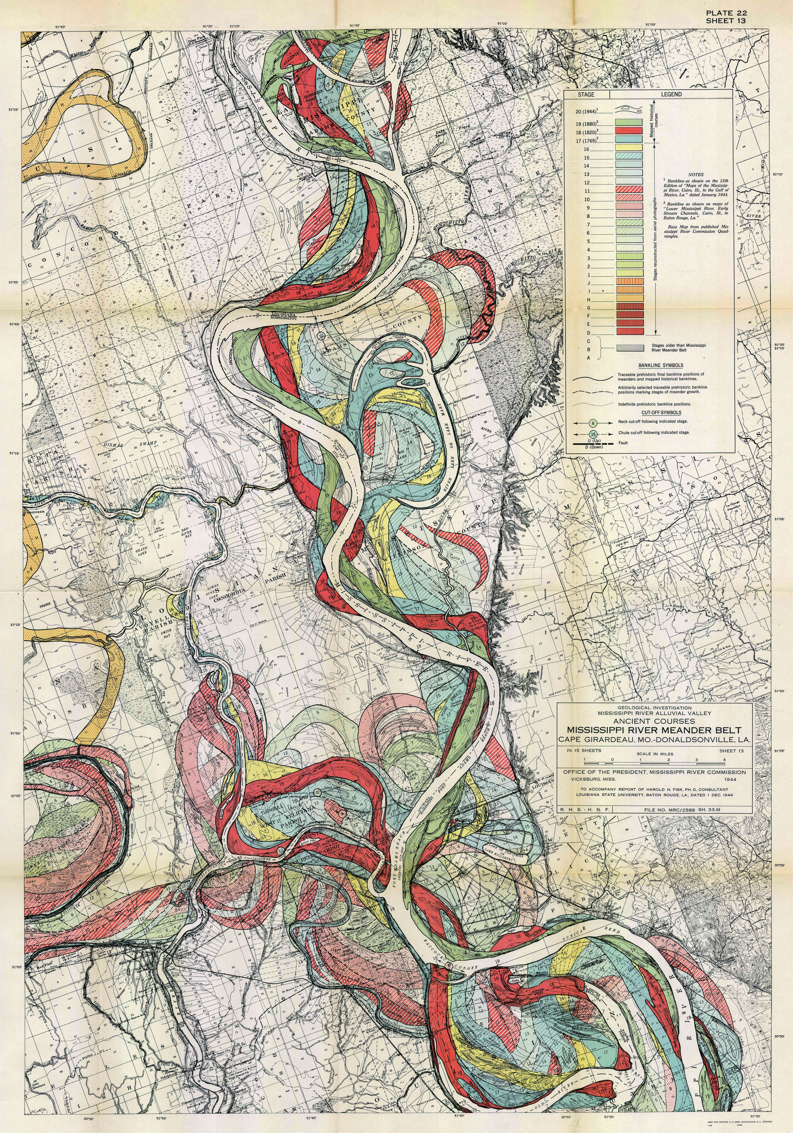
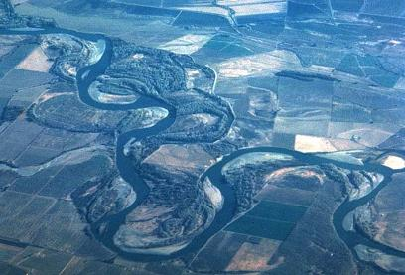
Meandering
Progressive growth of meanders leads to formation of meander belts

Slide 31
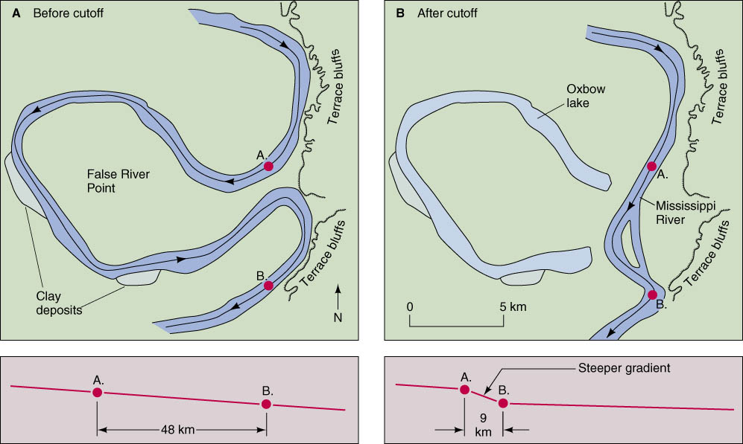
Growing meanders can intersect each other and cut off a meander loop, forming an oxbow lake

Slide 32
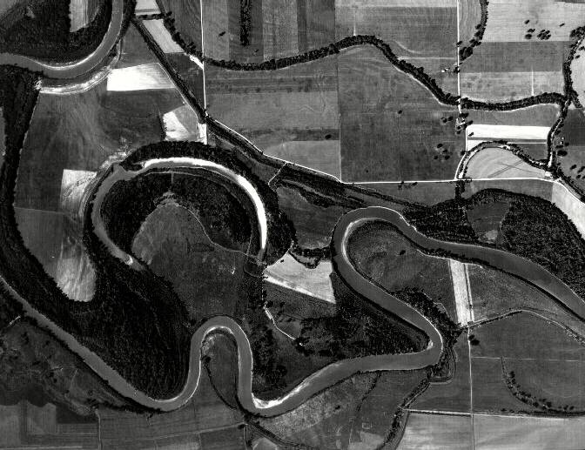

Slide 33
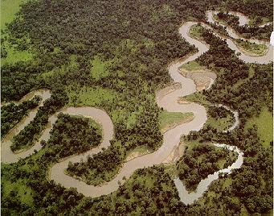
Meandering
most characteristic of large, low-gradient, fine-grained rivers
continuous, gradual change in channel course
create floodplains wider than the channel
  very fertile soil
  seasonal flooding

Slide 34
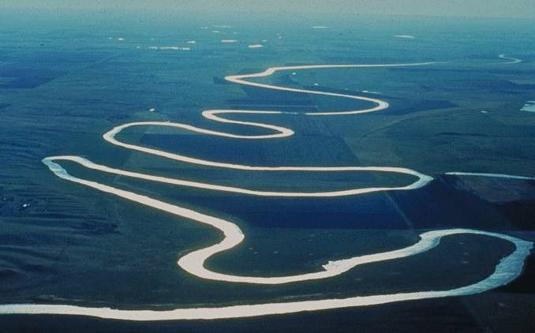
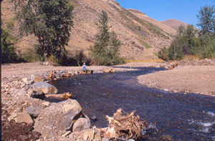
Sinuosity: Gradient and Substrate
Big meanders
  low gradient
  fine substrates
Small meanders
  high gradient
  coarse substrates
Notes:
All streams exhibit some sinuosity. The degree varies from stream to stream based on stream gradient, local geology, hydrology, and land use.

Slide 35
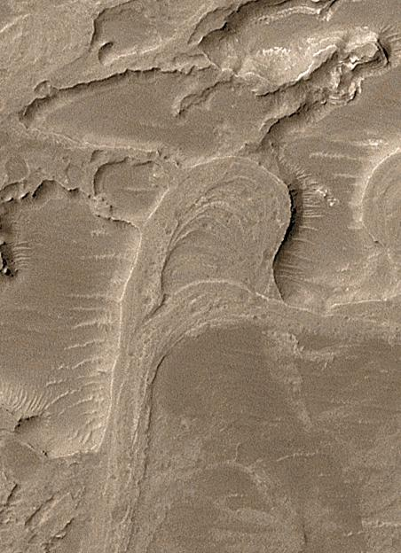
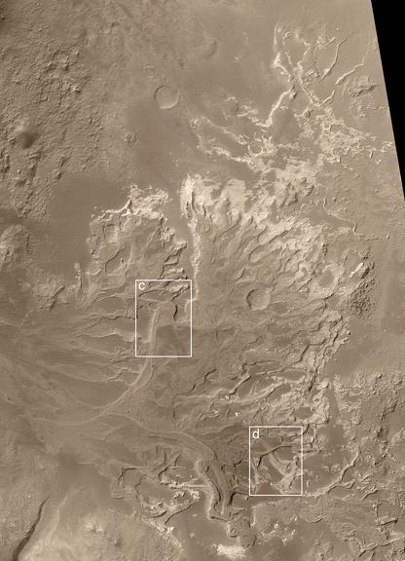
Holden Crater, Mars

Slide 36
Channel Patterns
1. Straight
3. Braided
2. Meandering
4. Anastomosing

Slide 37
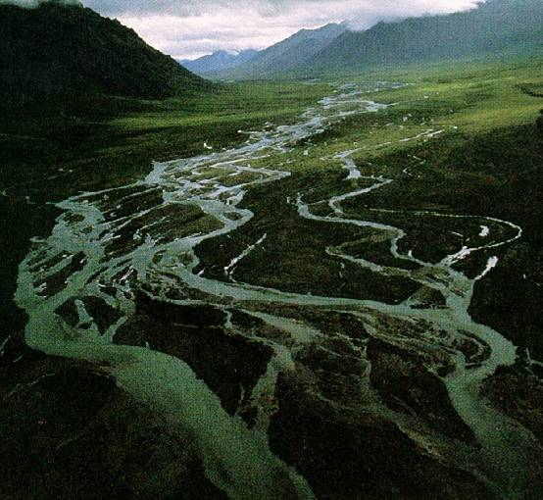
Braiding
Multiple converging & diverging channels separated by unstable mid-channel bars

Slide 38
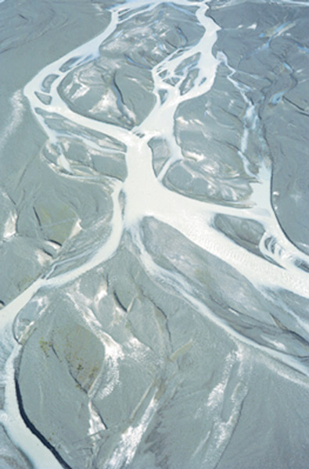
Braided Channels
high sediment load (relative to water Q)
constantly changing course
floodplain generally completely occupied by channels
many small islands called mid-channel bars
usually coarse sand and gravel (bedload grain sizes)

Slide 39
Braided Channels
Why not a single channel?
  amount of bedload grossly disproportionate to transport capacity of water
  leads to frequent deposition of coarsest sediment in bars that locally divide the flow
Braided channels typical in regions with:
  easily erodible banks
  and/or a high sediment load
  common near mountains & glaciers (not exclusively)

Slide 40
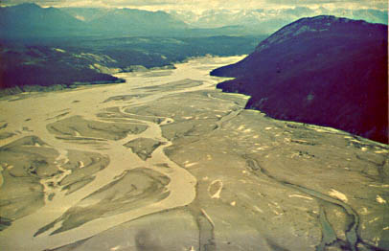
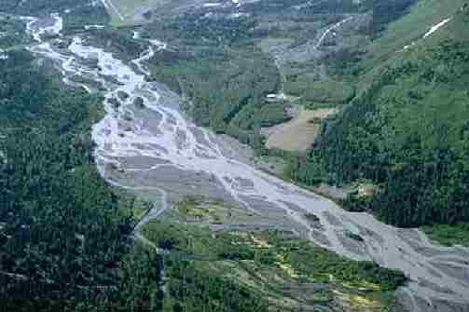
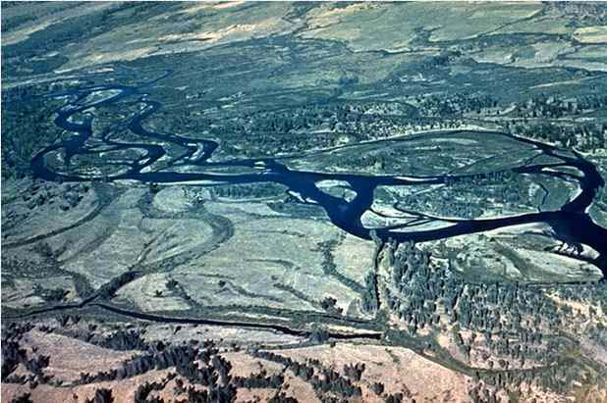
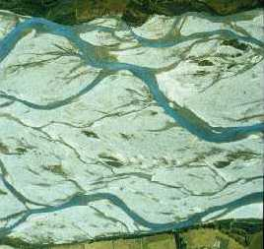

Slide 41
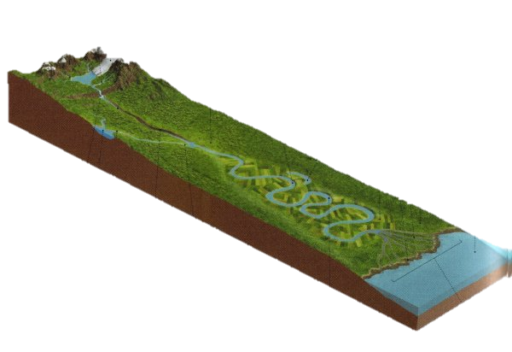
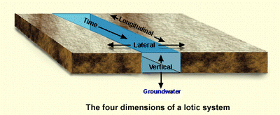
Broad Patterns
Four dimensions:
  longitudinal
  lateral
  time (temporal)
  vertical

Slide 42

Rakaia R. NZ
long. channel
pattern variation

Slide 43



Nisqually -
longitudinal variation (pattern, grain size, gradient, Q)

Slide 44

Mississippi
channel maturity → sinuosity (degree of meandering)
longitudinal & temporal

